Slide 1

Welcome
2025 Postdoctoral
Fall Symposium
The Office of Postdoctoral Affairs
The Graduate School | Florida State University

Slide 2




The Office of Postdoctoral Affairs
Presents:
Florida State University

Slide 3
Thank you Team!
Savannah Aleksic
Manuscript Clearance Advisor
Srivalli Dorasetty
Application Developer, Designer
Khadijat Pedro
Graduate Assistant - Office of Postdoctoral Affairs
Chandler Blount
Manuscript Clearance Advisor
Maryellen Hudgens
Manuscript Clearance Advisor
Donna Young
Business Analyst
Audrey Livingston
Graduate Enrollment Specialist
Keith McCall
Acting Director Office of Graduate Awards & Fellowships
Pearl Key-Rivers
Postdoctoral Scholar in Biological Science
PDA President
Joy Stein
Event Administrative Specialist
Kyle Wilson
Geoset Studios!
Calem Wooten
Graduate Enrollment Specialist
Postdoctoral Association Leadership Team! - Pearl Key-Rivers (President), Olivia Cook (Senior Advisor), and Betsy Mansfield (Senior Advisor).

Slide 4
Thank you Judges!
Alicia Batailles
Senior Associate Director of the Center for Undergraduate Research and Academic Engagement
Rick Burnette
Senior Vice Provost and Chief Strategy Officer
Sonja Carter
Director of Strategy & Recognition
Gloria Covin
FSU Librarian
Jenn Garye
Director of Business Operations,
VP for Research Office
Karema Harris
President & CEO Foreign Affairs Center,
Global Business Consultant
Renaine Julian
Head, Academic Liaison Programs and Services
Beth Hodges
Director of Research Development
Anna Prentiss
Assistant Director News & Web Content
Pamela Ray
Senior Director Sponsored Research Administration
Steven McDowell
Interim Dean of the Graduate School & Professor of Communications
Jennifer Winegardner
RW Law Firm
Civil Litigator

Slide 5

Evan Lloyd
Department of Biological Science &
The Program in Neuroscience
How Evolution Shapes the Brain
The Office of Postdoctoral Affairs
The Graduate School | Florida State University

Slide 6
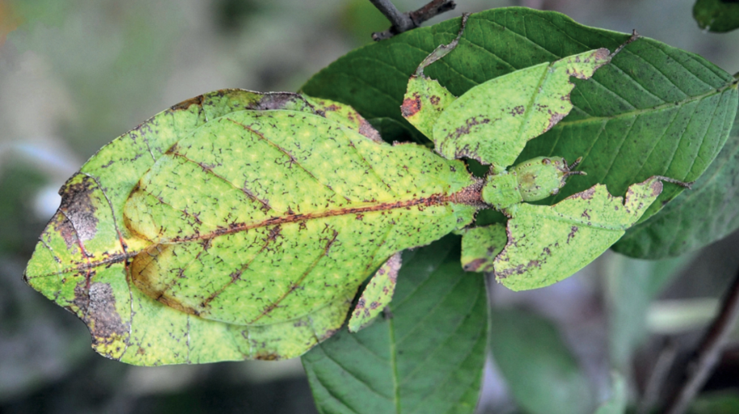
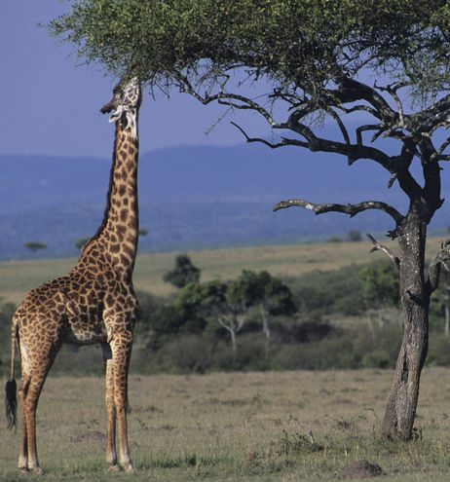
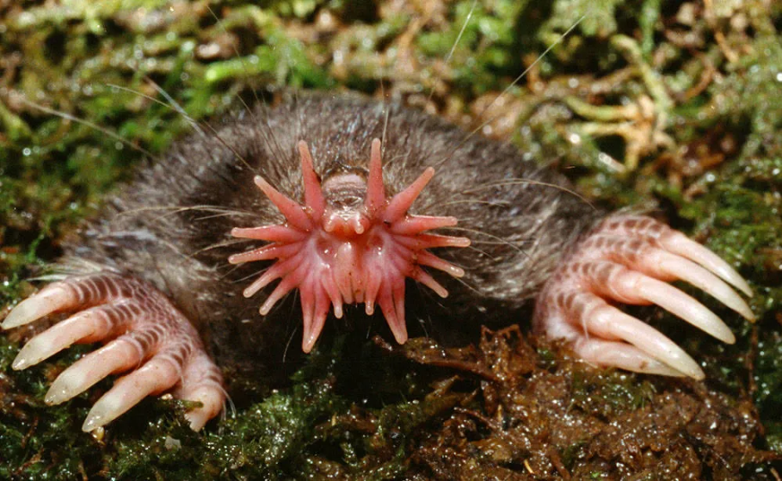
Evolution produces traits that suit the organism to its environment
Notes:
Start with a question – “Have you ever wondered…”
So, we know that evolution can produce an infinite variety of adaptive traits that help an organism thrive in its environment. From the classic example of the long-necked giraffe reaching up to the highest tree branches to forage for food, to this unique-looking leaf insect that has taken a camouflage approach to survival, or the extreme sensory adaptations that allow the star-nosed mole to feel its way around underground.
Explain adaptive before you use the word
But it’s usually very difficult to study the mechanisms underlying these adaptations, because we aren’t able to go back in time and track the evolutionary process, we don’t know how they got from there to here.
We call these changes adaptations. Find a better example to illustrate an animal that is uniquely adapted to its environment
Give a few examples? plant_-> cactus, horse? -> camel, find one more
- How do we understand this process on a biological, mechanistic level?
MAKE A COMMENT – I’m showing a fish here, but these same processes shape animal behavior across the animal kingsom

Slide 7
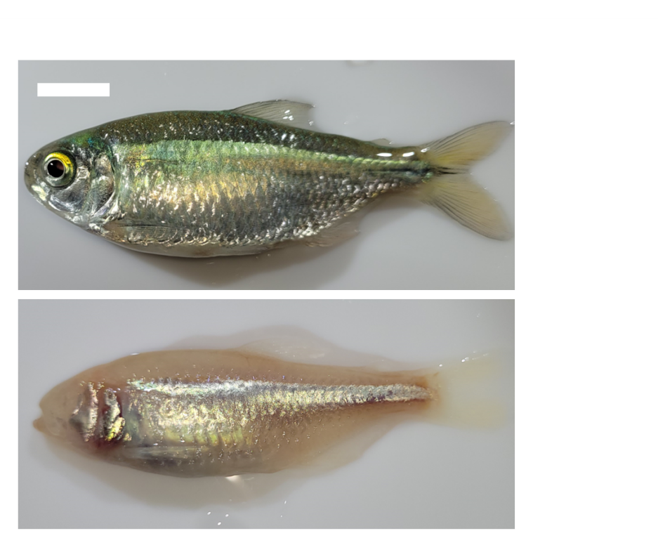
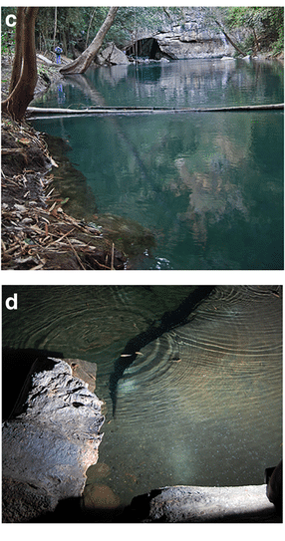
Astyanax mexicanus is a comparative model of evolution
Surface
Cave
Notes:
That’s where the Mexican cavefish comes in. this single species exists as both surface and cave adapted forms; the cavefish has evolved over thousands of years to thrive in a totally lightless environment with scarce food, and so has developed cave-adapted traits including eye loss, and expansion of nonvisual senses.
The Mexican tetra consists of an eyed, river-dwelling surface fish, and several independently evolved cave populations, which inhabit the caves of the sierra del abra region in Mexico, and which have converged on morphological adaptations like albinism, and eye loss, as you can see here. There are many different caves with standing cavefish populations; In our lab and several others we focus on a few populations, and we particularly like to focus on the Molino and Pachon populations, as they are thought to have evolved completely independtly and converged on many of these same traits.

Slide 8
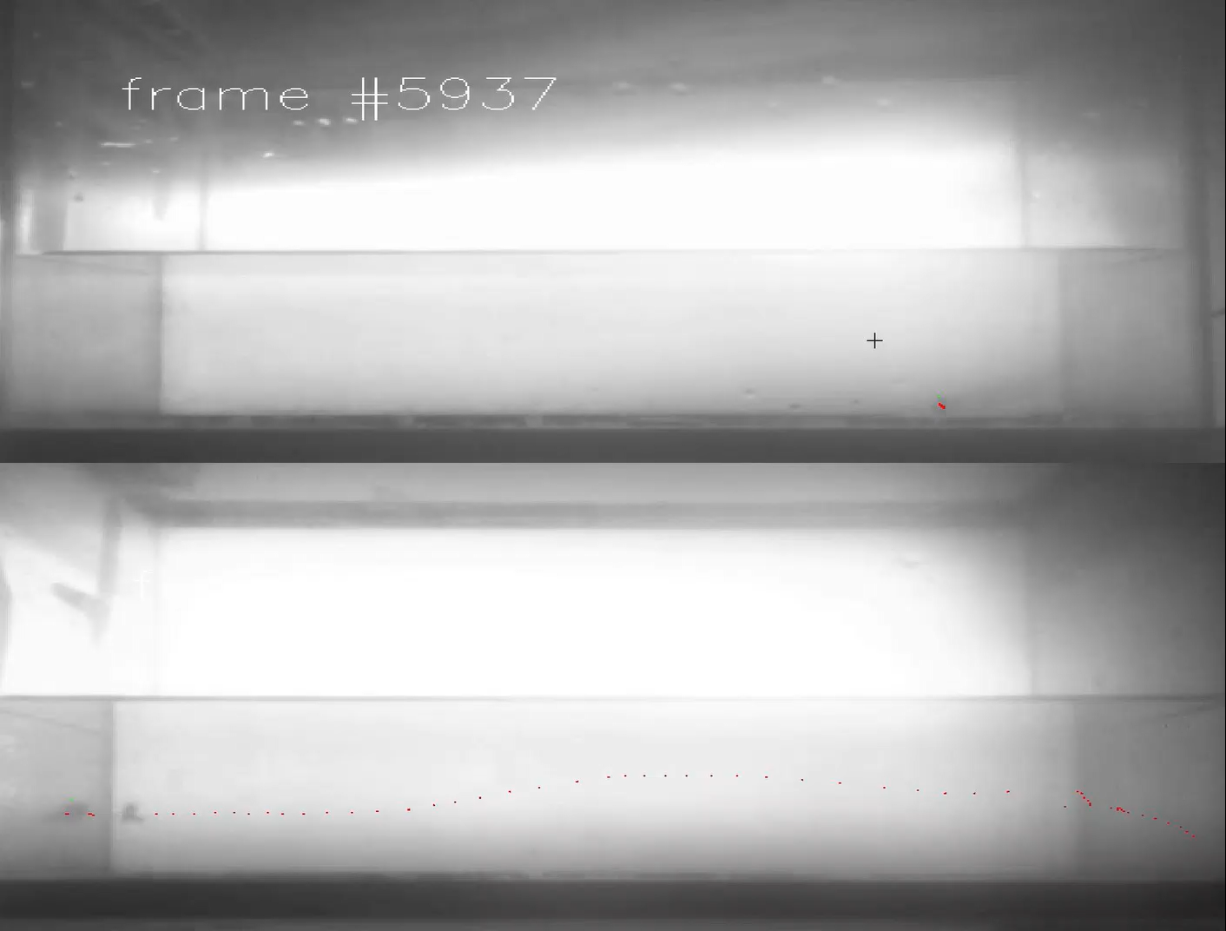
Surface and cavefish diverge significantly in their swimming behavior
Surface
Cave
Notes:
And those sensory changes have led to stark behavioral changes as well. You can see some of those differences in this odor tracking task. The surface fish on top is mostly still, while the cavefish is constantly swimming, surveying the odor landscape of the tank. And I’m really interested in the brain adaptations underlying these behavioral and sensory changes.

Slide 9
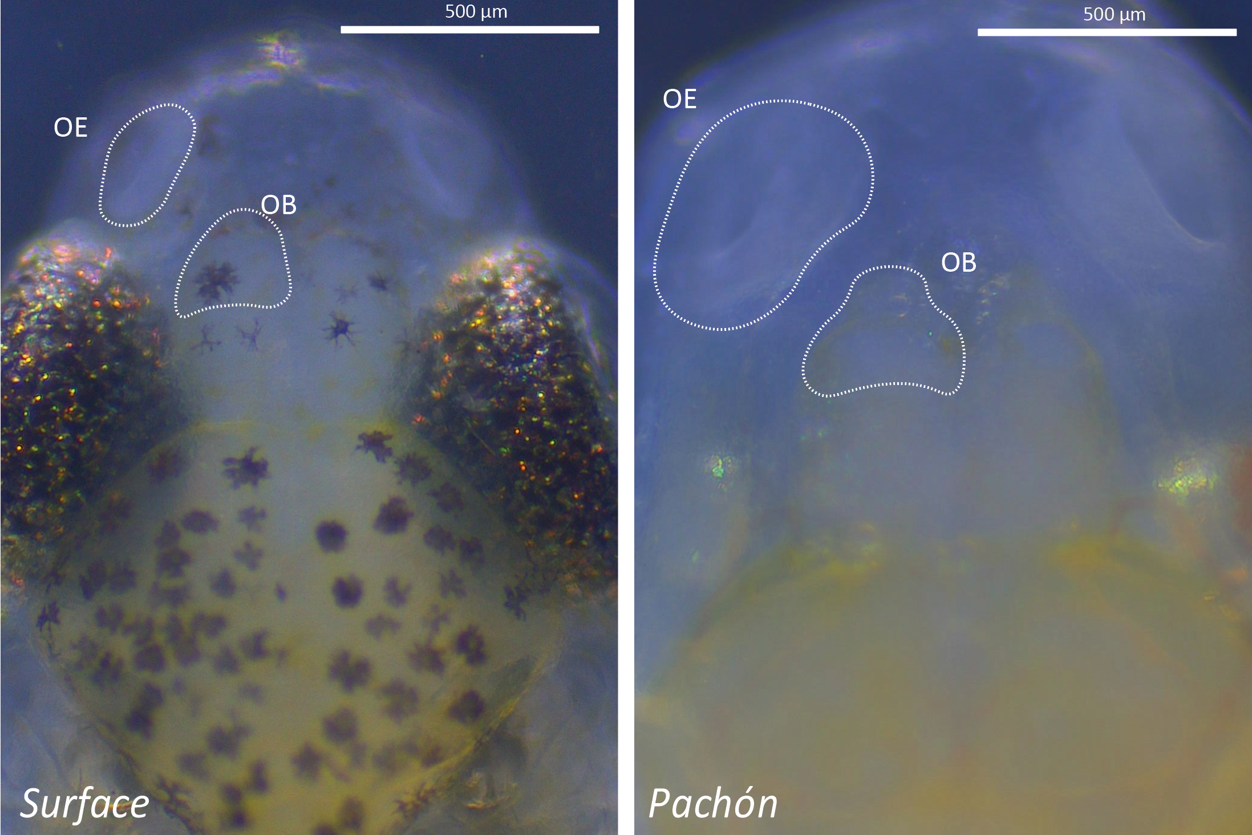
Evolved differences in sensory brain areas
Surface
Cave
Notes:
Here’s an example of that. You can see the loss of pigmentation, loss of eyes in the cavefish on the right. Those are both thought to be energy-saving adaptations to that nutrient-scarce cave environment. And you can also see the expansion of the olfactory centers, including the olfactory epithelium which hold the sensory cells, and the olfactory bulb which is the main sensory processing area for olfactory input.
I’ve drawn a outline around the odor-processing regions of these two morphs
Add in label for surface and cave

Slide 10
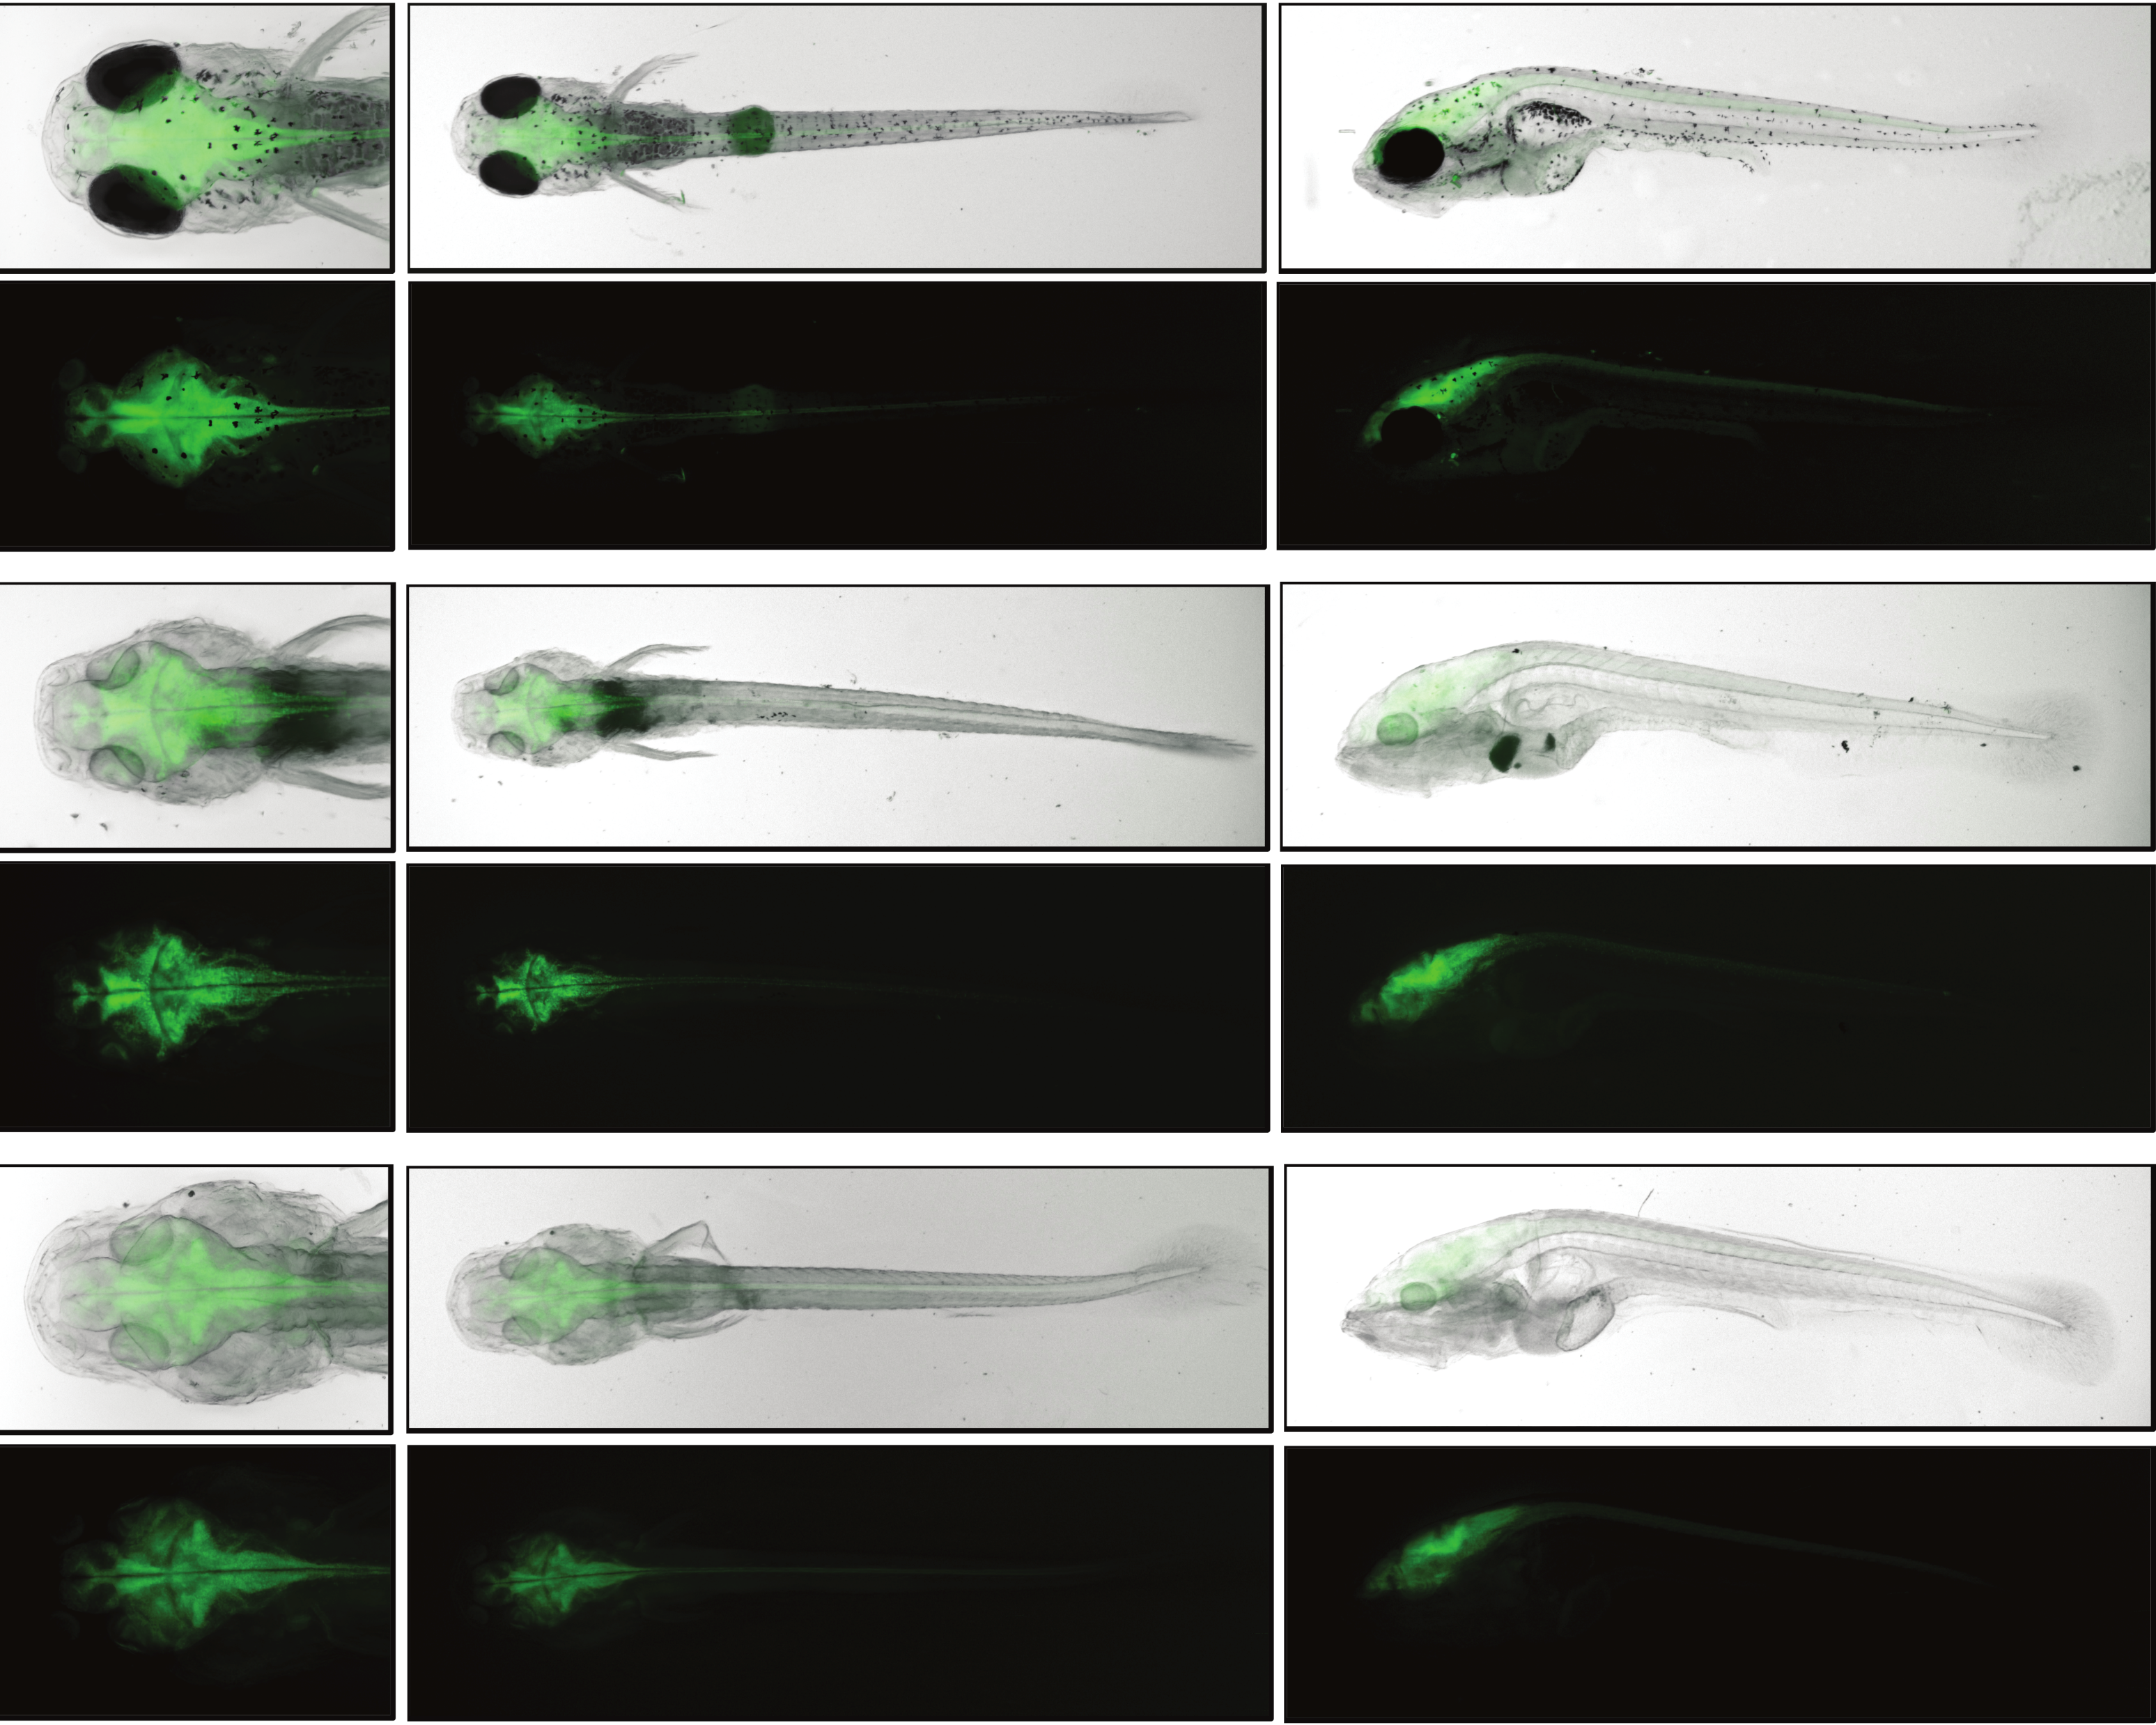
Genetic reporters enable monitoring of live brain activity on a cellular level
Surface
Cave
Notes:
Add in label for surface and cave
Reflect the image so sf is on left
Draw attention to the green fluorescence more explicitly “ here the green is fluorescence from their brains. If we zoom in…”
To understand those changes, I developed these special genetically modified animals which express a fluorescent protein in their brain; essentially that allows me to visually monitor brain activity in live fish.
Simplify the language you used on this slide; we made this fish that allows us to visualize their brain activity
Initially I studied loss off vision, transsitoned to olfactory bulb
Add a slide from the gcamp paper, explain more about the function of the protein. Ths is the first ...
Take advantage of the transparency of the fish to get high resolution videos
Talk about the strength of the two-photon/confocal imaging approach

Slide 11
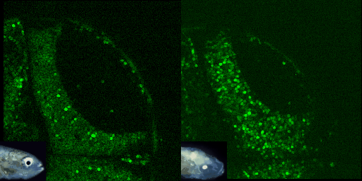
Cavefish lack responses to visual stimuli
Surface
Cave
Notes:
So for example, here we have the visual processing centers of the surface and cavefish. When a visual stimulus is [resented, represented by the white box on the upper right, we can see a robust response in the surface fish, and a total lack of response in the cavefish. So why do the cavefish retain this brain area, when the eyes have been lost?

Slide 12
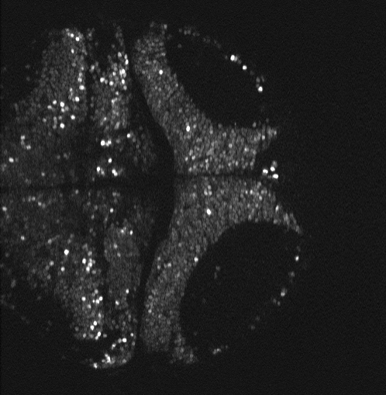
Cavefish “visual” center responds to water flow changes
Notes:
Well what we’ve found is that the cavefish has actually repurposed this area to process nonvisual inputs; here you can see the response to a tactile stimulation, and we think the cavefish is now using the brain area to oritent itself using tactile cues to map its environment
Delineate more strongly between your old work and your new work

Slide 13
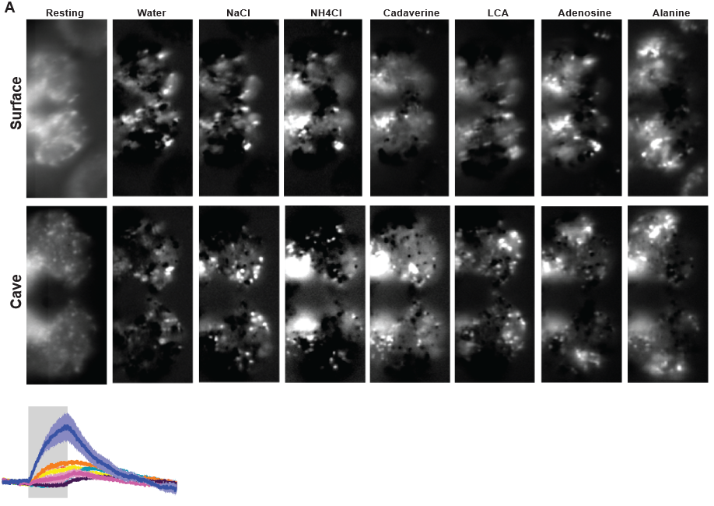

Cavefish odor processing center has enhanced water flow sensing
Resting
Water flow
Social Odor
Food Odor
Notes:
We see similar adaptations in other sensory areas. These images are showing representative responses of the olfactory bulb to a number of odors, as well as to changes in water flow. And we found that the cavefish have an enhanced response to changes in water flow, which may help them to track the source of odors in their environment and better find food.
Hat is the point of this slide? Simplify and create a coherent point for the audience to take home
Be more clear with the comparisons between surface and cave. Put an arrow pointing to the point you want to make. Give more time to breather, talk through everything on the slide. Show a better frame subtraction,
Figure out a title for this slide

Slide 14
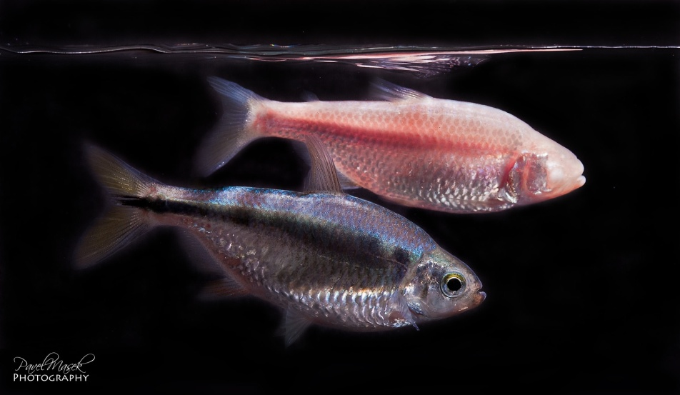
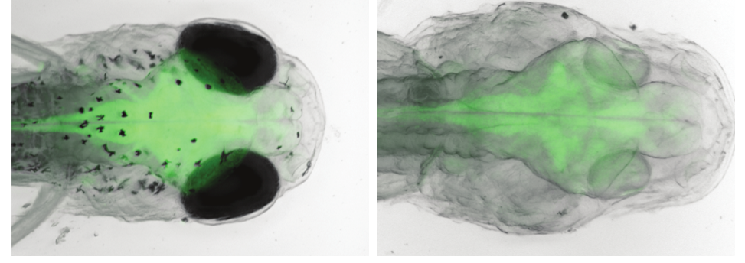
Conclusions
Cavefish brain has evolved to help it thrive in a cave environment
Increases in non-visual senses make up for their lack of vision
Studying the evolved changes in the cavefish brain will help us to understand how our own brains evolved
Notes:
Simplify again – no olfactory
Figure out the important conclusions you want to share
Add images which represent your points, a data point that provides context
Link your conclusions back to the title
Add animations to break up your points

Slide 15

Thank You…

Slide 16
People’s Choice Award
Vote for your favorite presentation!
The Office of Postdoctoral Affairs
The Graduate School | Florida State University

Slide 17


People’s Choice Award
6 – Buna Bhandari
Isolation within Isolation: Unmasking
COVID-19 Stigma
7 - Yijiong Yang
Genes, Health, and Heritage: How DNA and Ancestry Shape Our
Metabolic Profiles
8 – Saptarsi Mitra
From Smell to Appetite: Linking Odors with Feeding Circuits
9 – Behrouz Ghazi Esfahani
Seeing is Curing: Cyro EM in the Fight Against Respiratory Pathogens
10 – Shekhar Chauhan
Memory and Math Across the Nations
To Vote = Scan the QR Code and Then
Click Your Favorite Number!
1 – Yu-Jou Chou
Plastic in Our Plates, Plastic in Our Bodies?
2 – Evan Lloyd
How Evolution Shapes the Brain
3 – Anirudh Lakshmi Narasimha Prasad
Taming Jet Roars with Tiny Lightening Zap
4 – Sagiv Shiber
Exploding Stars – The Role of Magnetic Fields
5 – Ashley Allen Carr
Living Glass in Space

Slide 18
Awards & Reception
Please join us for refreshments and award presentations
The Office of Postdoctoral Affairs
The Graduate School | Florida State University

Slide 19
Program End
2025 Postdoctoral
Fall Symposium
The Office of Postdoctoral Affairs
The Graduate School | Florida State University

