Slide 1


Buna Bhandari
College of Nursing
Isolation within Isolation: Unmasking COVID-19 Stigma
The Office of Postdoctoral Affairs
The Graduate School | Florida State University

Slide 2
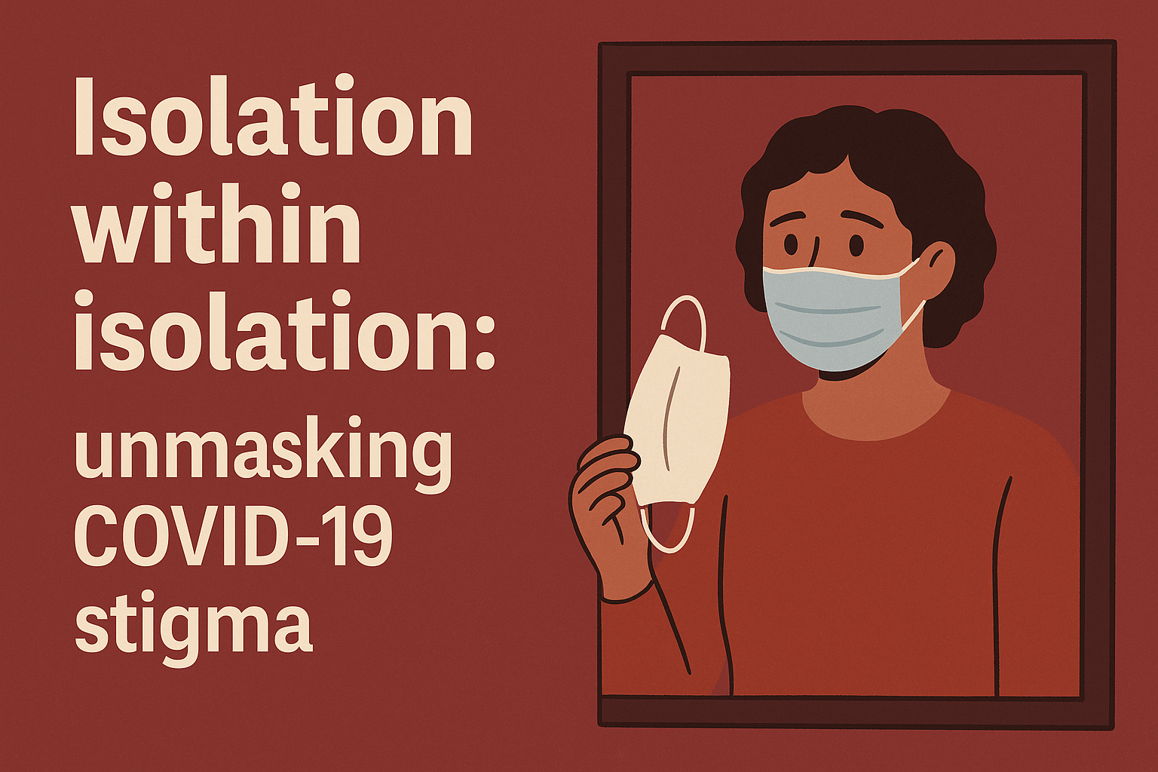

Slide 3

Unseen burden of stigma
“Negative attitudes and discrimination toward individuals”
Pooled estimated prevalence of 34%, stigma related to infectious diseases
(Yuan, K. et al, 2022)

Slide 4
Stigma Matters: Here’s Why
Delayed Health seeking
Mental distress
Mistrust in health systems
Increased spread
Logie, C et.al, 2015

Slide 5
COVID-19 Stigma at the LMIC setting
Method
Setting
Population
Duration
Mixed method Research
Nepal- South Asia
COVID 19 survivors
Apr to Jun 2021
5

Slide 6
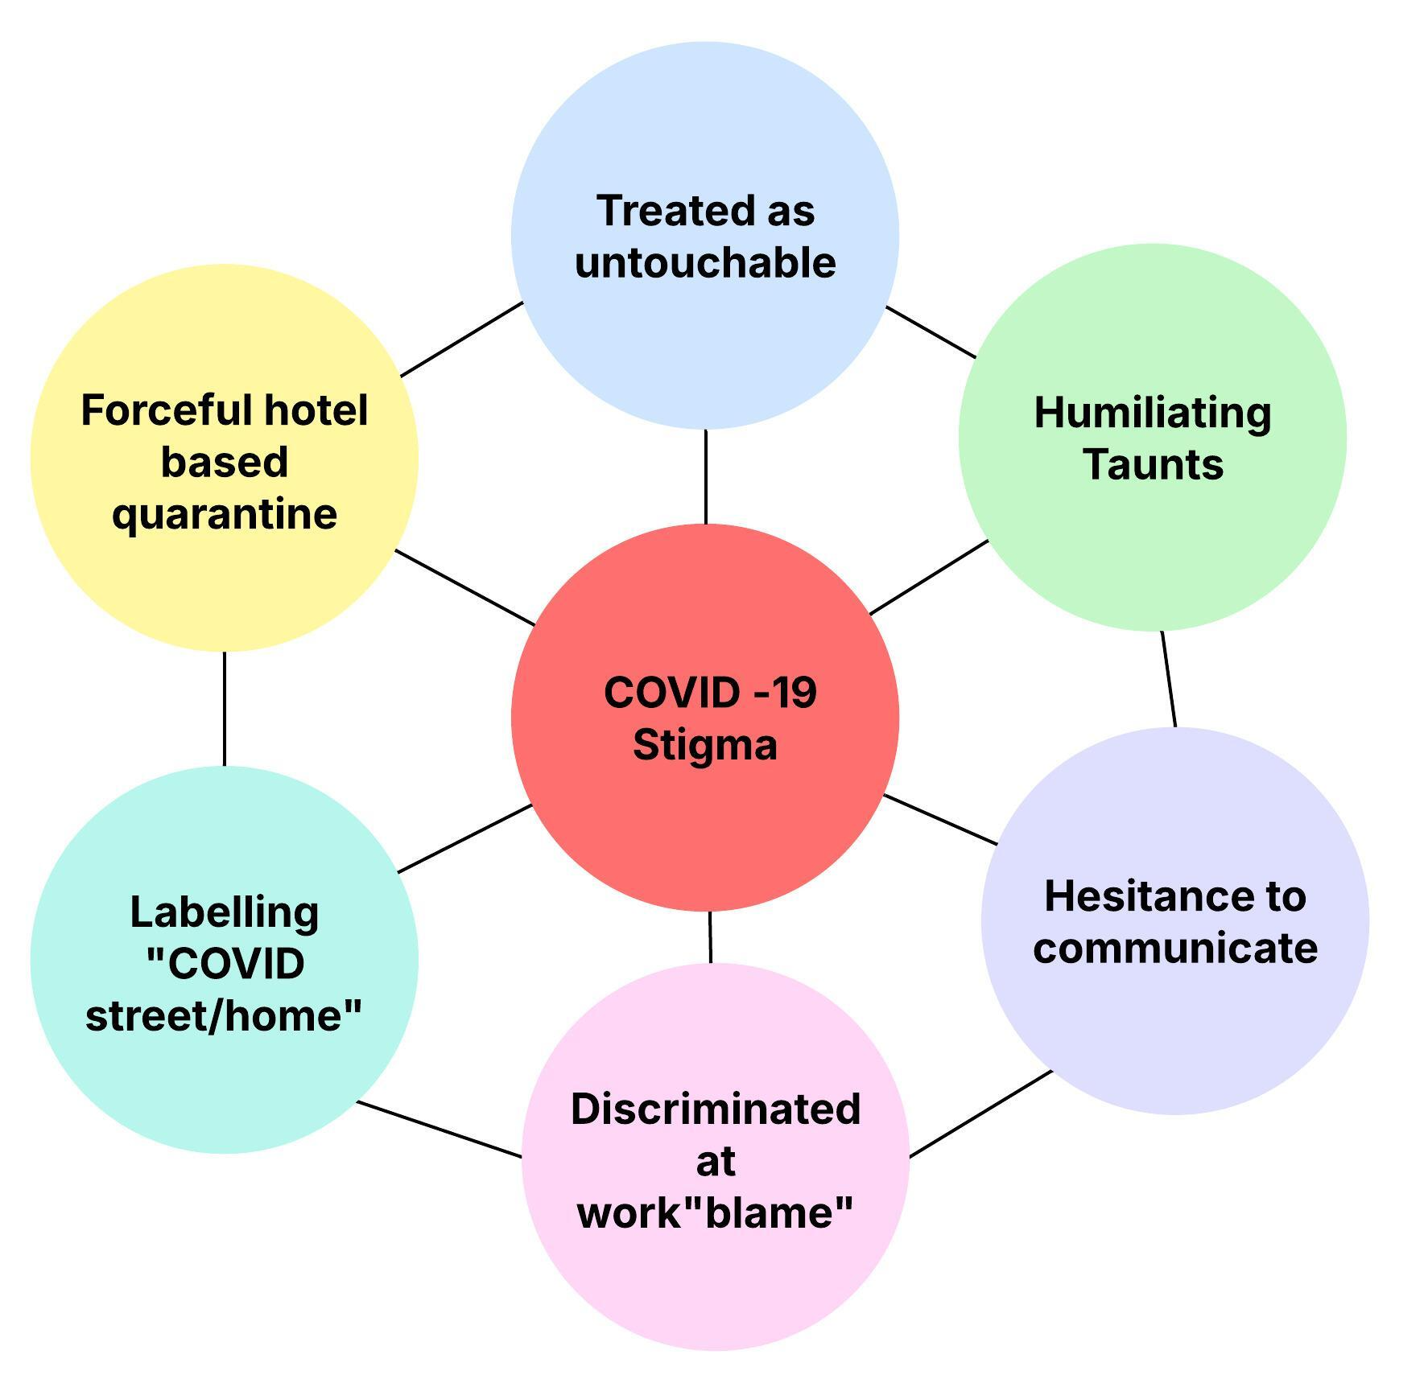
Forms of stigma

Slide 7
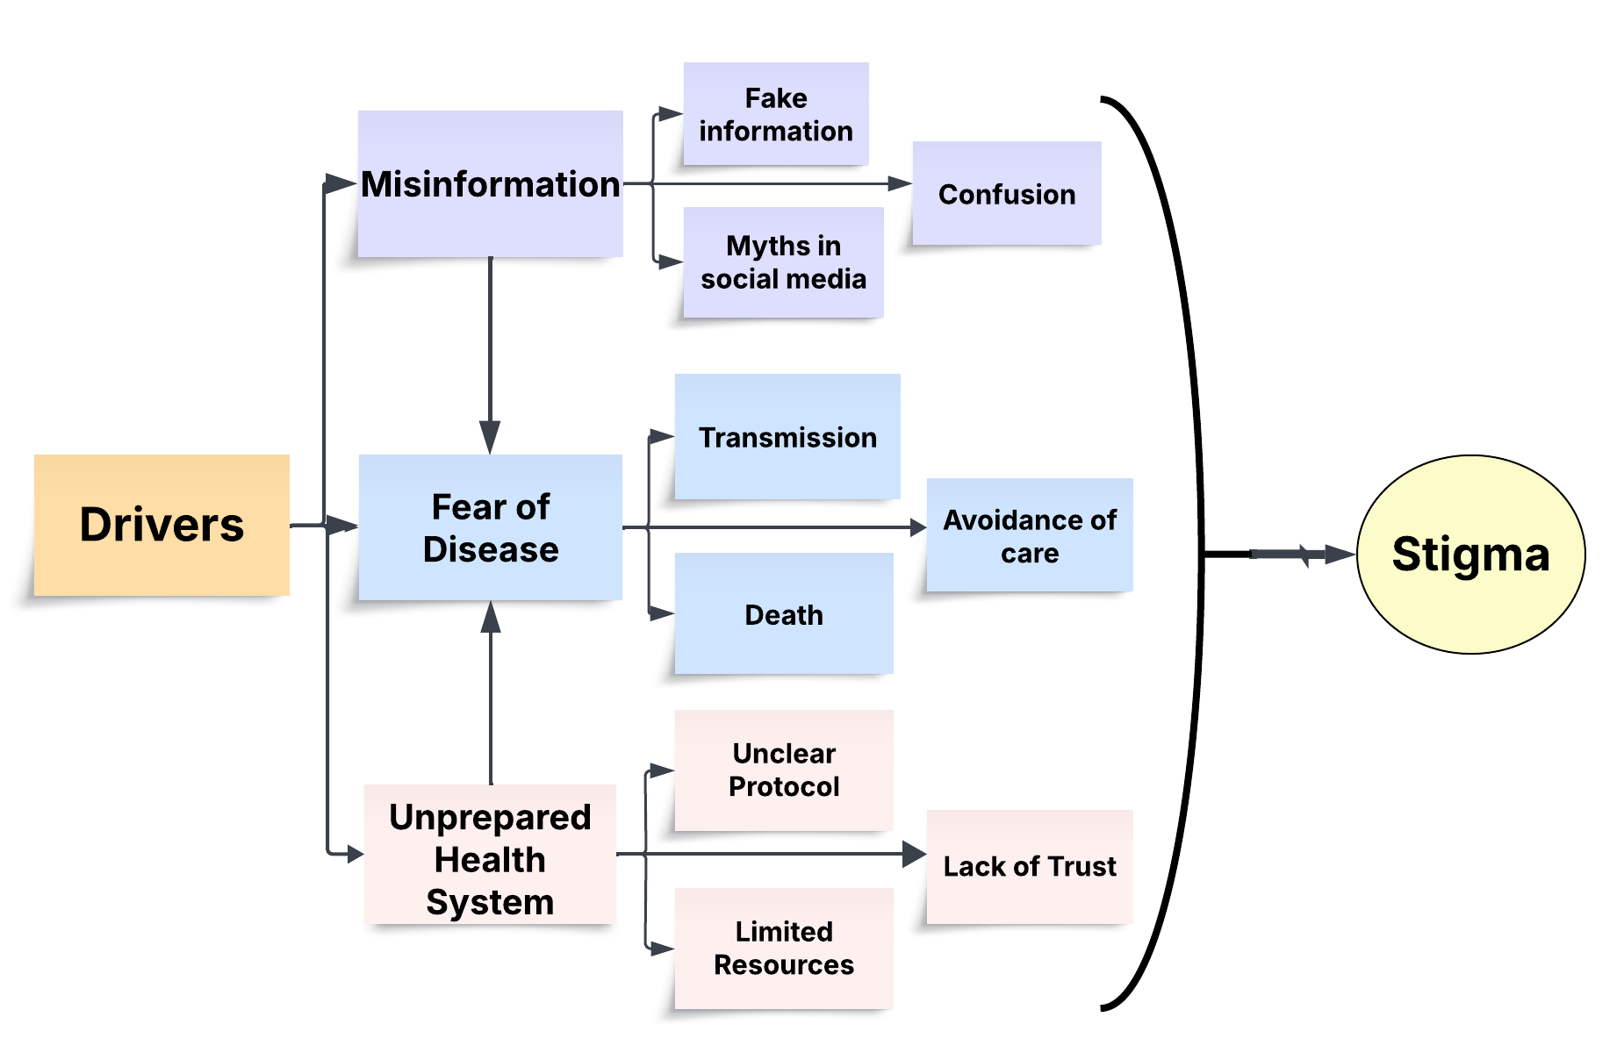

Slide 8
Impact
Limited access to treatment
Mental stress and anxiety
Limited social support
Loneliness/low self esteem
Financial Hardship

Slide 9
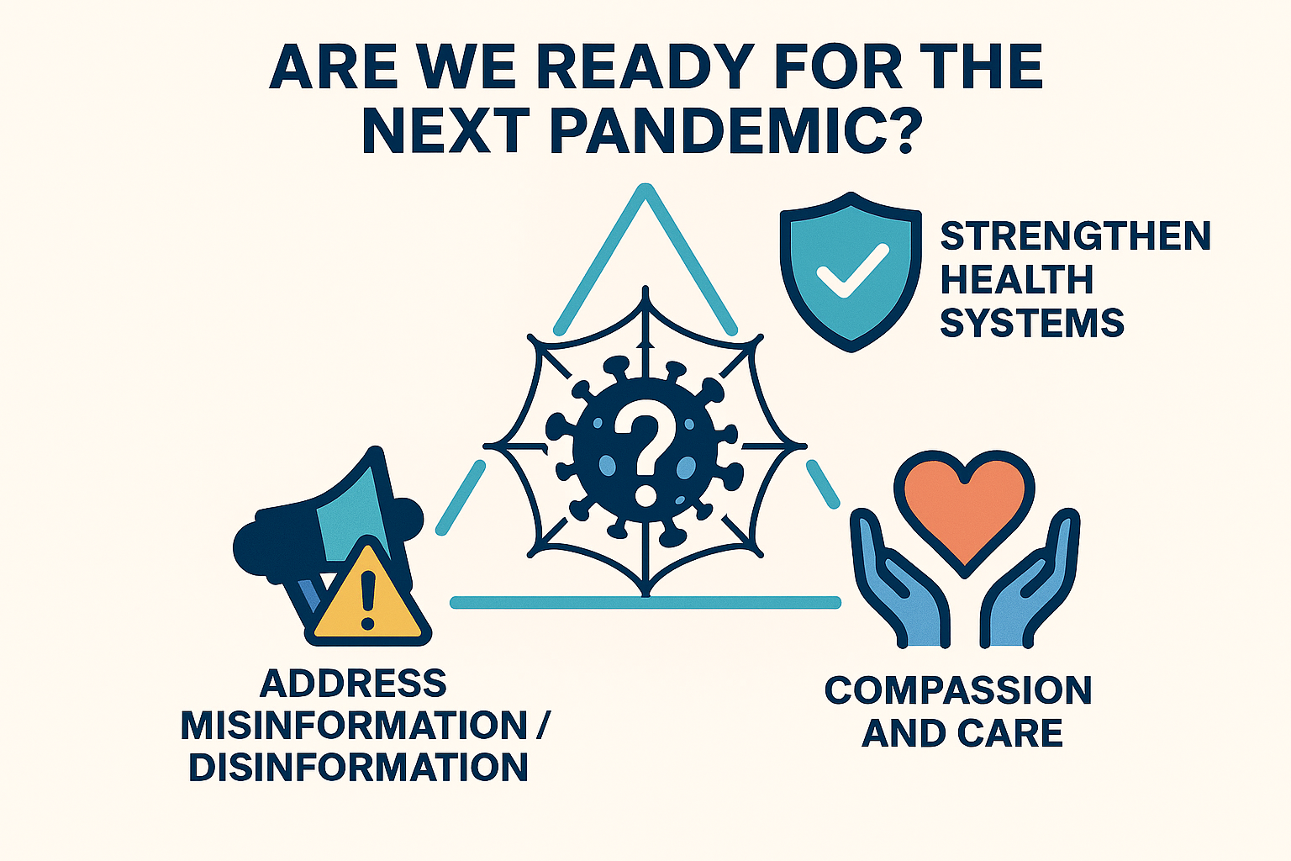

Slide 10






Acknowledgements
Jing Wang
Dean and Professor
PhD, MPH, RN, FAAN
Postdoctoral scholar
Postdoctoral Scholar,PhD
Hongyu Miao
Professor,
PhD
Chengdong Li
Data Scientist, PhD
Setor Kofi Sorkpor
Assistant Professor
PhD, MPH, MSN, RN
Study collaborators
Dr Poshan Thapa, PhD, McGill University, Quebec, Canada
Prof Archana Shrestha, PhD, Kathmandu University, Dhulikhel Hospital, Nepal
Mr Rajiv Karn, MPH, Biratnagar Eye Hospital, Nepal
Mr Haider Ali, MPH, Biratnagar Metropolitan City, Nepal
Mr Amit Timilsina, MPH, IPAS, Nepal
Prof Ashley Hagaman, PhD, Yale School of Public Health, USA
Funding support: Nepal Health Research Council, Provincial Research Grant, 2020

