Slide 1


Ashley Allen Carr
Department of Chemical & Biomedical Engineering
Living Glass in Space
The Office of Postdoctoral Affairs
The Graduate School | Florida State University

Slide 2
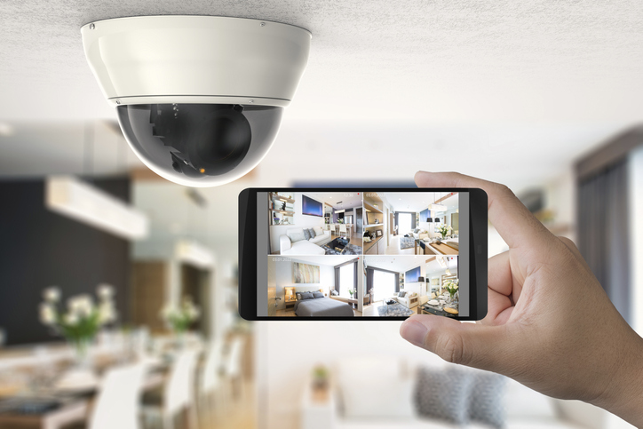
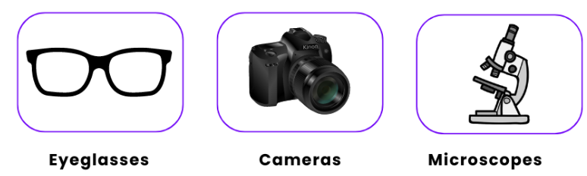
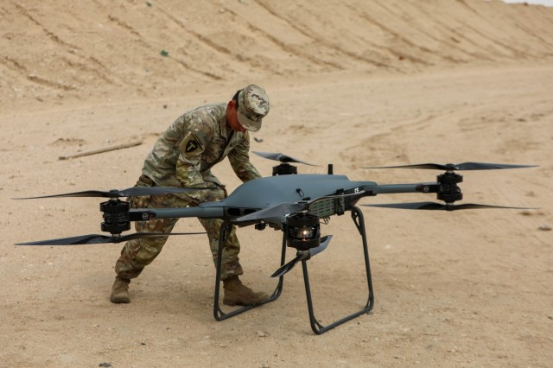
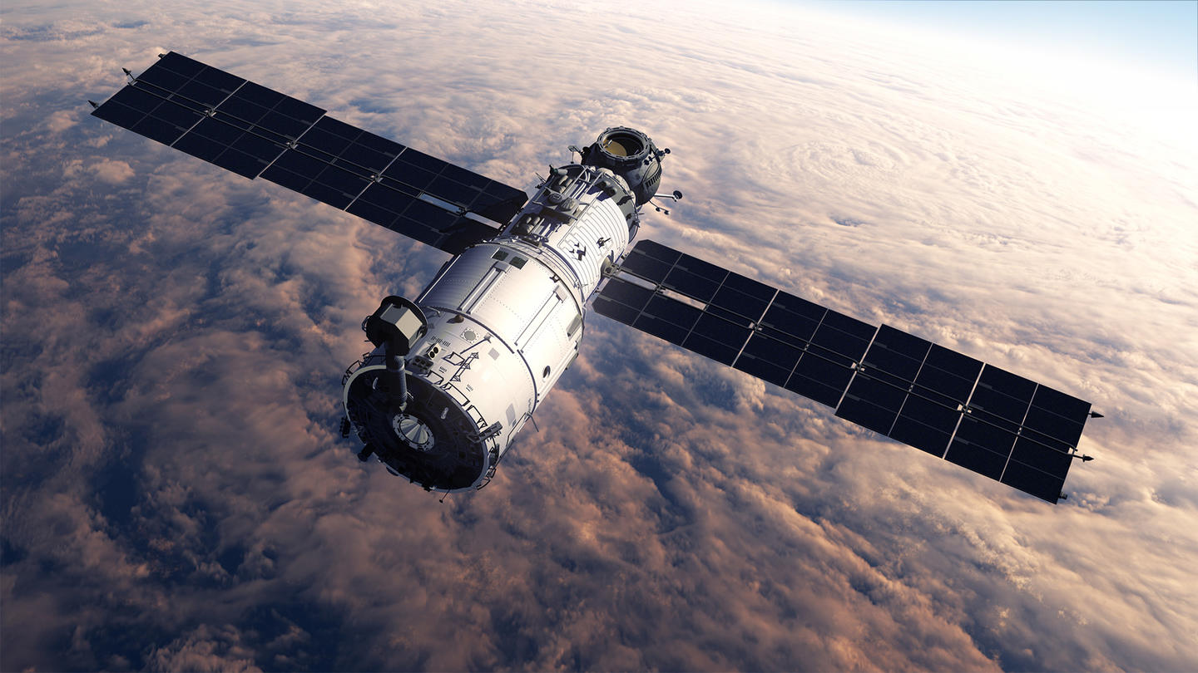
Glass Lenses are Everywhere.
Photo Credit: CBS Europe
NASA & the United States Space Force rely on glass optics in space
Photo Credit: Princeton Plasma Physics Laboratory
Photo Credit: US Army
Photo Credit: Princeton Plasma Physics Laboratory
Notes:
Let me make a really safe bet..
I bet every single person in this room is holding something that contains glass. Its probably your phone, maybe its your glasses, or your watch. This projector uses a glass lens and the mouse that controls the computer uses a little optical component. Silica-glass-based optics have proliferated every aspect of our lives as civilians.
So you can imagine how important they are to agencies like NASA and the Space Force. Navigation, operations and experimentation in space all rely heavily on glass based optical components.

Slide 3
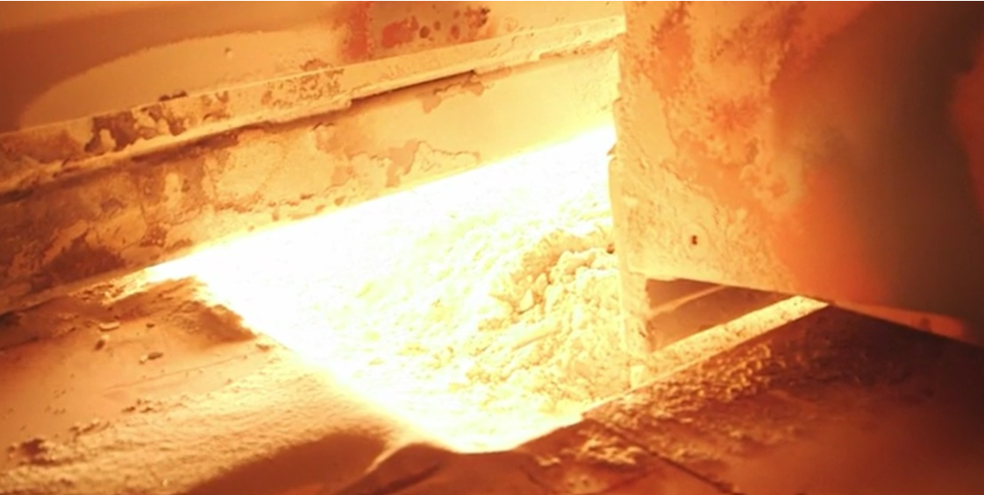
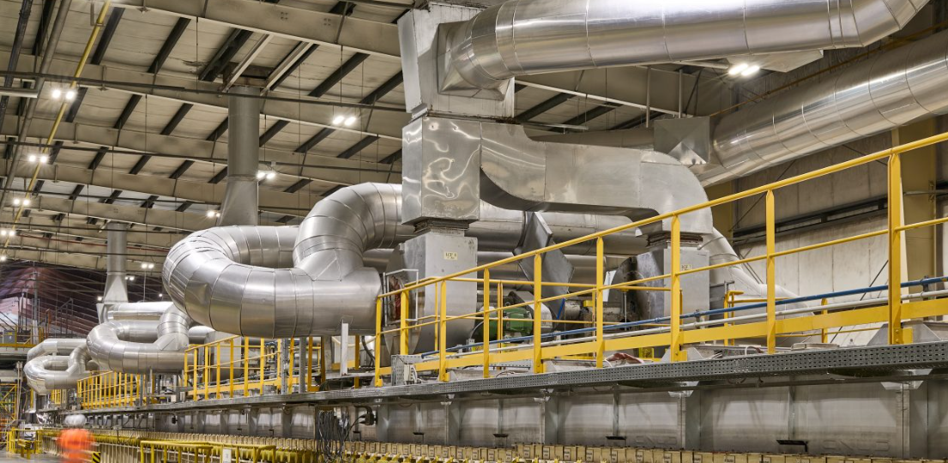
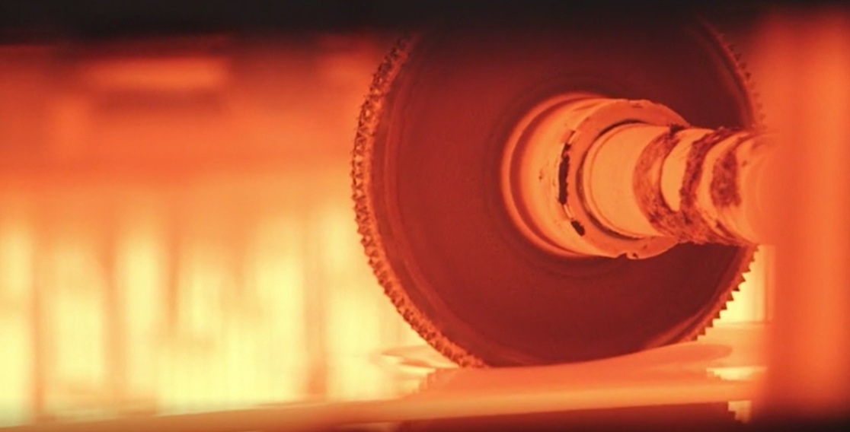
Glass Lenses are Difficult to Manufacture in Space.
High heat
Harsh chemicals
Heavy infrastructure
Launch-to-space cost: ~$2,500/lb of material
Photo Credit: Guardian Glass
Notes:
The problem is that today, silica-based lenses are made on Earth using high heat, harsh chemicals, and heavy infrastructure; not ideal for space operations where size, weight, and power consumption must be minimized.

Slide 4
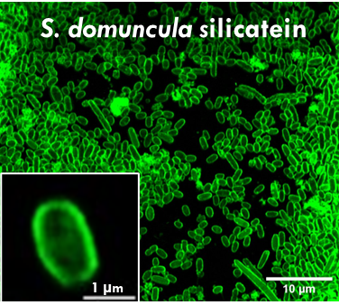
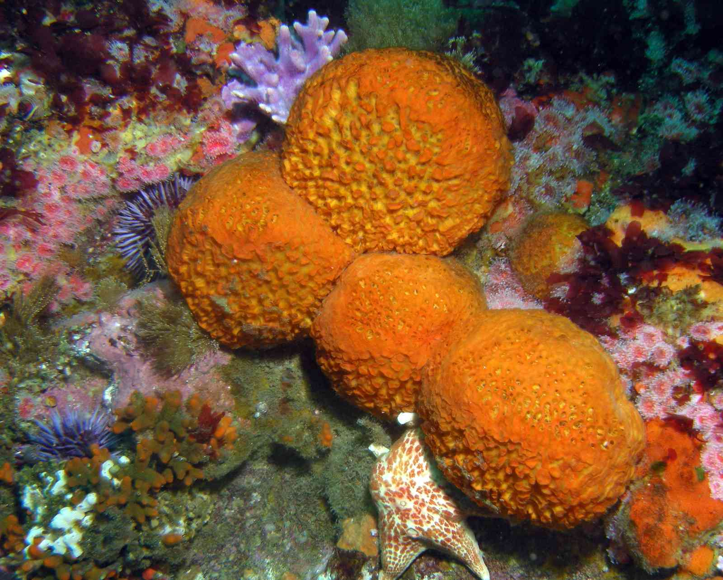
Nature May Hold the Solution.
Photo Credit: University of Rochester
Certain sea sponges use Silicatein to form glass shells
Silicatein-modified E. Coli bacteria can grow themselves into glass microbeads.
Glass shells are stained green.
Notes:
So we are looking to nature for a solution — specifically, there are sea sponges that use the protein silicatein to polymerize silica from their environment and form their unique shells. Synthetic biologists have isolated the genes responsible for Silicatein and modified E. coli bacteria to contain it. This gives them the ability to surround themselves in glass. You can see in the image where the glass is stained green—These bacteria effectively grow themselves into glass microbeads.

Slide 5



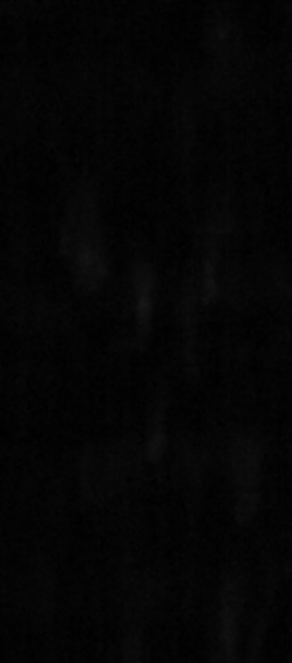
Self-Assembling Bioglass Can Act Like a Lens.
Wildtype
S. domuncula silicatein
Bioglass-coated cells scatter light with higher intensity.
Can we grow or repair functional optical components in space?
1 µm
Notes:
It has also been shown that these little glass microbeads display enhanced light focusing —you can see in these videos the modified e. coli produce clear jets of light while the normal e coli does not. these are the early steps to self-assembling bioglass– could we use this material to grow or repair glass optical components in space?
So we know genetically modified bacteria can form bioglass and that bioglass can focus light.

Slide 6
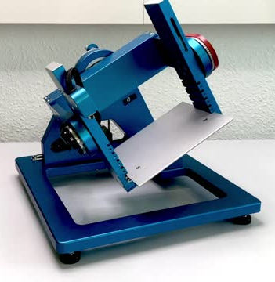
Simulating Microgravity Complicates Things.
How does the bioglass behave under zero gravity?
Complicating factors:
  Simulator spins continuously
  Very compact area: 6”x6”x6”
  Sample must remain at center of both rotational axes
Random Positioning Machine (RPM) Microgravity Simulator
Notes:
But we don’t know how these systems grow and behave in the zero gravity condition of space. So I’m growing this bioglass under simulated microgravity using random positioning machines, or RPMs. These devices approximate near-weightless conditions by continuously spinning. Here you can see an RPM, its pretty simple, it has an experimental stage where the sample sits. What complicates things is that it’s a very compact area, 6 by 6 by 6 inches cubed, its continuously moving, and the sample must remain in the very center.

Slide 7
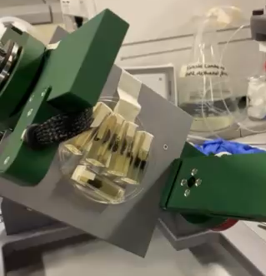
How do you microscopically image something in constant motion?
Notes:
So how do I microscopically image something that’s constantly moving? You can see some samples on the stage here while it is in motion. While it’s not moving fast, I’m certainly not able to remove the sample, view it with a microscope and replace it without disrupting the zero gravity condition.

Slide 8
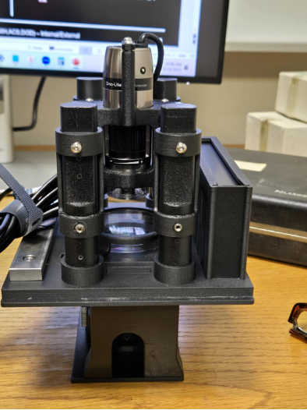
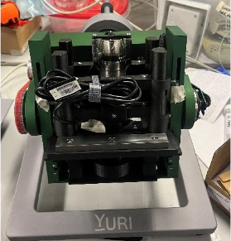
Use custom imaging modules that fit inside microgravity simulators.
Microscope
Sample
Wifi transmitter
Module onboard RPM
Notes:
To get around this I’m building custom imaging modules that fit inside the microgravity simulator. You can see the module on the right here. We’re keeping it simple, using commercial off the shelf parts and 3D printed plastic. You can see the microscope, petri dish sample holder and the wifi transmitter that allows it to remain wireless. (wires would get tangled afterall… can talk about power access on the arms if need to fill more time)
This slides directly into the module as you can see in the image on the lower left.
To remedy this I am developing custom imaging modules that will fit at the center of gravity
My role in the project is to build custom instruments to study growth and investigate tunability of optically active biomaterials; instruments of interest include compact imaging and spectroscopy modules that fit onboard an RPM and a spectrometer capable of angle-resolved reflectance and transmittance measurements. Our instruments will facilitate the correlation of structure and photonic function for bioglass and biofilm systems, and will also help us to understand how living systems respond to the unique environments encountered during space exploration.
Tunability is the challenge ahead — guiding self-assembly so that structure and optical function align to create real components.
Want to take this material and grow it into functional optical components.
Like 3d printing, want tunability
To do this, must correlate physical microstructure with optical performance

Slide 9
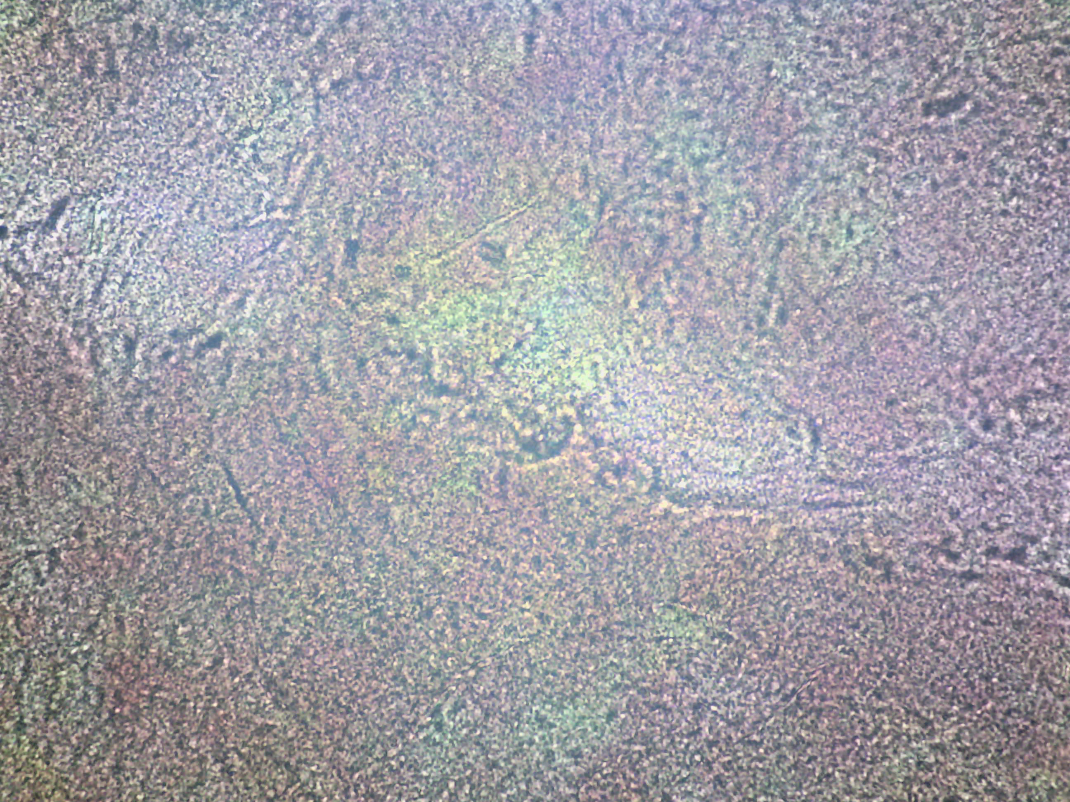
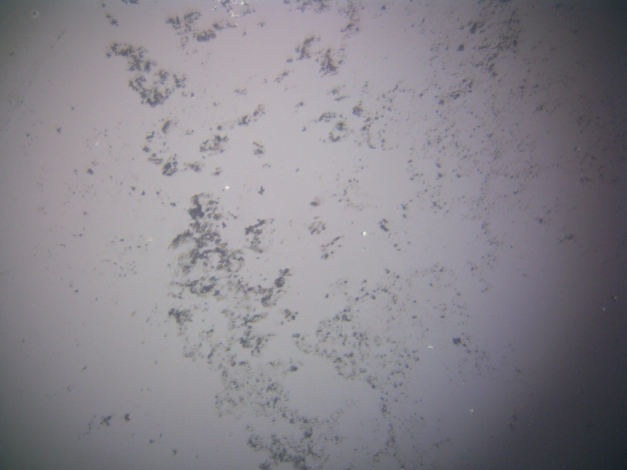
Digital Images Allow Us To Quantify Growth.
Write computer program to calculate growth rate from images
C. Lytica
E. Coli
Growth rates are calculated from imaging data.
Notes:
This module allows us to image the bacteria over long time periods in the simulator. Once I acquire the images, I write a computer script that will calculate the growth rates directly from the imaging data. You can see some images I’ve acquired using this module directly.
What I’ve described is just one of many modules and imaging instruments I am building. These devices that will ultimately help to facilitate the correlation of structure and photonic function for the bioglass systems, and will also help us to understand how living systems respond to the unique environments encountered during space exploration.

Slide 10
Functional Tunability is the Challenge Ahead.
To grow functional optical components from this material we must:
  Correlate physical structure with optical function
  Investigate tunability
    Humidity, temperature
    Nutrient composition
    Self-repair capabilities
Notes:
Tunability is the challenge ahead —Similar to 3D printing I want to be able to guiding self-assembly so that structure and optical function align to create real components. My future experiments also explore temperature/humidity & nutrient composition effects as well as self-repair capabilities.

Slide 11
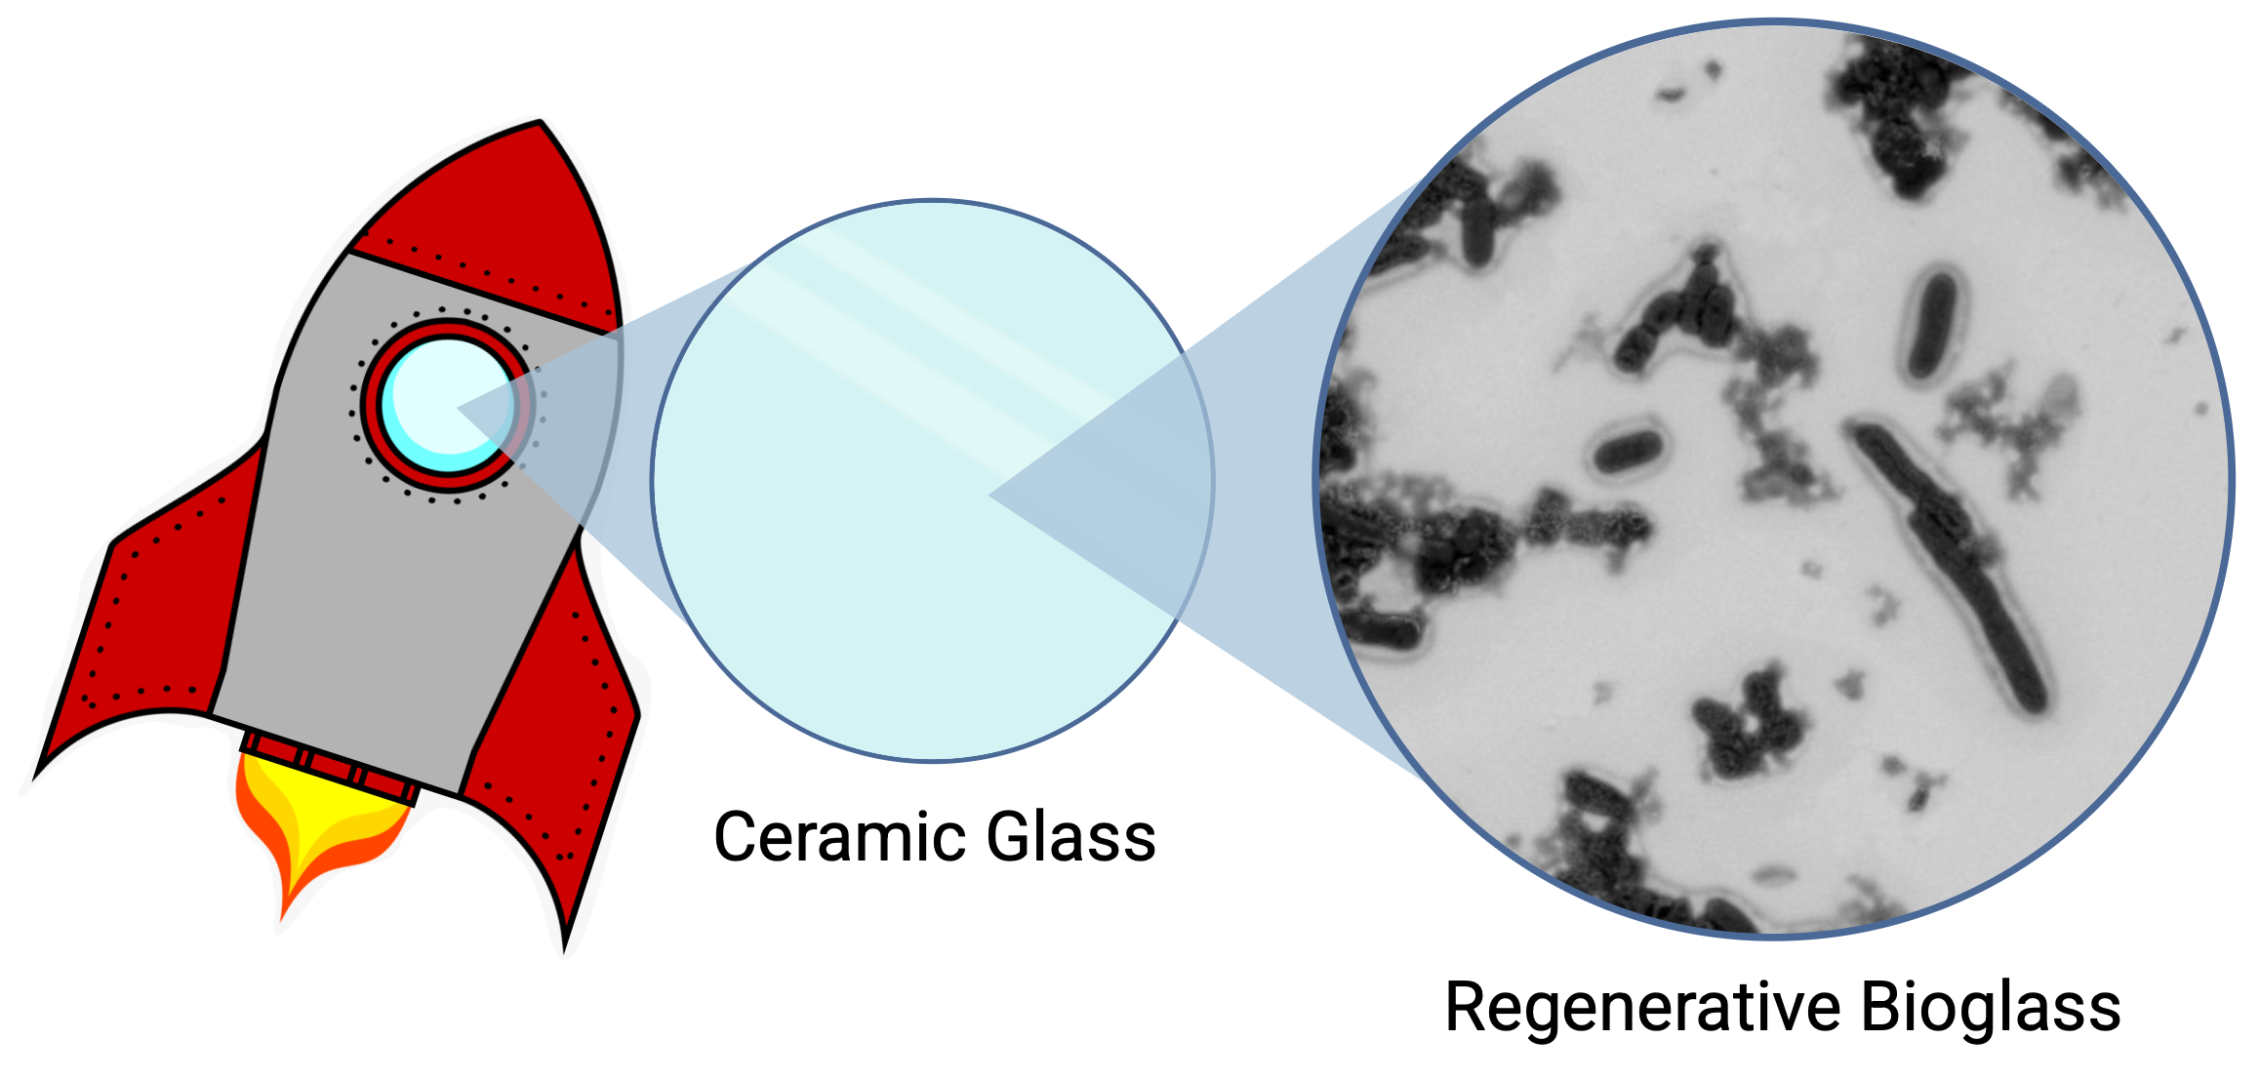
On-the-fly Optics in Space as a Strategic Capability
The ability to grow or repair optical components while in orbit would enable more resilient systems in space.
Notes:
Space is the environment where this research ultimately matters. If spacecraft could one day grow or regenerate optical elements in orbit, it would reduce the need to haul heavy, fragile lenses from Earth — lowering launch costs, extending mission lifetimes, and enabling more resilient systems for the Space Force.

