Slide 1


Shekhar Chauhan
College of Social Science & Public Policy
Memory and Math Across the Nations
The Office of Postdoctoral Affairs
The Graduate School | Florida State University

Slide 2

Scaffolding Theory of Aging and Cognition
Brain builds backup pathways with age = Strengthened by Experience & Weakened by Stress

Slide 3
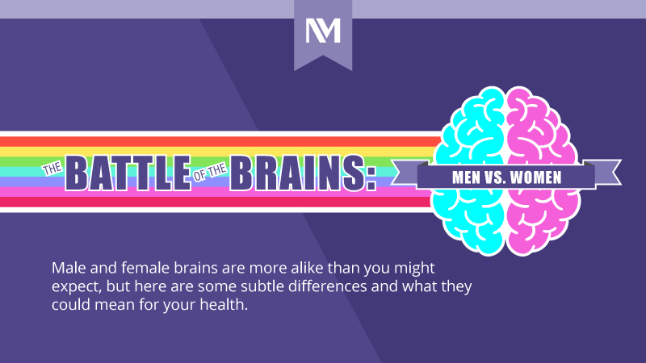
Male and female brains share more similarities than differences, but one subtle twist stands out, and it’s the key takeaway of this study

Slide 4

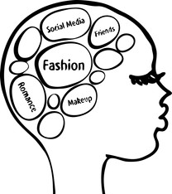
CAT
DOG
GOLD
SCHOOL
TREE
CHAIR
Men (Numeracy) vs Women (Verbal Fluency)

Slide 5

Hypothesis…
H1a = Higher educational attainment is positively associated with cognitive function within each country.
H1b = Individuals in developed regions (e.g., the United States, European Union) will exhibit higher cognitive function than those in developing contexts (e.g., India, Mexico)

Slide 6
Figure 1. Predicted Numeracy Scores by Years of Education Across Countries/Region (H1a)

Slide 7
Figure 2. Predicted Verbal Fluency Scores by Years of Education Across Countries/Region (H1a)

Slide 8
Figure 3. Country/Region Estimates in Numeracy By Number of Additional Years of Educational Attainment (H1b)

Slide 9
Figure 4. Country/Region Estimates in Verbal Fluency By Number of Additional Years of Educational Attainment (H1b)

Slide 10
Figure 5. Average Female Relative to Male Cognitive Score By Countries Among Adults Aged 55+ Years
Males are higher
Females are higher
Verbal Fluency

Slide 11

Thank You…

