Slide 1


Yu-Jou Chou
Health, Nutrition, and Food Science
Plastic in Our Plates, Plastic in Our Bodies?
The Office of Postdoctoral Affairs
The Graduate School | Florida State University

Slide 2

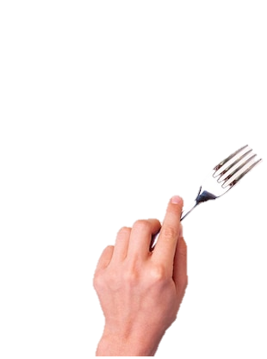

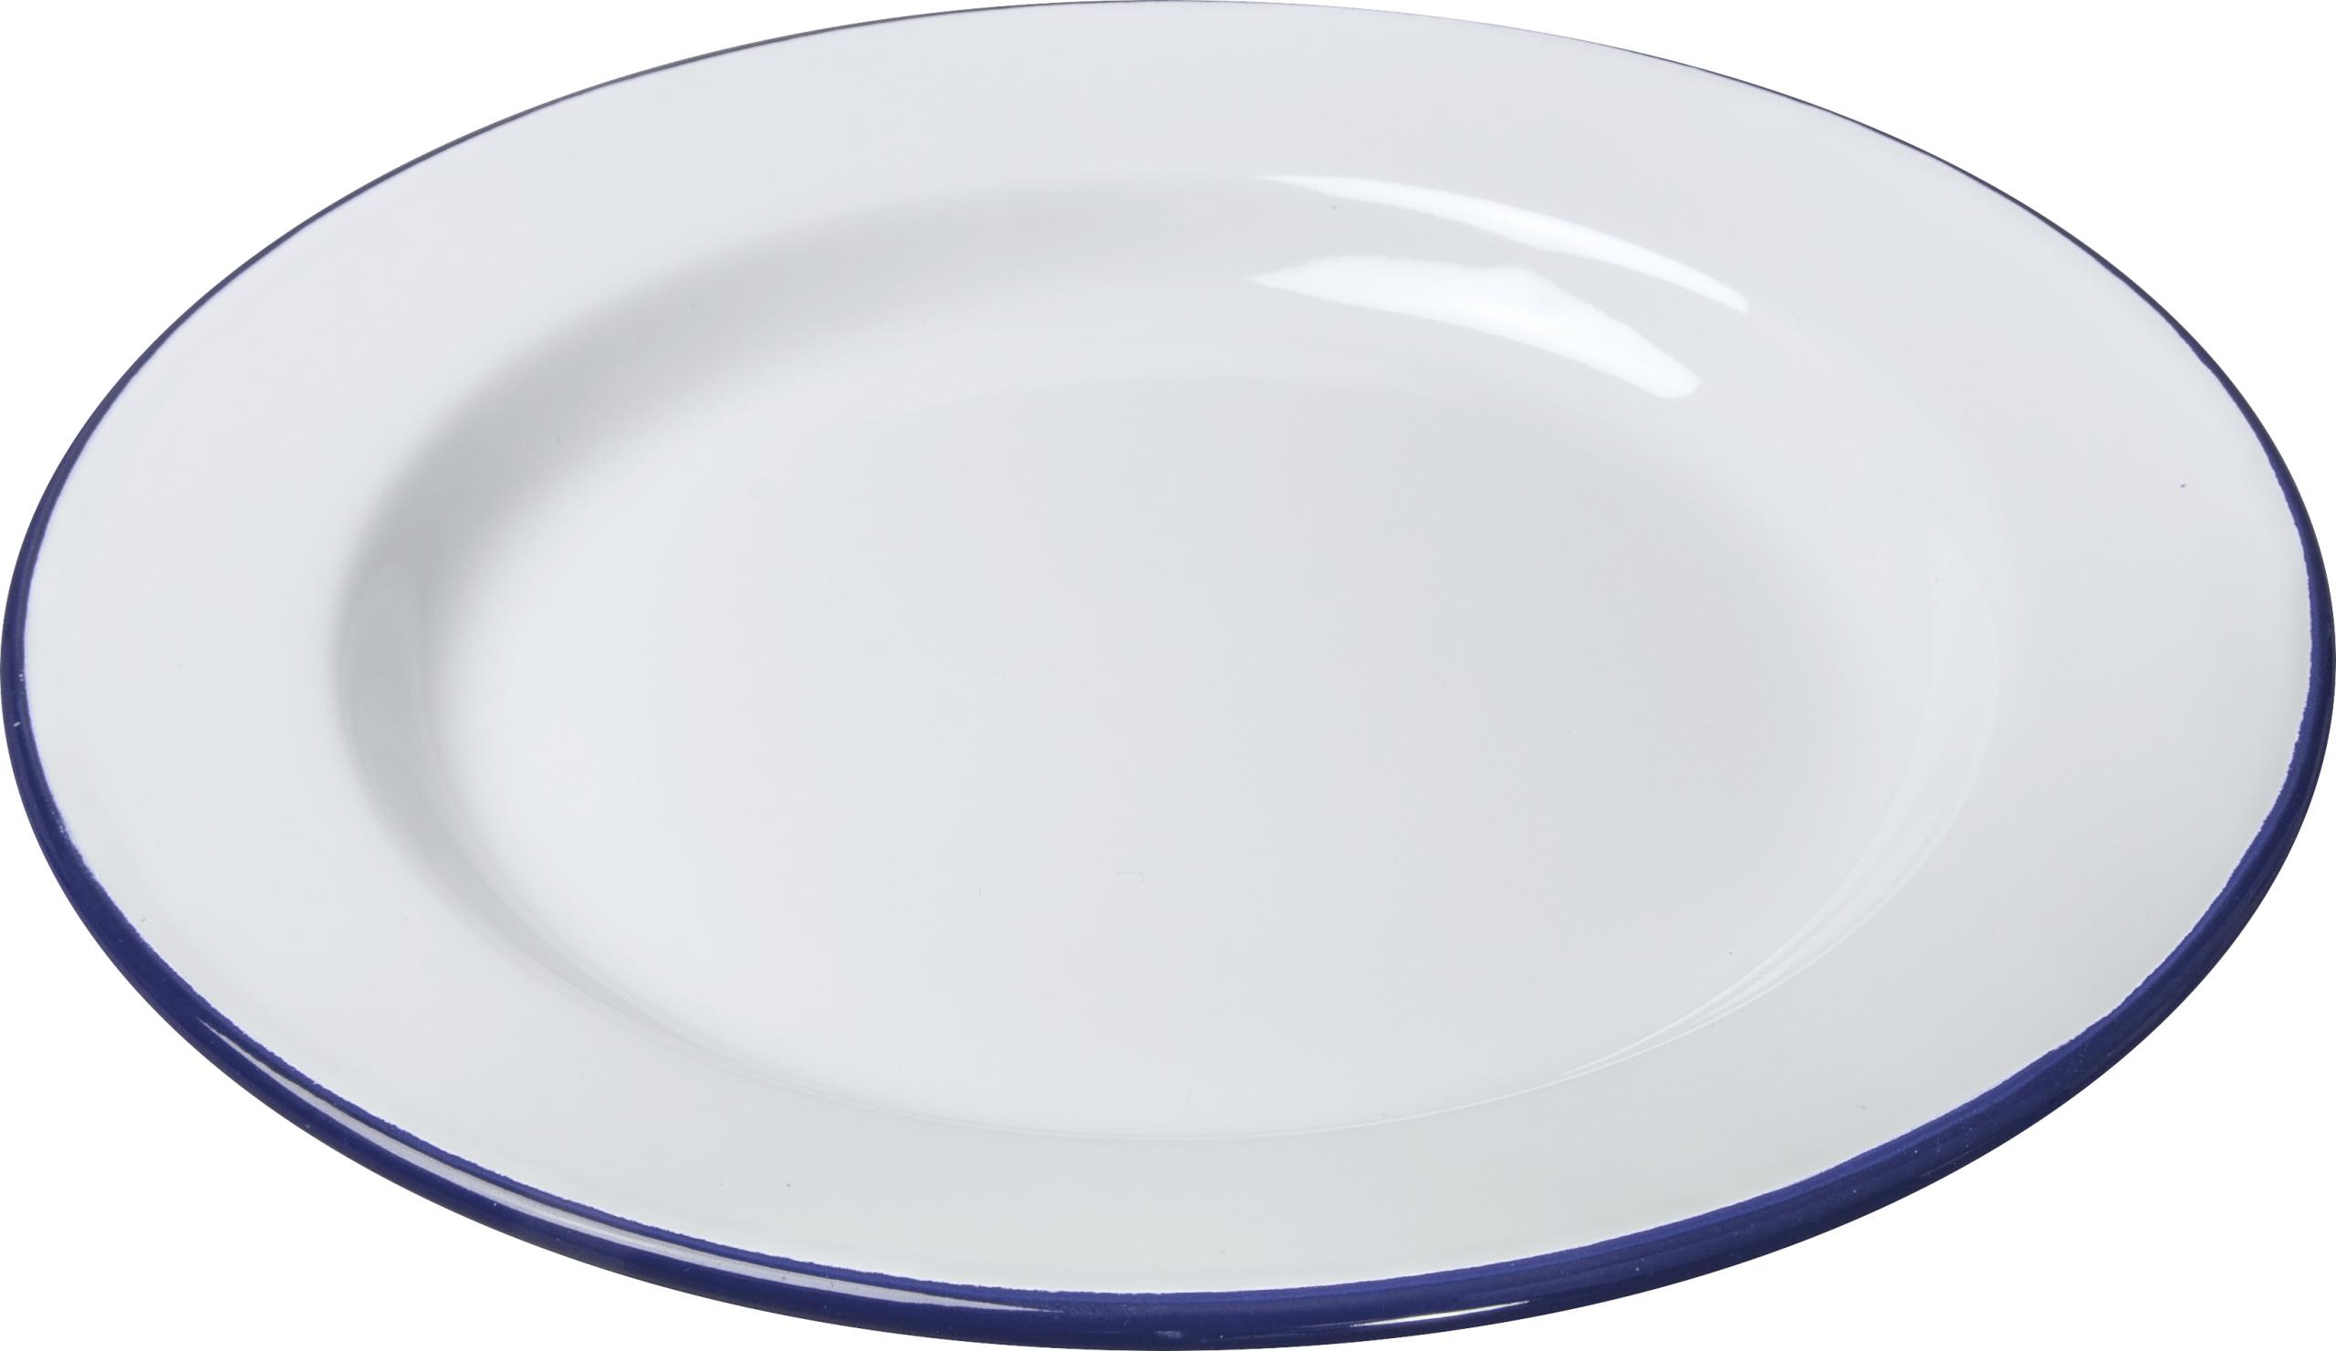
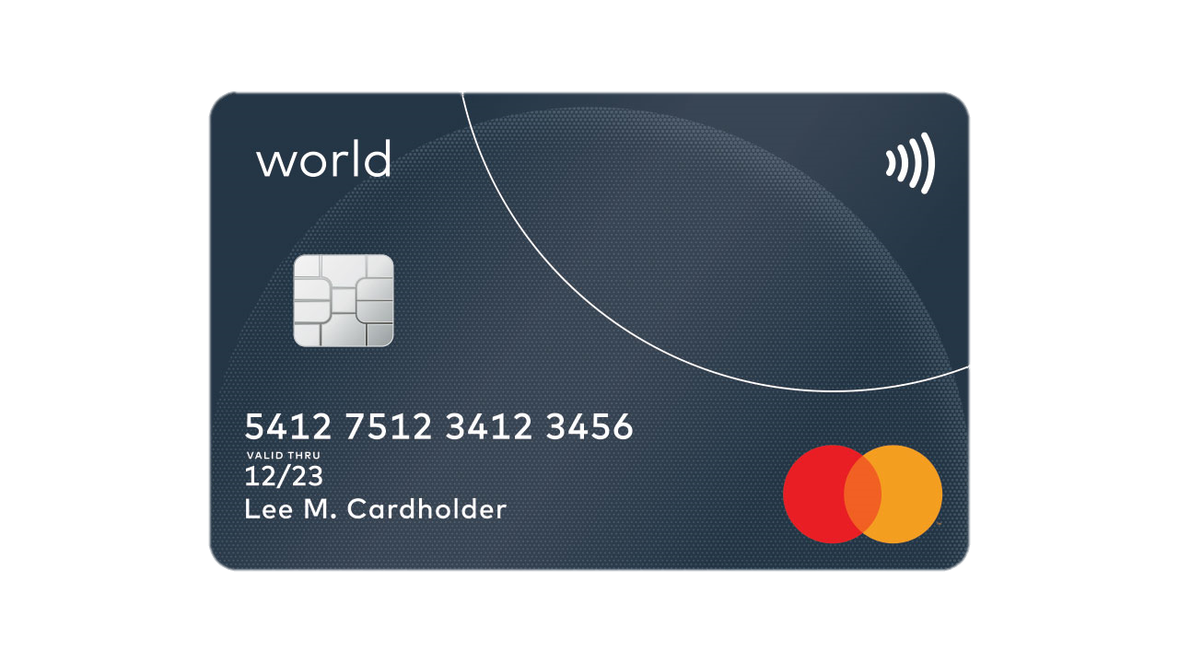
Would You Eat a Credit Card?
An average person could be ingesting approximately 5 grams of plastic every week
(wwf, 2019)

Slide 3
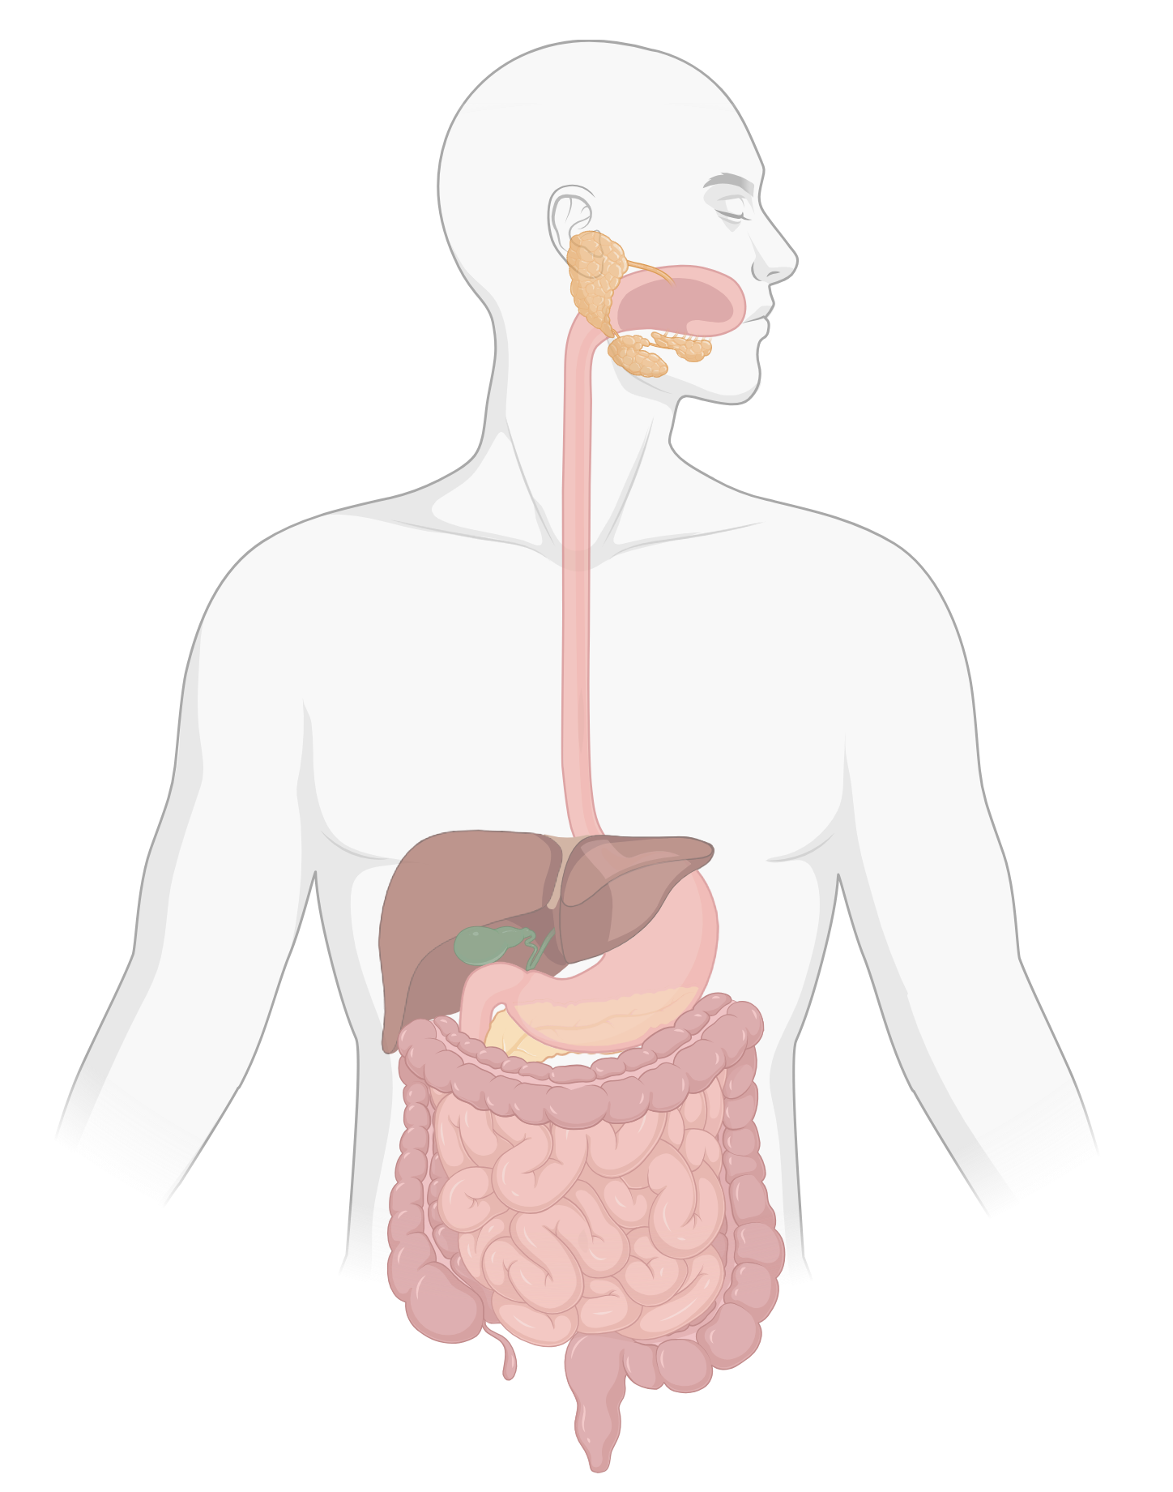
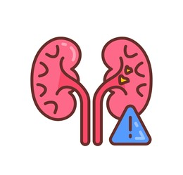


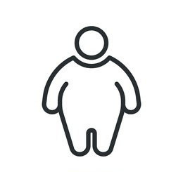


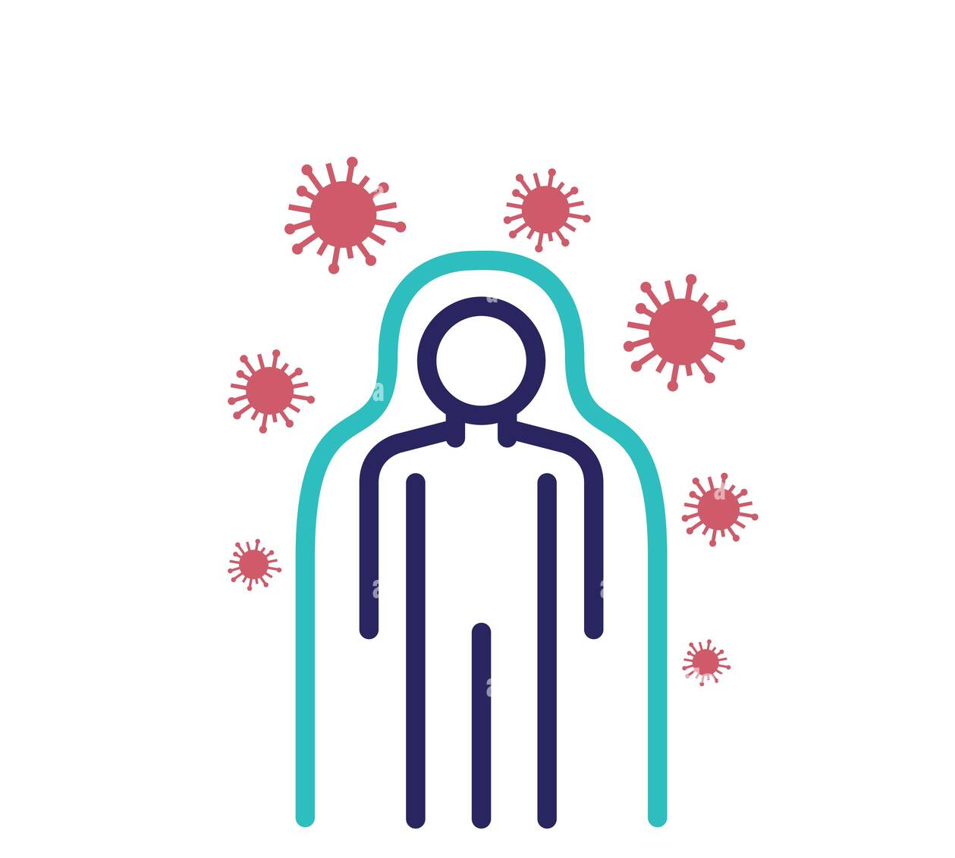



How Does Plastic Enters the Body?
Expose
Toxicity
Ingestion
Inhalation
Organ dysfunction
Metabolic disorder
Immune response
Toxicity
Air
Drink
Skin contact
Food
Facial wash
Food
container
Wound
(Lee et al. 2023)

Slide 4
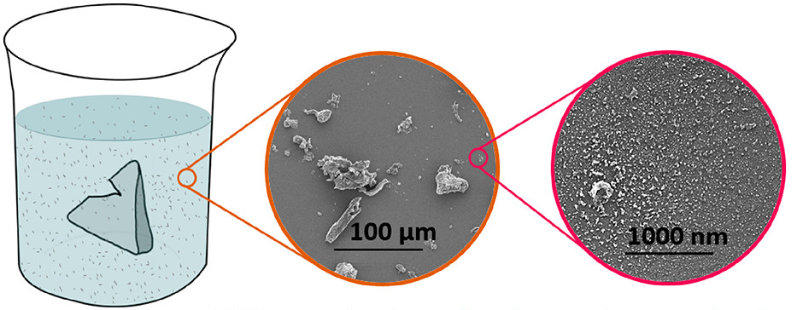
Your Tea May Contain Plastics
Plastic teabag soaked at 95 °C
Microplastics
Nanoplastics
(Hernandez et al. 2019)

Slide 5
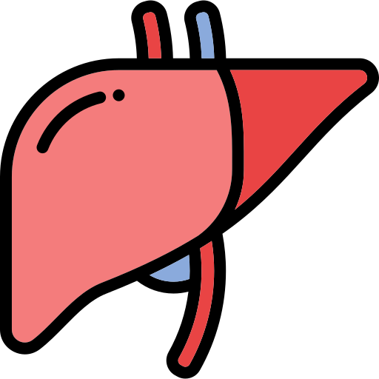


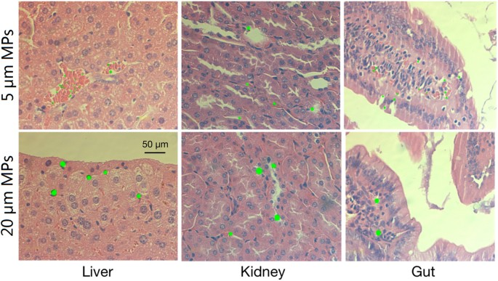
What Damage Can Plastic Cause?
Liver
Kidney
Gut
Plastic
Fig 1. Accumulation of different sizes of Microplastics in mice tissues after exposure for 28 days.
(Deng et al. 2017)

Slide 6
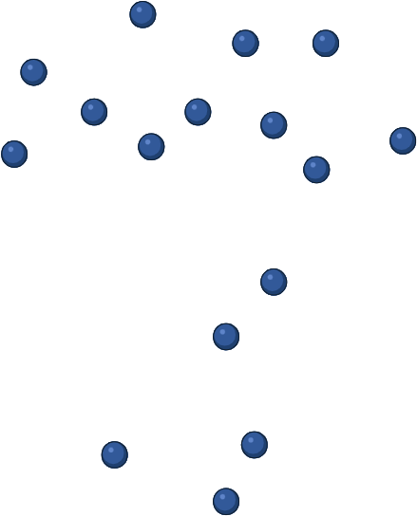

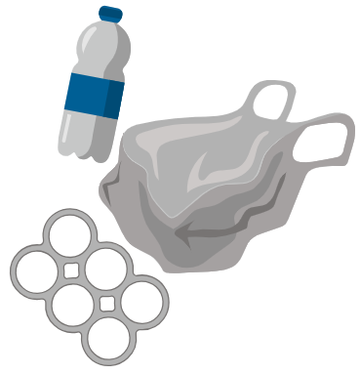

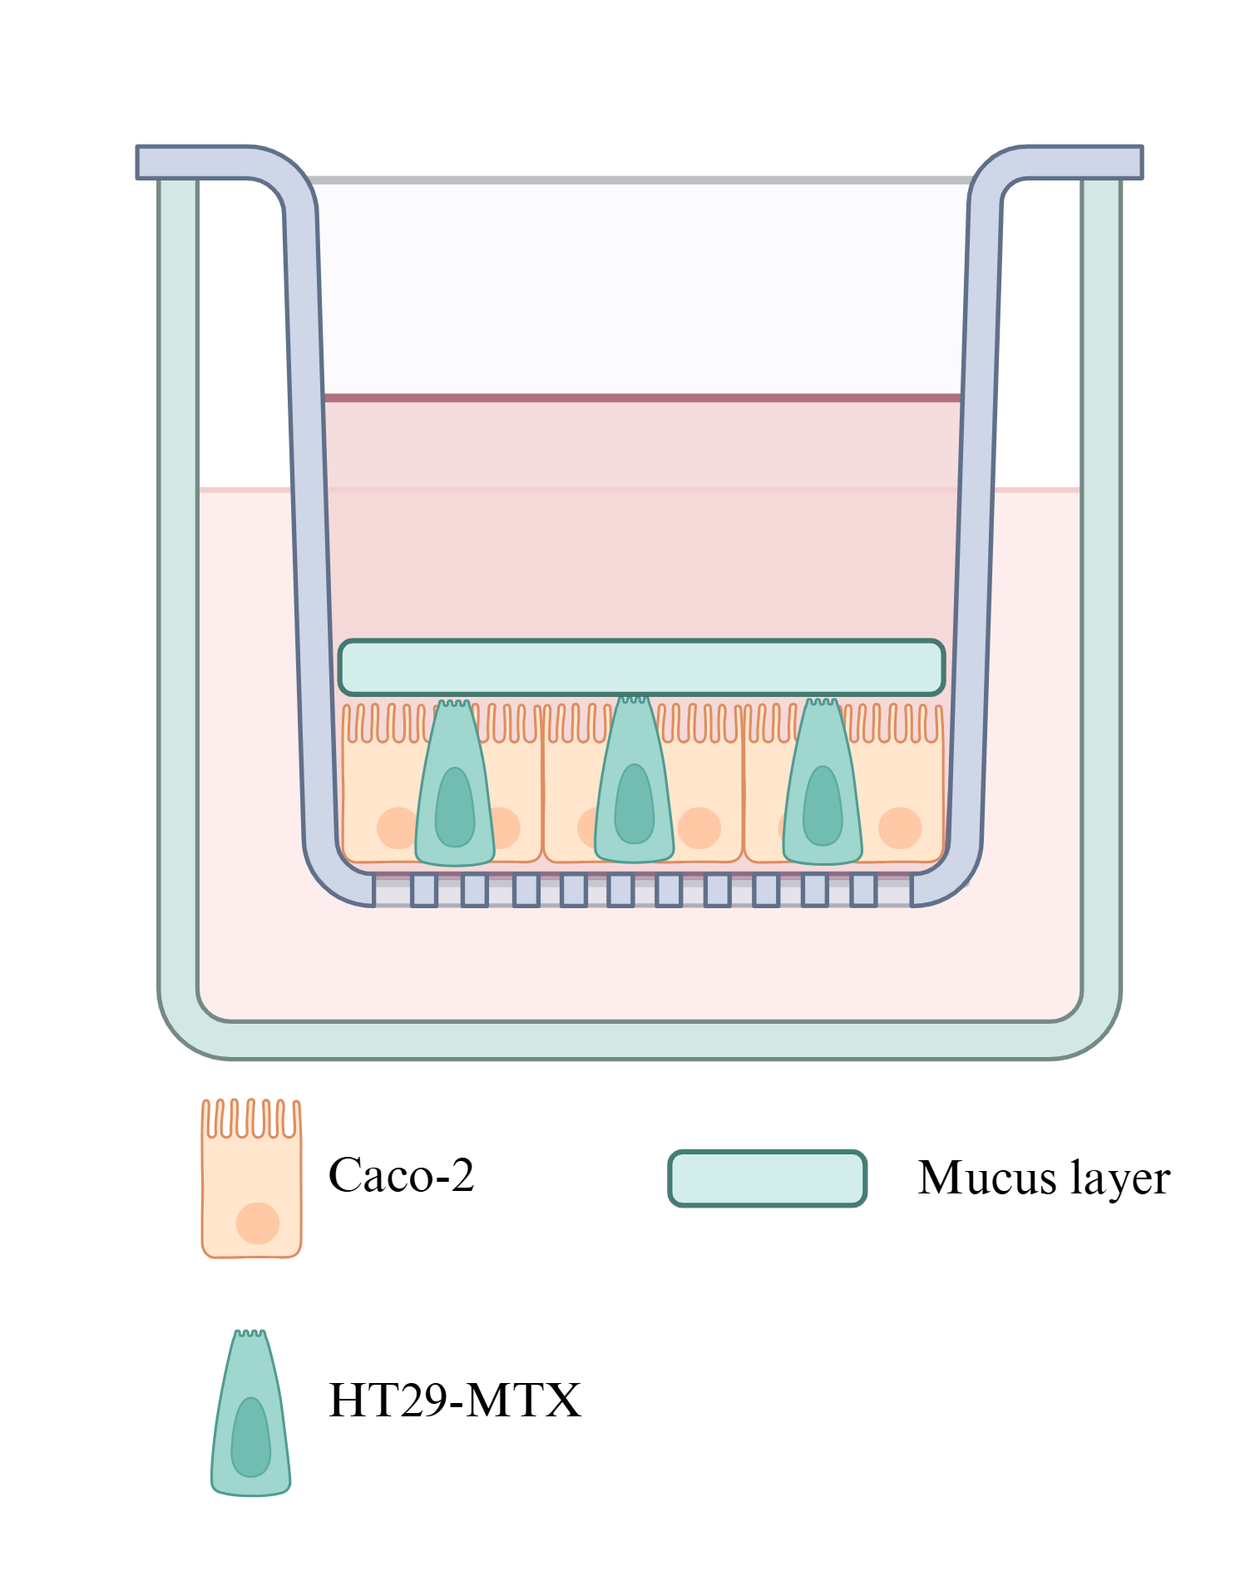

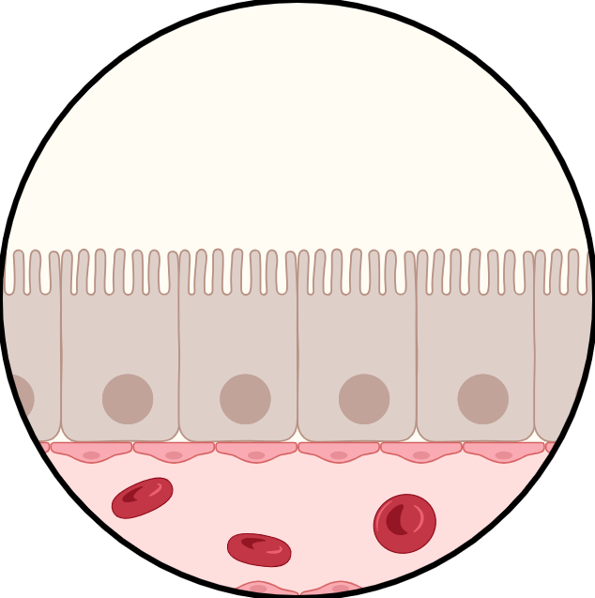

Tracing Plastics: From Gut to Lab
Plastic
Plastic
Plastic
Cell

Slide 7



Cell Viability : Small Plastics are More Toxic than Big Plastics
Live
cells
Dead
Cell
99.39%
18.13%
Figure 2. Cell viability of cells after exposure to microplastics & nanoplastics.

Slide 8



Why This Matters : From Lab to Policy
Protect human health
Set strict food safety standards
Protect future generations
From invisible particles to visible action

Slide 9



Acknowledgement
Thank You!
Mentor:
Dr. Qinchun Rao
Laboratory Team:
Dr. Yaqi Zhao
Aravind Kumar Bingi
Chunya Tang
Asmaul Nupur
Yuefan Yang

