Slide 1


Saptarsi Mitra
Department of Biological Science &
The Program in Neuroscience
From Smell to Appetite: Linking Odors with Feeding Circuits
The Office of Postdoctoral Affairs
The Graduate School | Florida State University

Slide 2


Feeling hungry?

Slide 3
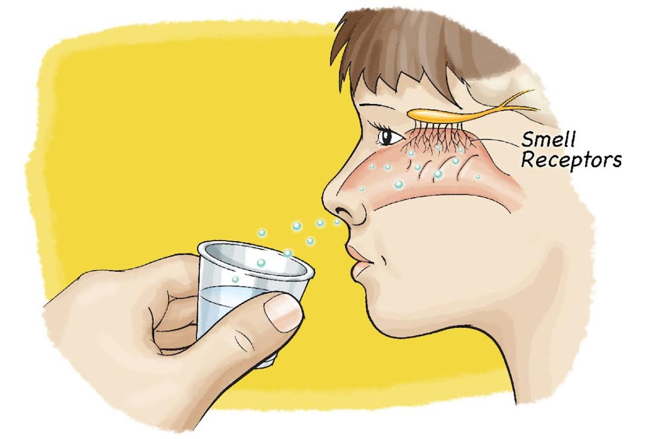
How Smell Works
• Air carries odor molecules into the nose.
• Olfactory epithelium has sensory neurons that detect odors.
Notes:
When we breathe in, air carries odor molecules into our nose. Inside the nose, we have a thin sheet called the olfactory epithelium. This has special sensory neurons that detect odors. Think of these neurons like little antennas, tuned to pick up different smells around us.”

Slide 4
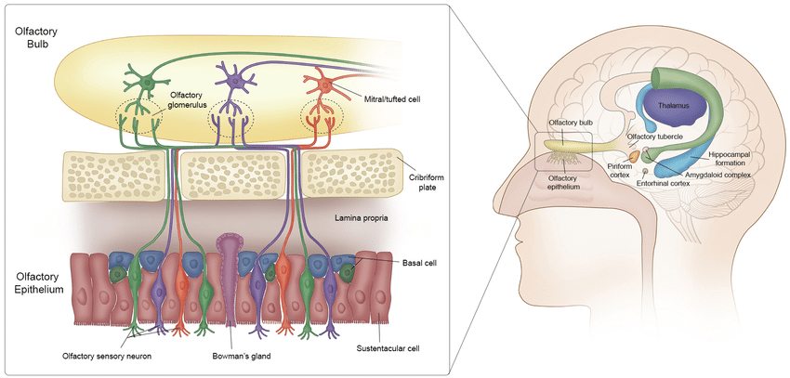
Odor information passed to the brain
Smell molecules are detected in the nose and passed to the olfactory bulb, which then sends the information to other parts of the brain.

Slide 5


Smell and Feeding
• Odors influence appetite and food choices.
• The brain links smell with hunger and satiety signals.
• Strong odors can make us hungry or lose appetite.

Slide 6
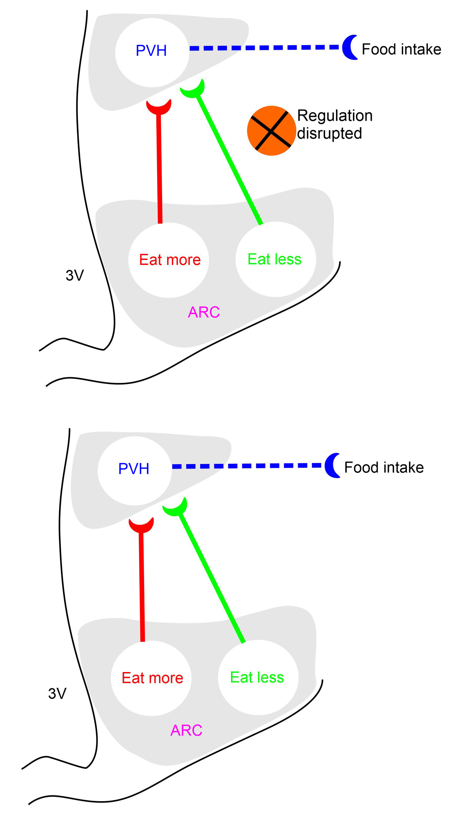
Hypothalamic control of feeding
Arcuate nucleus (ARC) contains two key neuronal groups:
Orexigenic → Eat more.
Anorexigenic → Eat less
ARC neurons project to the Paraventricular Nucleus (PVH) to control how much we eat.

Slide 7
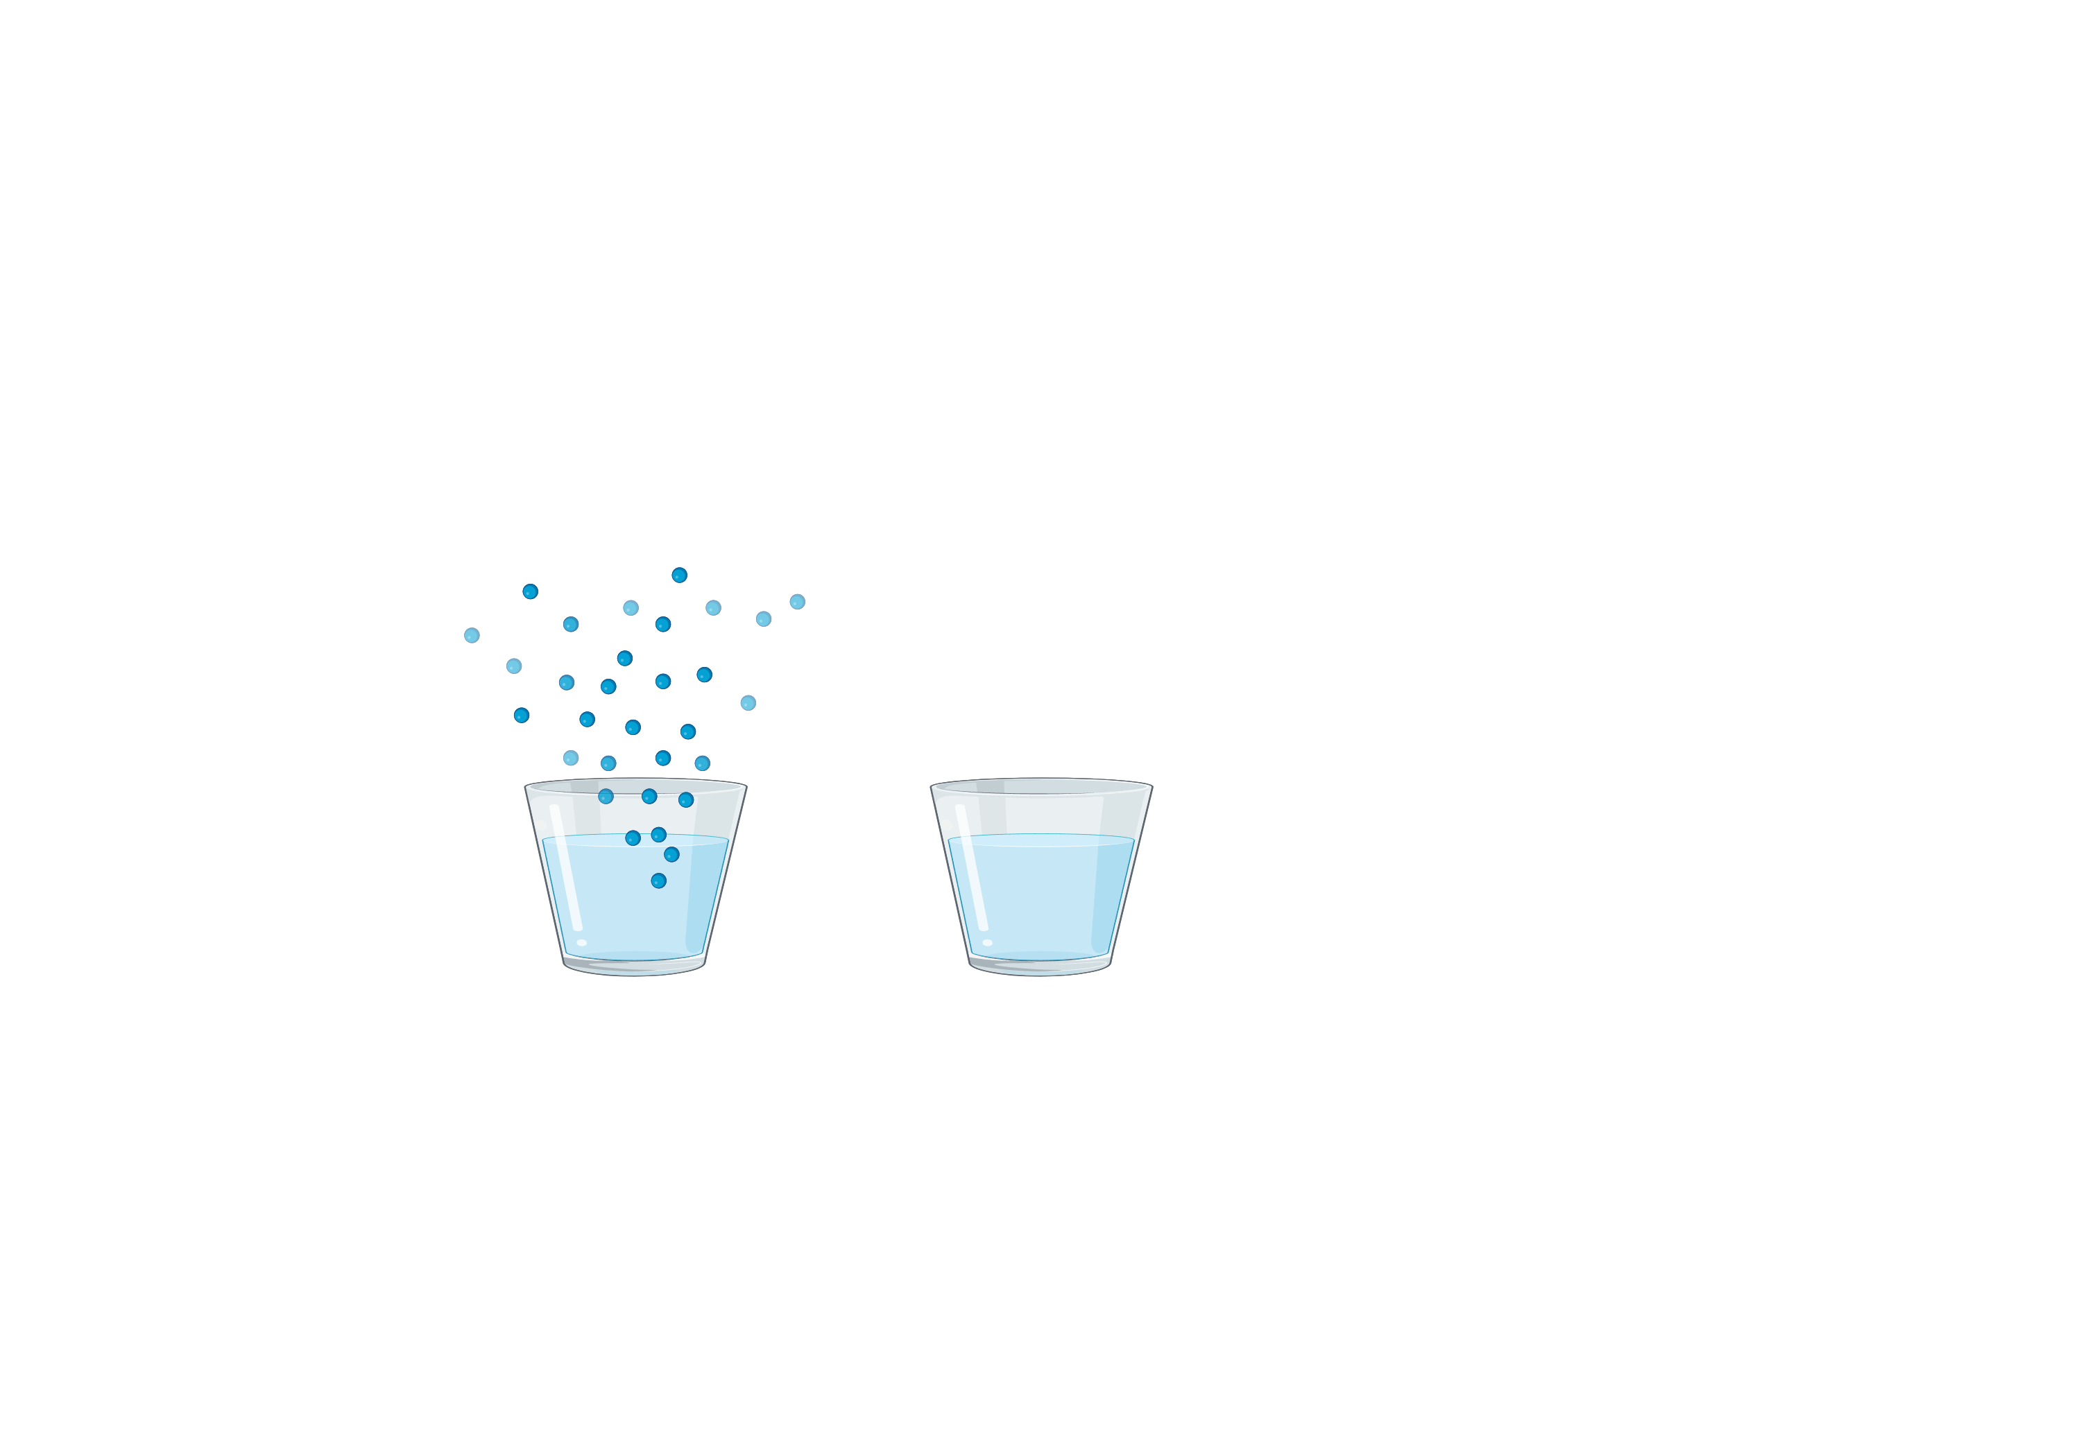
Odor chamber
Food odor

Slide 8
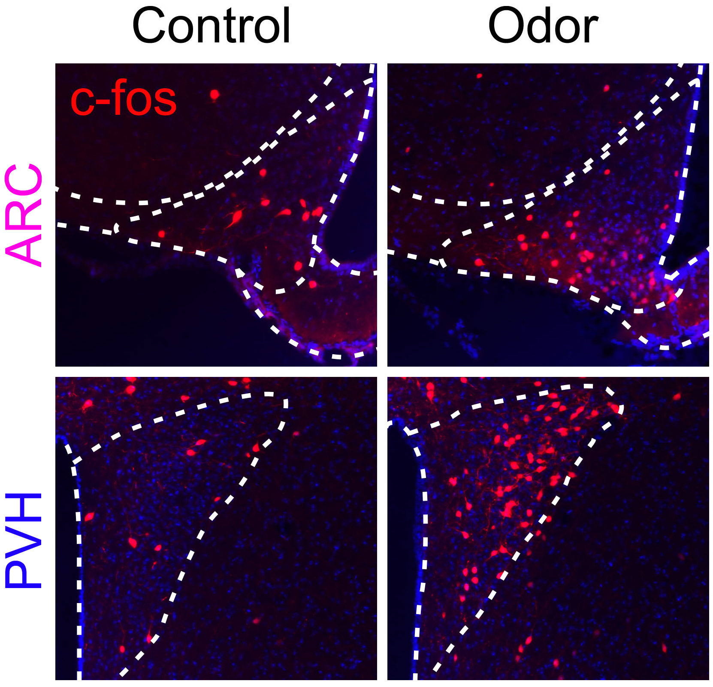
Odor engages feeding circuits
c-Fos: A Window into Brain Activity
• c-Fos is a marker of recently activated neurons.
• When neurons respond to odors, they express c-Fos.
• Used in my research to study odor-driven feeding circuits.

Slide 9


Can diet influence brain activity?

Slide 10
High fat diet makes us eat more

Slide 11
Food odor causes more anticipatory drive towards eating in high fat fed animals
High anticipation for food!

Slide 12

Thank you

