Slide 1


Anirudh Lakshmi Narasimha Prasad
Department Mechanical and Aerospace
Engineering
Taming Jet Roars with Tiny Lightening Zap
The Office of Postdoctoral Affairs
The Graduate School | Florida State University

Slide 2
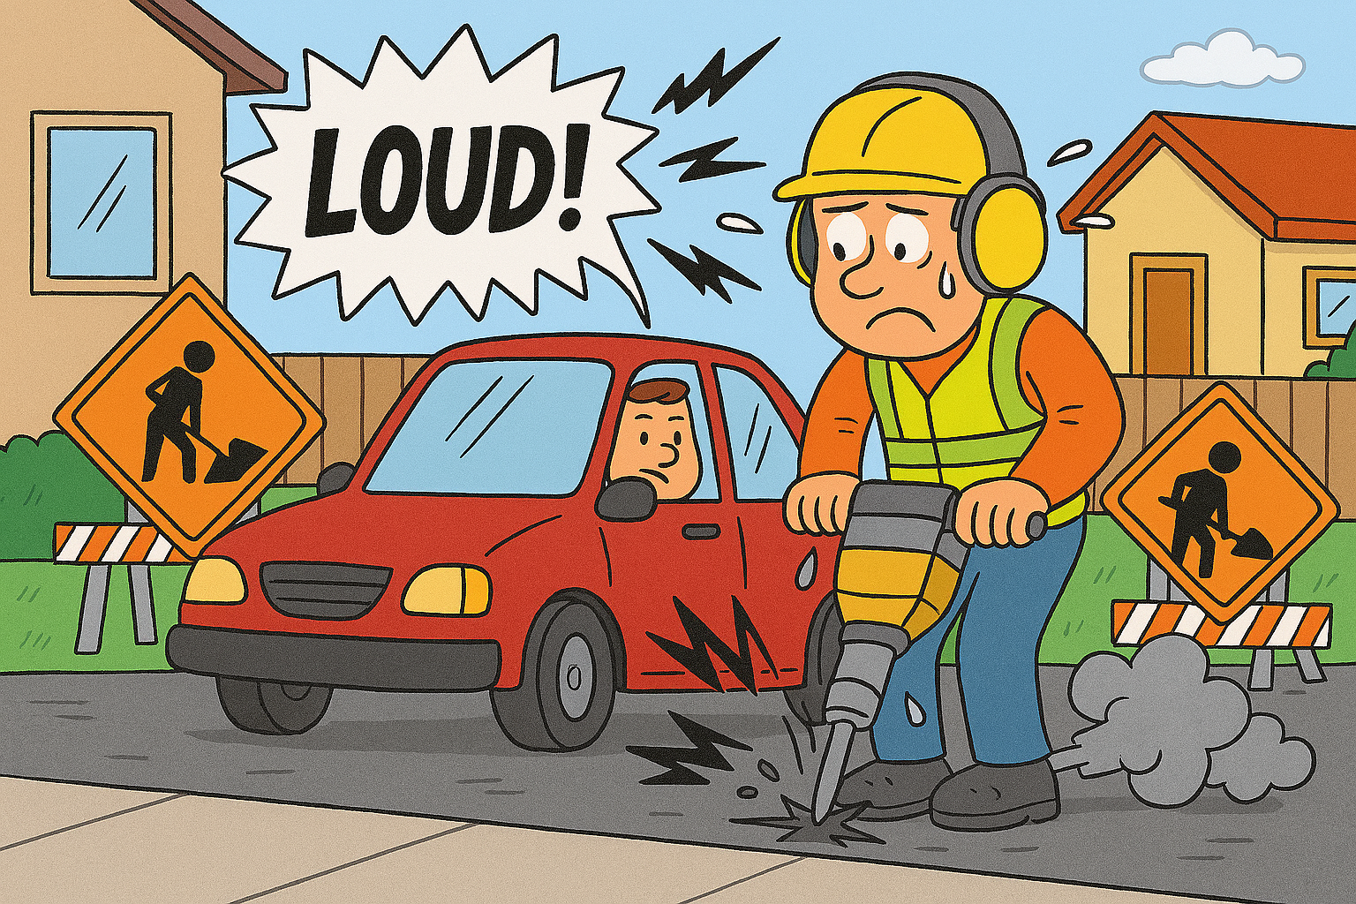
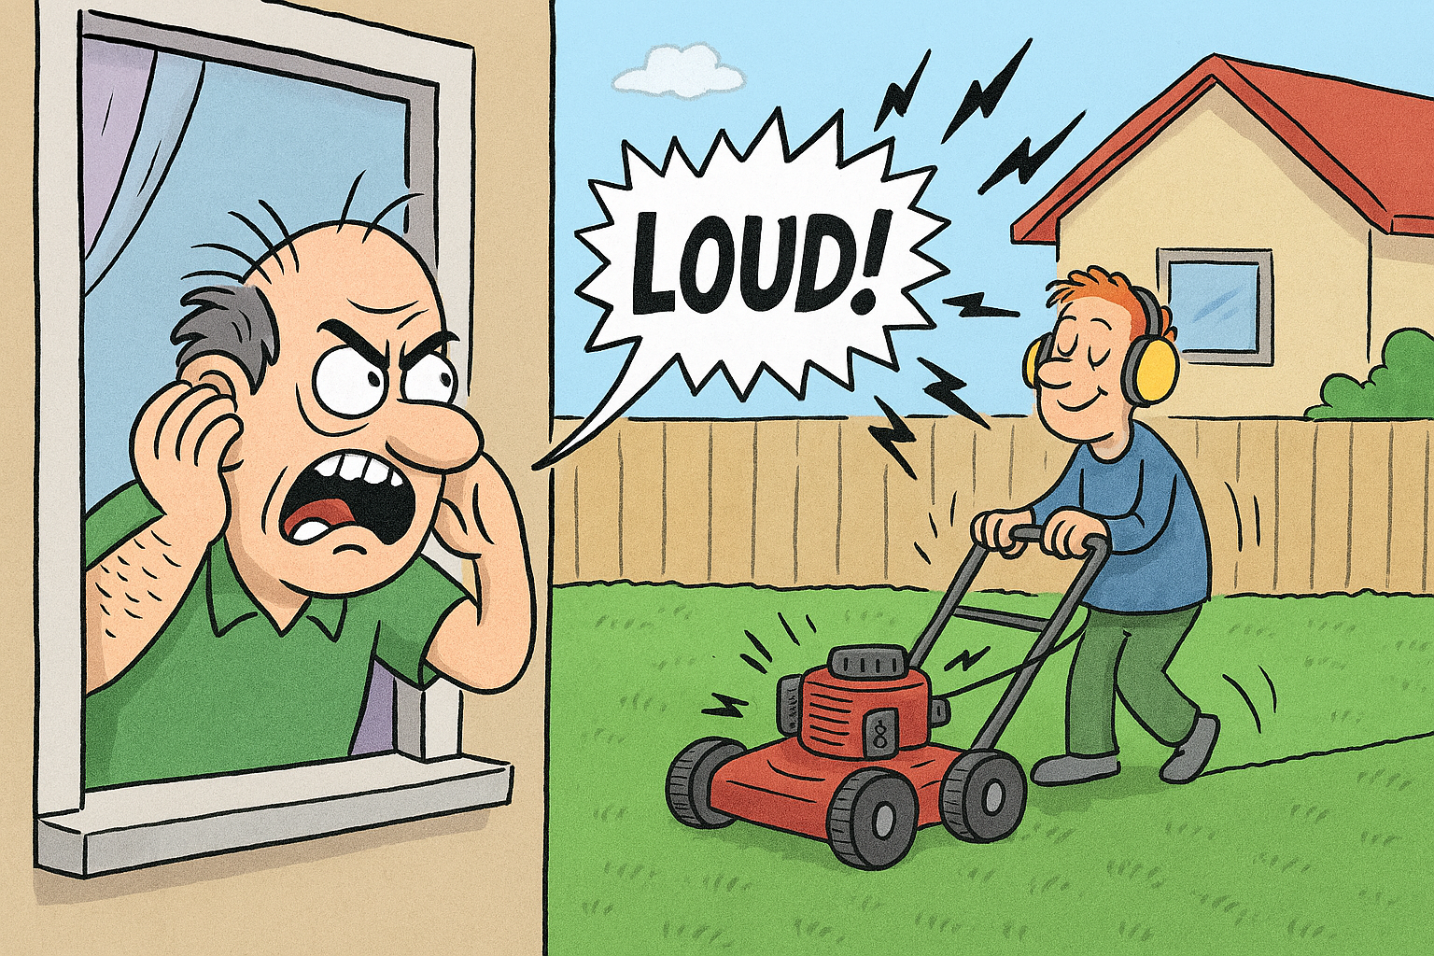
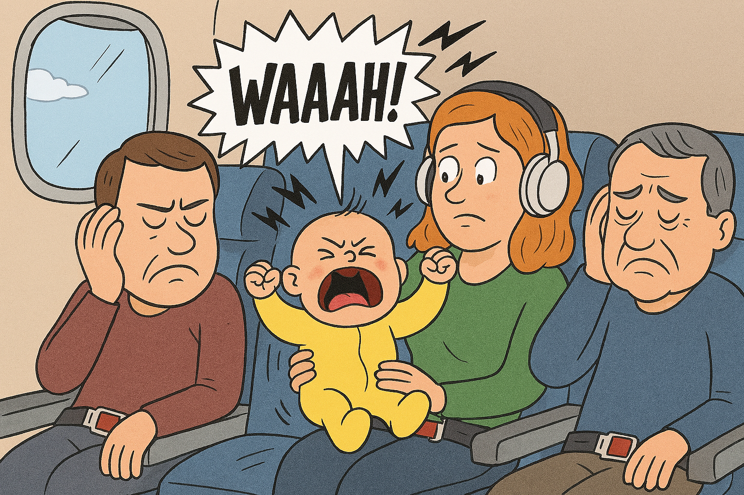
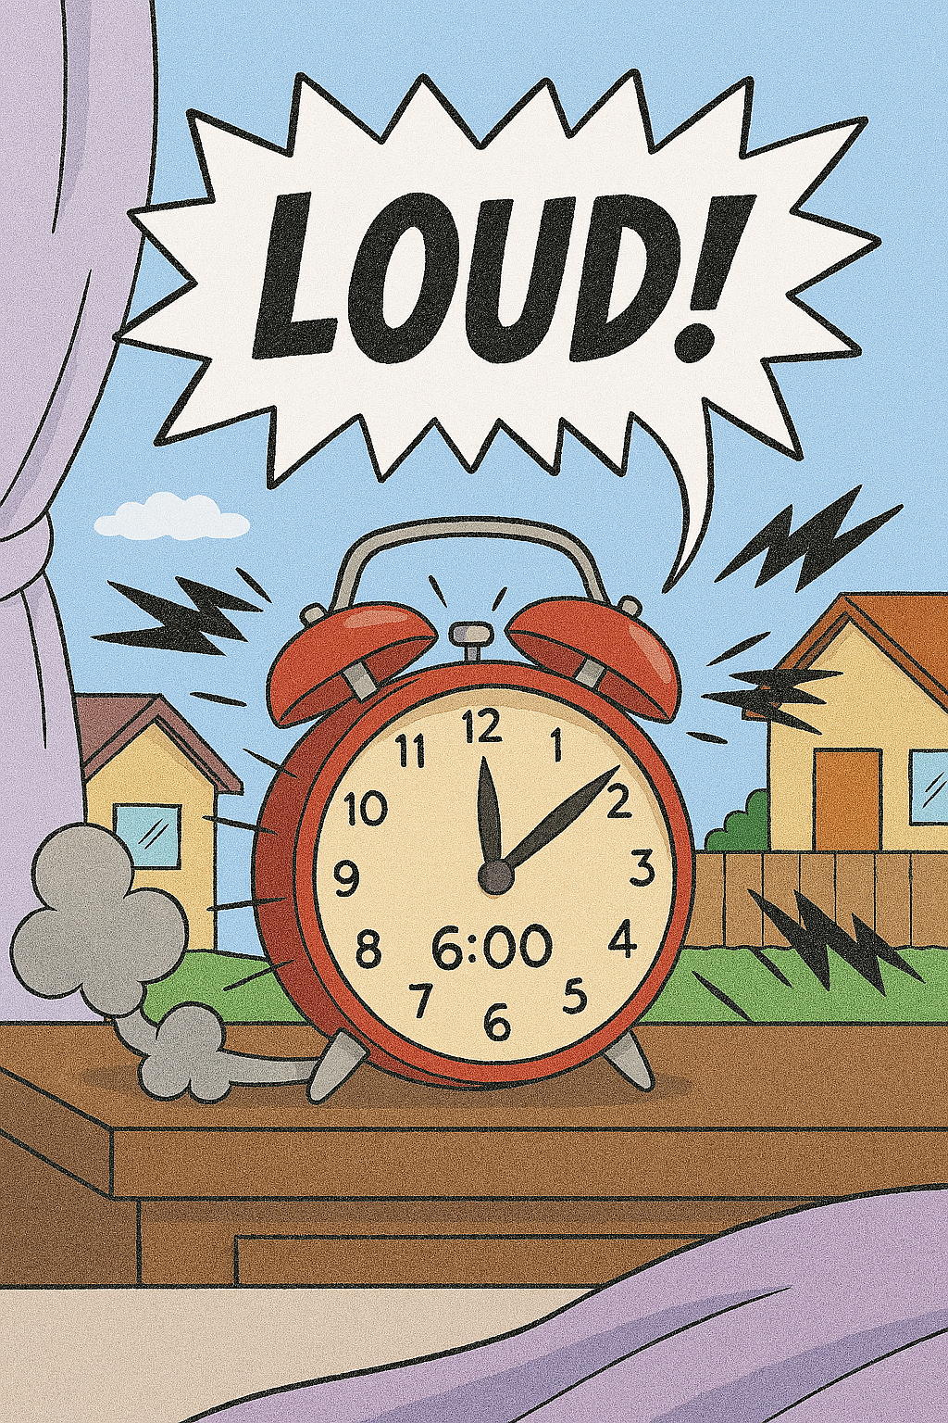
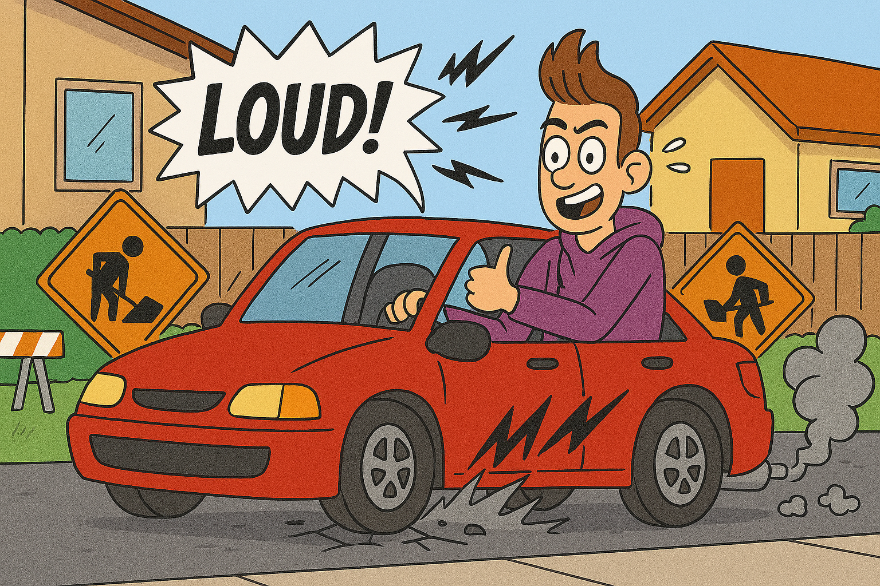
NOISE

Slide 3
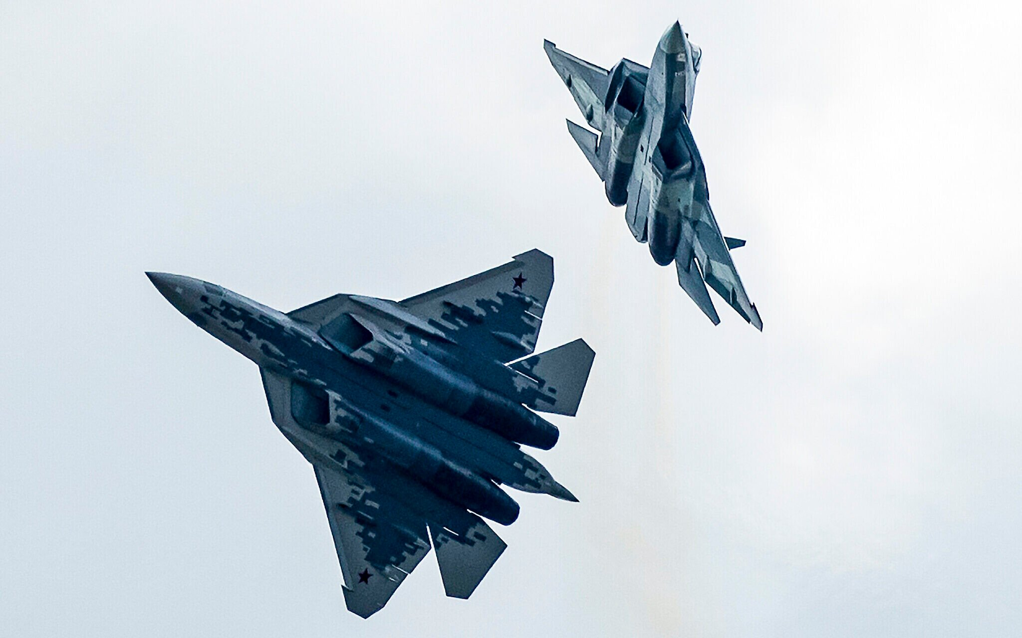
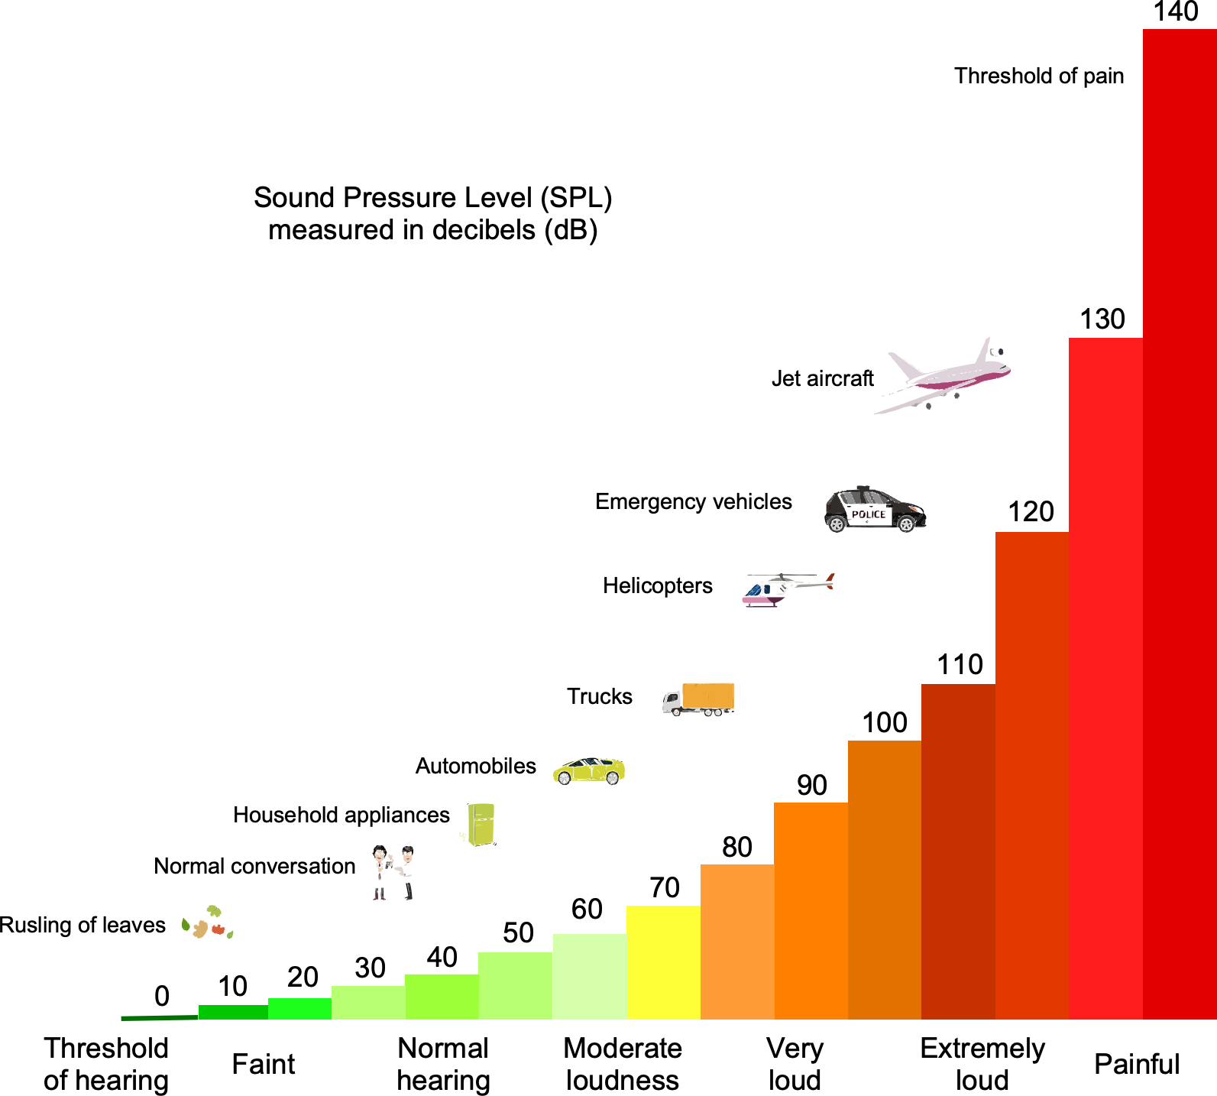
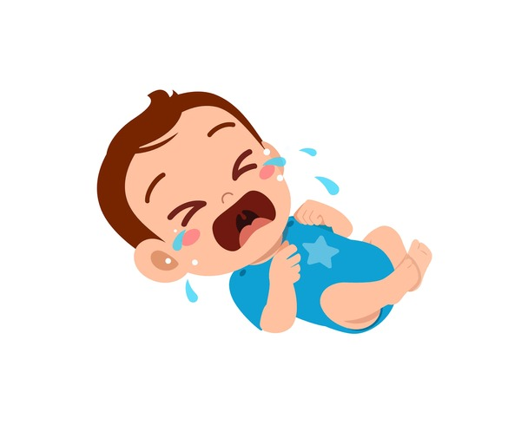
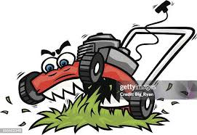
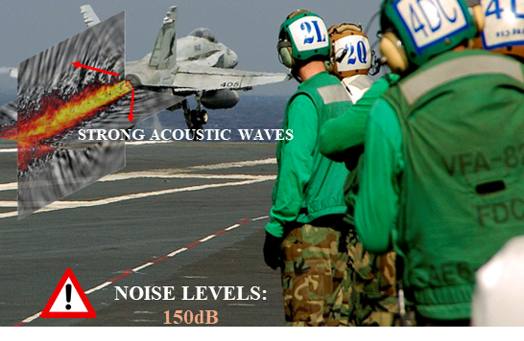
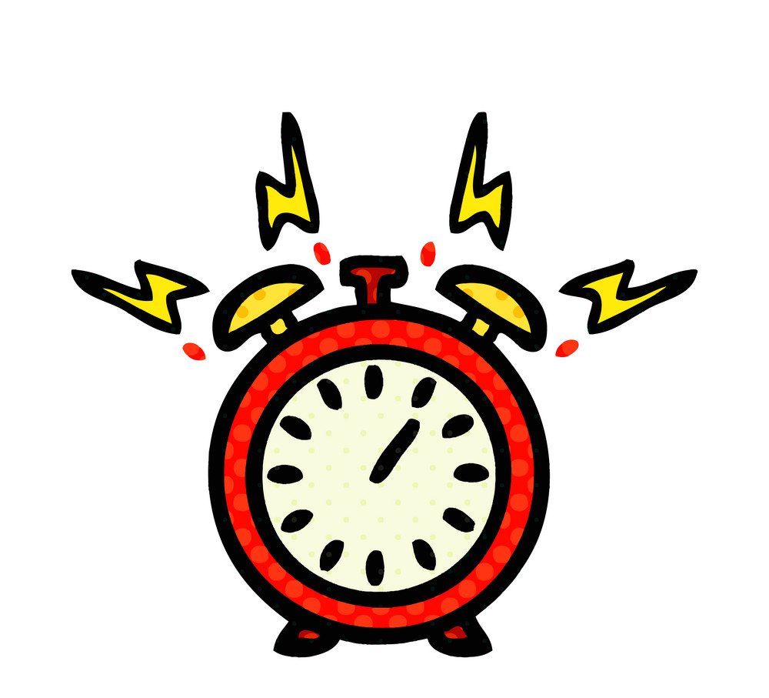
Military jets be screaming!!
Permanent
hearing loss
150dB
Harmful to the brave people working around these beasts.
Annoys people living near airports = Protests
Military jets are so loud it’s like a hundred lawnmowers and every car alarm in the neighborhood decided to start a band in your backyard.
Objective: Reduce noise emission from these jets

Slide 4
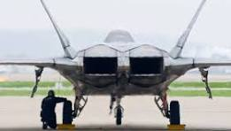
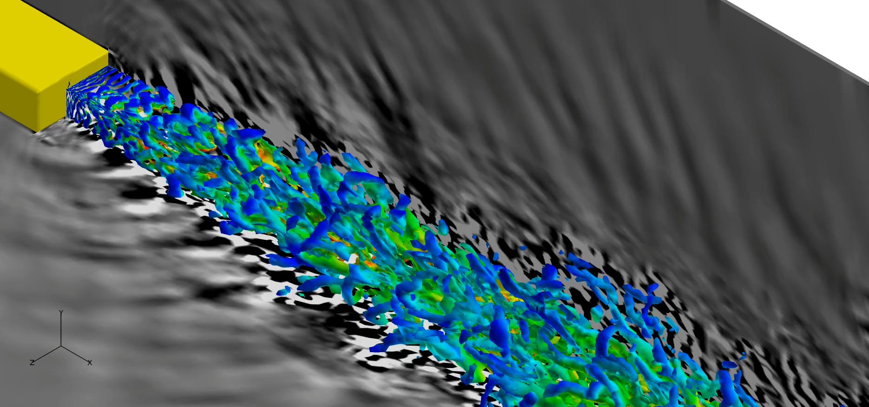


Know Them Before We Shush Them
Next best thing: Simulate a jet
$143 million
CFD = Computational Fluid Dynamics gives a “Computerized Jet-in-a-Box”
We simulate jet flow and noise on a supercomputer by solving equations which are so long and complicated that I cannot fit them in one slide. (Ignorance is bliss!!!)
Let's us test ideas safely → no fried grad students
F22 – Raptor
Noise
Me: Broke Post doc on 50k salary
MORE CHAOS = MORE NOISE
Fluid flow (Chaos)

Slide 5
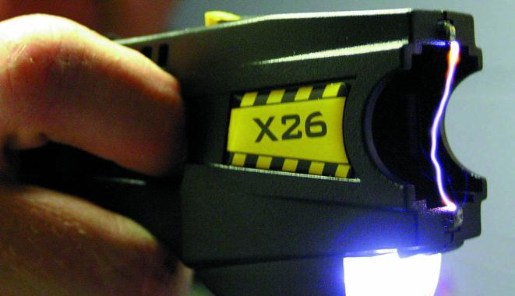
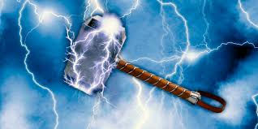
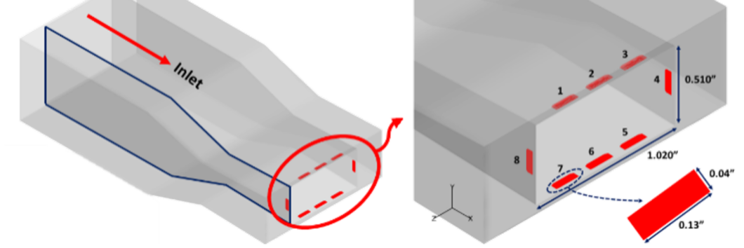
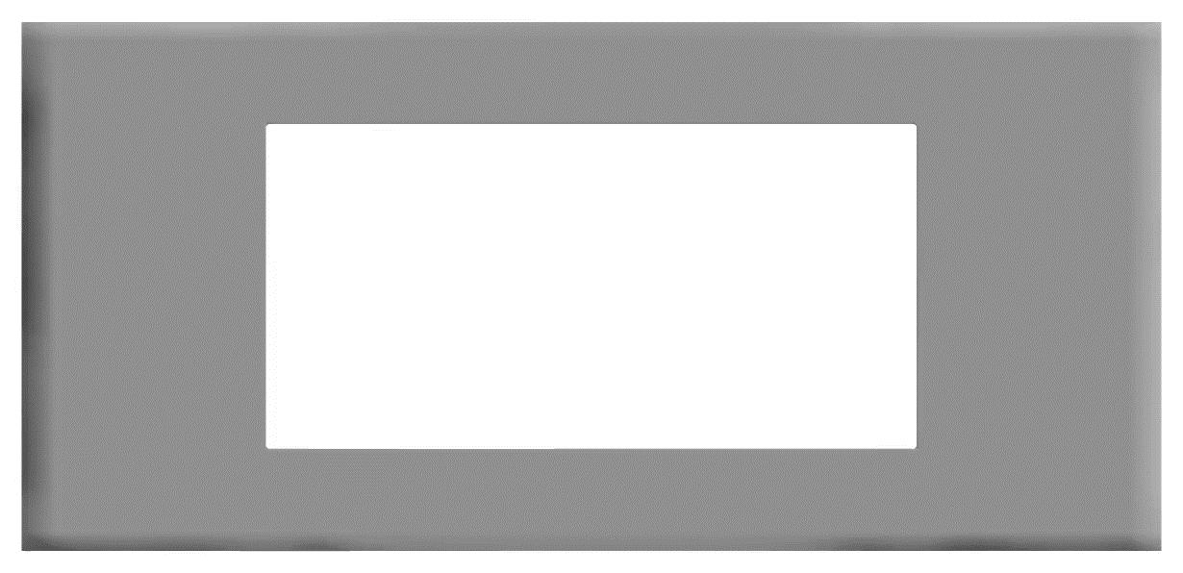
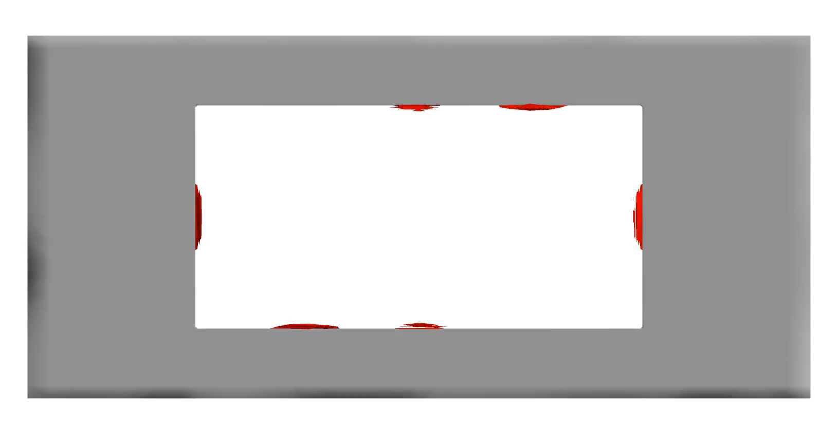
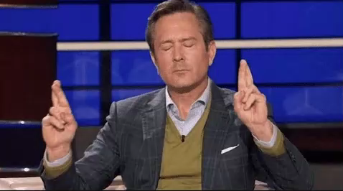
How to control this chaos?: Zap the jet with lightning
Tiny tasers or Thor’s hammers
They nudge chaos into rhythm → less noise
L
A
F
P
A
High voltage
ocalized
rc
Electrodes
ilament
Lightning Arc
lasma
Plasma (Super charged hot gas)
Placed 8 zappers around our rectangular jet
Tried several combinations of zapping
Hope they control the jet’s tantrum
ctuators

Slide 6
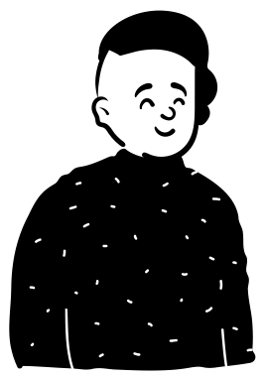
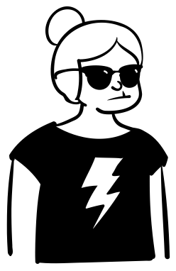
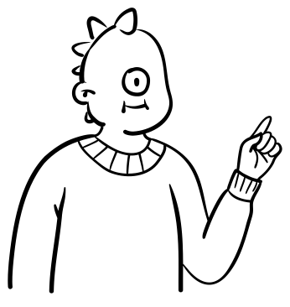
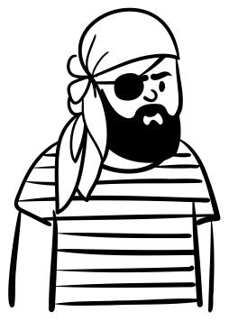
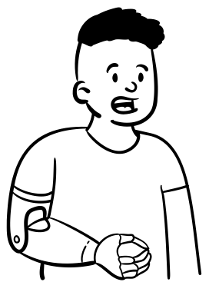
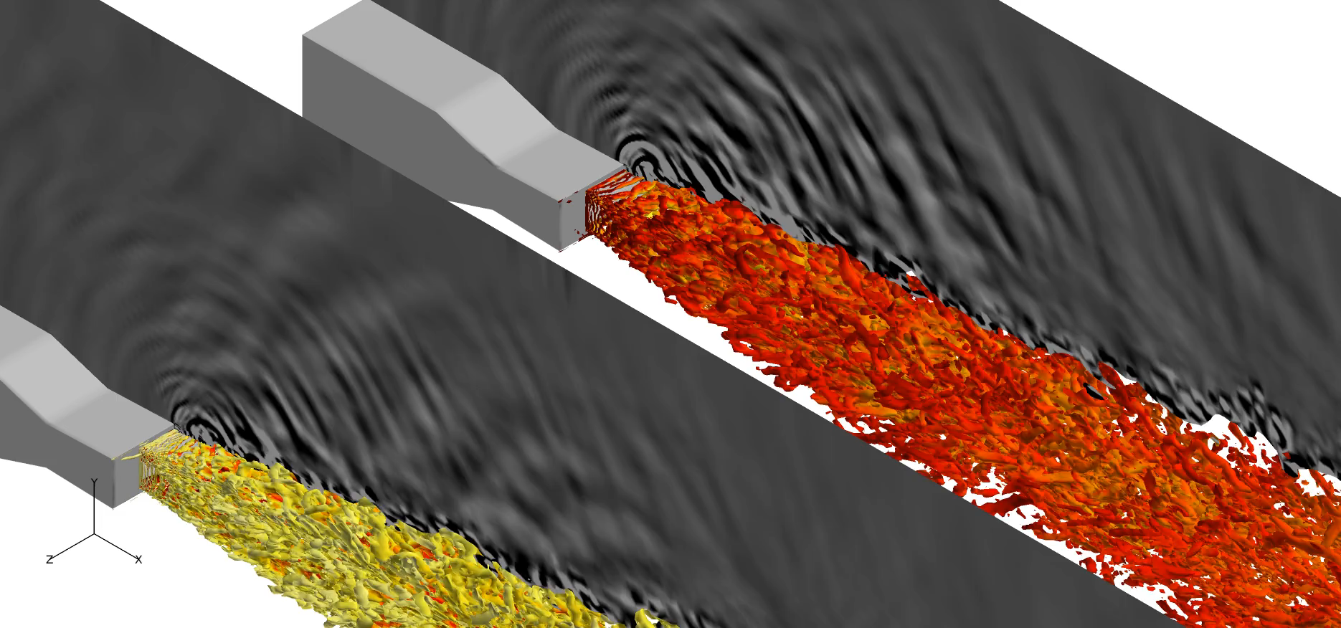
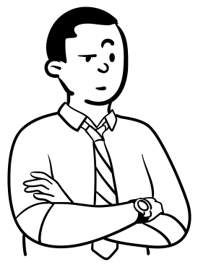
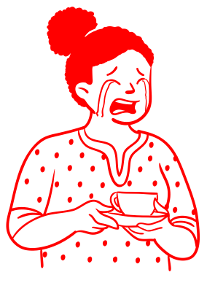
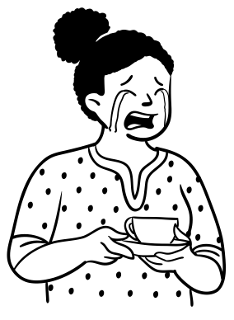
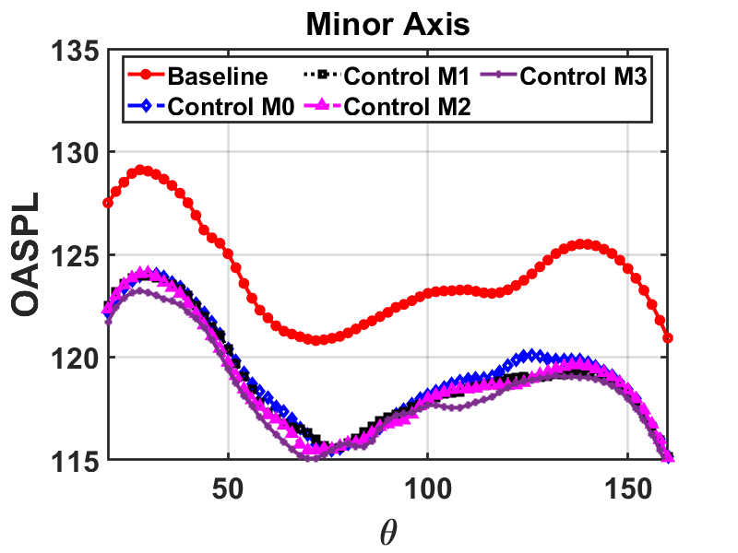
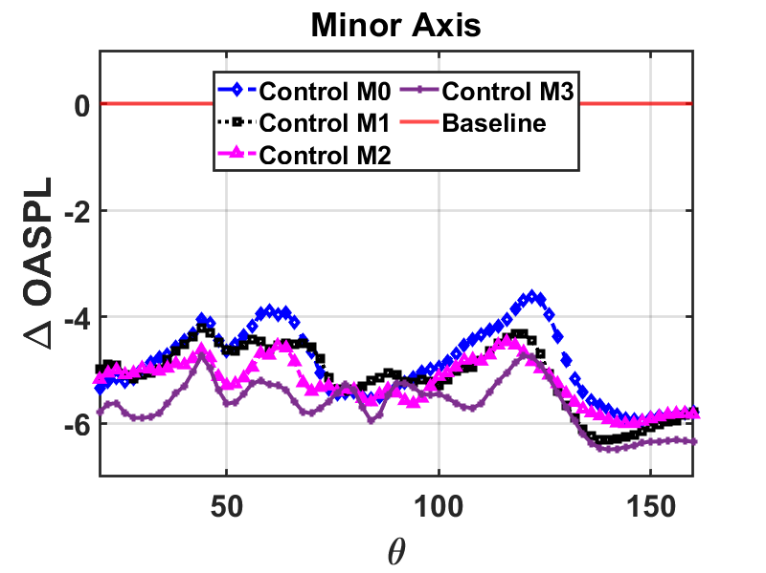

Did it work?
Controlled
90^{O}
AAAAAAH!!!
160^{O}
AAH!!!
r = 40D_{eq}
0^{O}
Noise went from AAAAAAH to AAH.
Noise levels vary based on the observer location.
Peak noise levels is observed just adjacent to the direction of jet flow.
Our best forcing sequence gave 6dB reduction in noise levels.
That is an equivalent difference between noise from a busy highway to the noise from regular human speech.
Change in noise levels with control
Noise_{baseline} - Noise_{controlled}
Noise variation with angle
No control
-6dB
With Control

Slide 7


If none of that made sense here is what you should take away!
Jets = Rowdy toddlers (lots of energy, no direction, extremely noisy)
LAFPAs = Adult supervision (nudge chaos into rhythm to make them less noisy)

Slide 8

ಧನ್ಯವಾದಗಳು
ಧನ್ಯವಾದಗಳು

