Slide 1

Postdoctoral and Doctoral Extramural Grants Workshop
Sponsored by the Office of Postdoctoral Affairs,
the Office of Graduate Fellowships and Awards, and the VP for Research
Debra Ann Fadool
and Keith McCall

Slide 2
Speakers YESTERDAY –
Debi Fadool – Overview of Strategies
Kay Jones – United States Department of
Agriculture (USDA)
Alan Spector – Biomedical Grantsmanship and the
NIH R01 Grant Proposal
Lara Perez-Felkner – NAEd/Spencer and AERA fellowships
Anasa Hicks – Best Grant Practices for Humanities
Proposals
Keith McCall – Newcombe, ACLS/Mellon, Fulbright
PEER Mentor Networking – Introduced during
Writing workshops, Part II and III.

Slide 3
Speakers TODAY –
Debi Fadool – Overview of Strategies
Jim Fadool – NIH F31, F32 NRSA
Hengli Tang – NIH R03 and R21
Linda Rinaman – NIH K99/R00
Beth Stroupe – American Heart Association (AHA)
Emily Moriarty-Lemmon – NSF GFRP and NSF Postdoctoral
Fellowship
PEER Mentor Networking – Introduced during
Writing workshops, Part II and III.

Slide 4
What they intend to tell you!
What is the eligibility?
What are the application components?
Are there supporting documents that are required?
How much preliminary data are required? And how much has to be generated by you?
What are common mistakes in designing your first grant application?
How long is the grant award, if funded? What is provided?
What is a pre-proposal? Is there an oral interview? What is current success rate?

Slide 5
Why Should You Design a Grant AND Submit it?
Being able to express your idea is pinnacle as a postdoctoral scholar or doctoral researcher.

Slide 6
The Idea

Slide 7
Why Should You Design a Grant AND Submit it?
Being able to express your idea is pinnacle as a postdoctoral scholar or doctoral researcher.
Having a planned roadmap of your proposed work that has been rigorously examined by many individual experts that have provided feedback to you – will save you time!

Slide 8

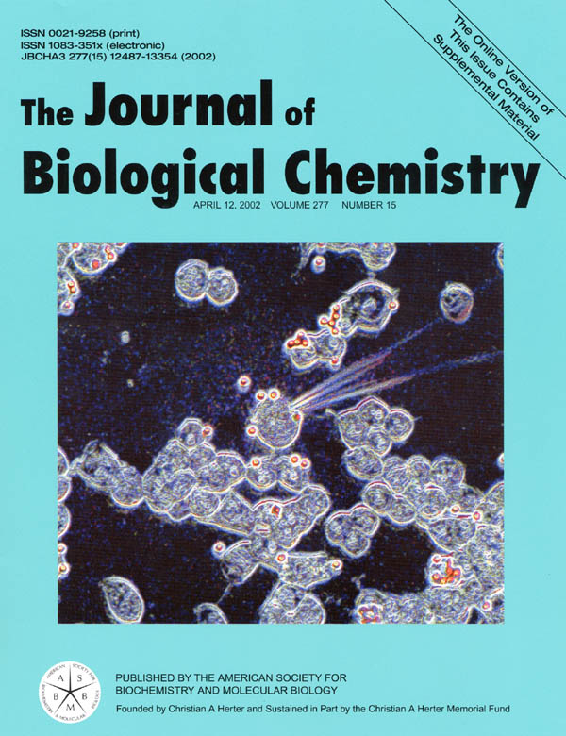
The Road Map

Slide 9
Why Should You Design a Grant AND Submit it?
Allows an intense thinking period for you to devise the best research.

Slide 10
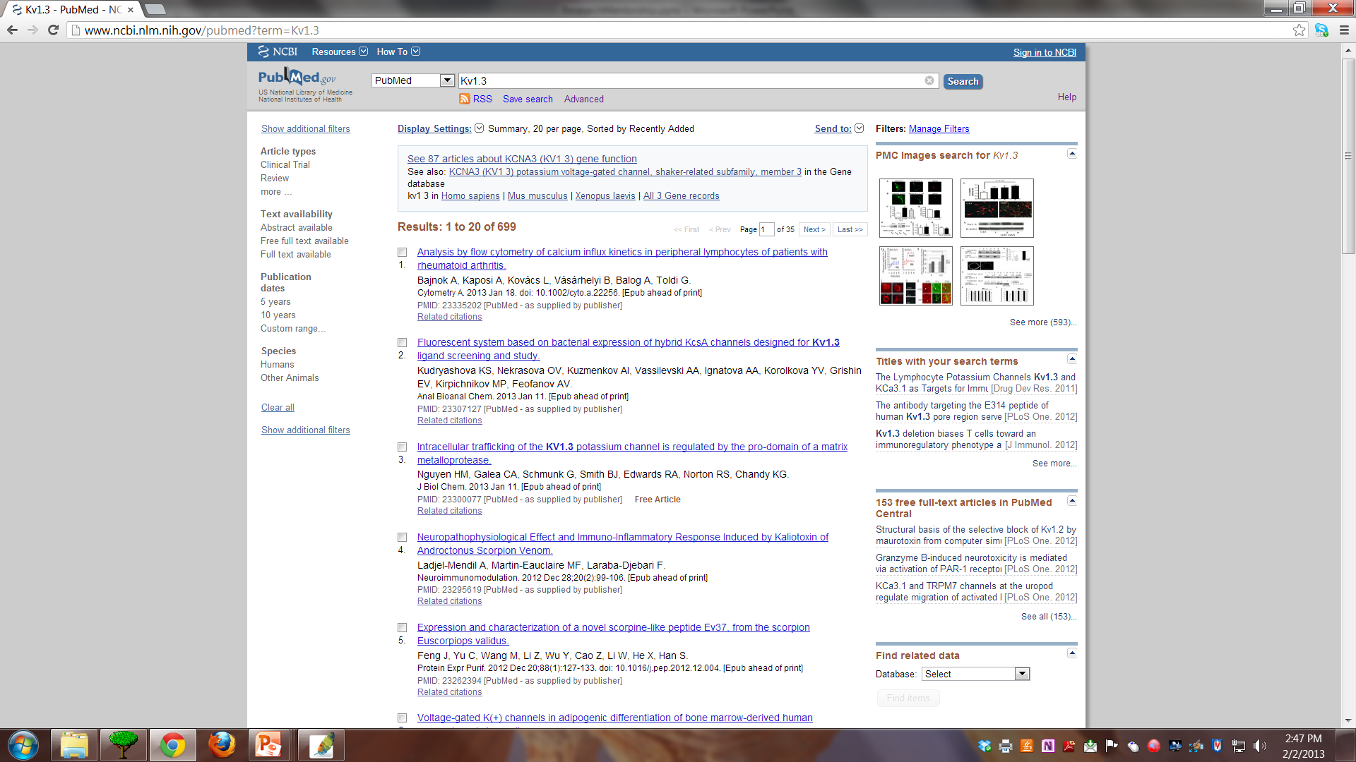
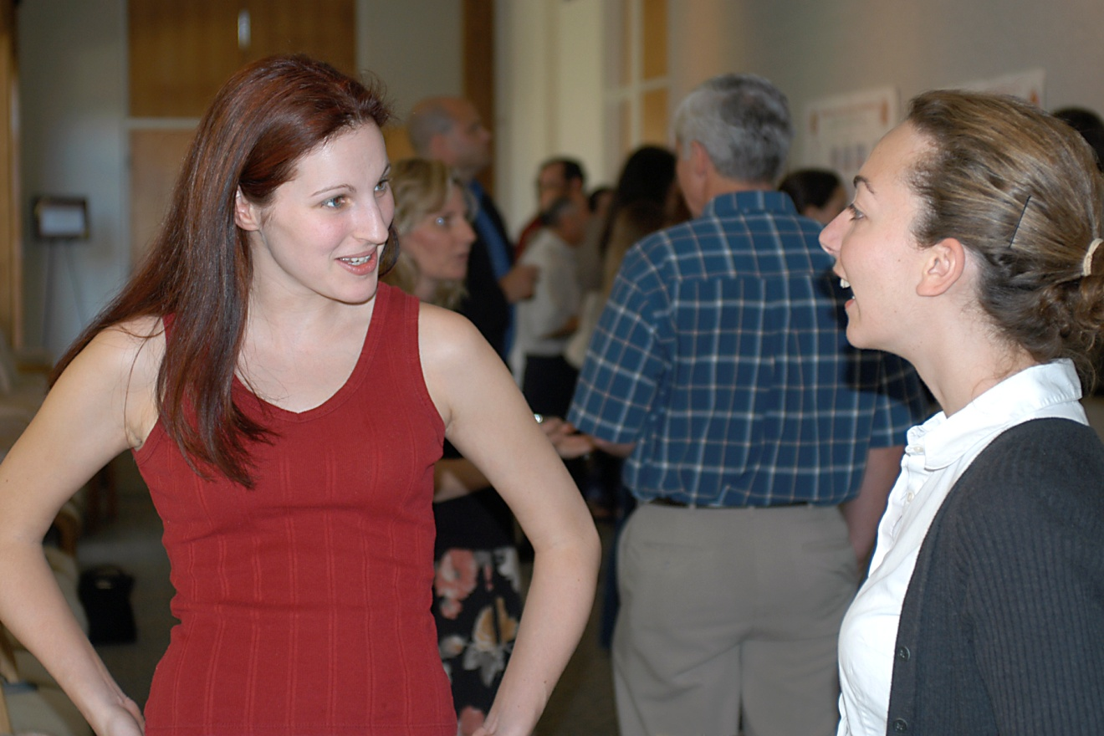
Intense Thinking and Reading
Bounce ideas off your colleagues

Slide 11
Why Should You Design a Grant AND Submit it?
Allows an intense thinking period for you to devise the best research.
Makes you consider the big picture of your research.

Slide 12
The Shopping Mall
Who is your consumer?
What do they want?
How do you know that is what they want?
How do you place your ideas into context?
What is everyone else’s product?
How is your product better?
Once you get your “loan”, you can build
any store that you want….
But you must generate a product….
And it is good to have stock supplies….

Slide 13
Why Should You Design a Grant AND Submit it?
Allows an intense thinking period for you to devise the best research.
Makes you consider the big picture of your research.
Your submitted grant can be used for more than just that extramural review committee.

Slide 14
What Mileage Can You Get from Your Grant Proposal?
You can use the proposal for your prospectus (doctoral).
You can use the proposal for your research statement of your job application packet (postdoctoral).
You can use the background introductory material for a Review Paper.
You can use prepared images on websites, in oral presentations, conference posters.

Slide 15
Why Should You Design a Grant AND Submit it?
Allows an intense thinking period for you to devise the best research.
Makes you consider the big picture of your research.
Your submitted grant can be used for more than just that extramural review committee.
Makes you competitive on the job market – that your idea was reviewed and approved for funding.

Slide 16
More Competitive for the Next Career Move
Demonstrates you are organized and an effective communicator of ideas.
Makes you knowledgeable about your broad field of research.
Your resume/c.v. is higher impact – sets you apart from your peers.
Institutes comb federal data bases to search for young scholars that have been funded and they invite them to apply to their ongoing job searches.

Slide 17
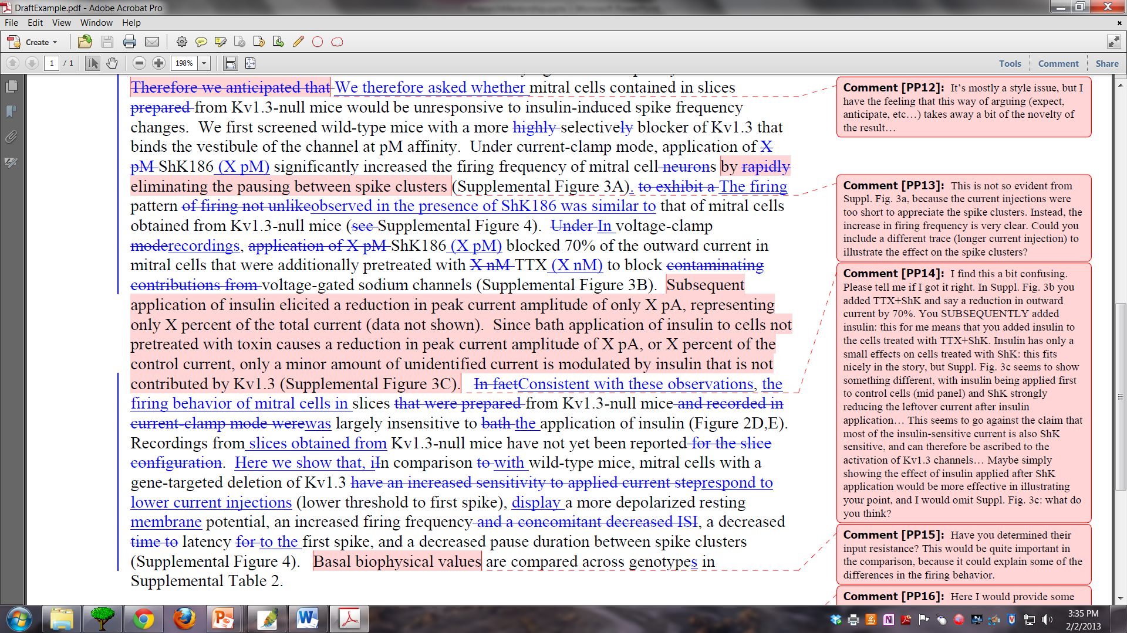
When is it NOT a good time to prepare a grant application?

Slide 18
When is it NOT a good time to prepare a grant application?
Too much demand between manuscript/ book/thesis and grant application.
Still completing your coursework.
You are too senior for a particular grant mechanism.
You did not perform well in the classroom.
Your advisor has conflicting time commitments and cannot develop a training plan with you.
You do not have an expert to help analyze the planned research.

Slide 19
When is it NOT a good time to prepare a grant application?
Conflict with a planned off-campus experience that would also provide research opportunity.
Poor match of environment to the research planned.
No one knows your experiences well (letters).

Slide 20
What Type of Peripheral Preparations are Required?
Vertebrate or human subject approval
Recombinant dna, virus, hazardous materials, select agents
Conflict of interest approval
Budget approval
Departmental signatures
Form pages and navigating the program announcements
Familiarity with the submission software - RAMP
Government ID or registrations

Slide 21
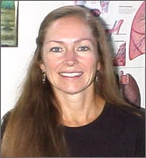
How to Navigate and be Competitive with your Research Idea?
Find a Mentor!
Get Copies of Funded
and Unfunded
Applications
Ask lots of questions!

Slide 22
Logistics of the Workshop
April 15 – Abstracts due and Set up OneDrive
May 1 – Submission of Specific Aims with 5 names
of committed reviewers for your discipline
May 13-14, & June 3-4 – Critique of your Specific Aims
Writing review in small groups
August 10 – Full proposal due to your 5 committed
reviewers
Sept 17-18 or Oct 1-2 – Mock Study Section w/ reviewers

Slide 23
RESPOND TO NEXT QUALTRICS End of March!!!
Whether continuing or not
All Visuals Will Be Accessible Online
at the OPDA Slide Archive!

