Slide 1

WELCOME!
The Center for Global Engagement
Florida State University
Division of Student Affairs
Supporting international students and scholars and offering programs to foster global understanding and awareness

Slide 2
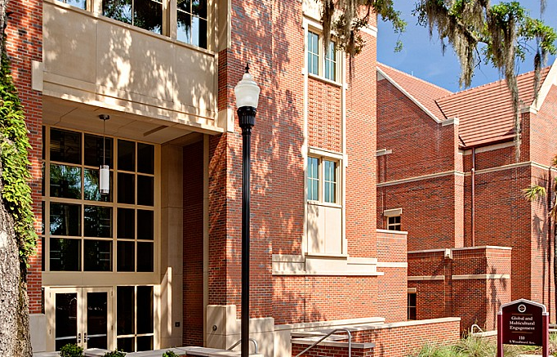
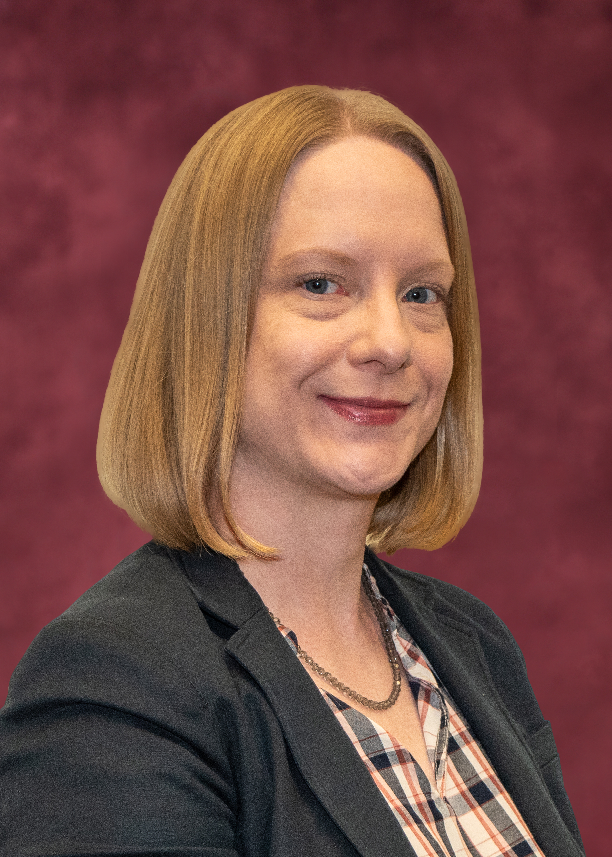
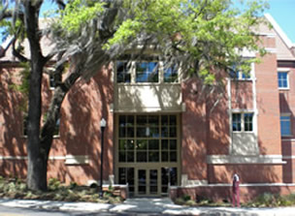
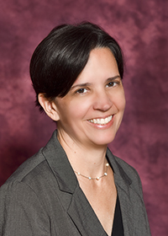
CGE International Scholars Staff
Florida State University
Samantha Buckley
J-1 Program Manager
jscholar@fsu.edu
(850) 645-3179
Tanya Schaad
Tanya Schaad
Associate Director
tschaad@fsu.edu
(850) 644-0977
Offices are located on the second floor of the Center for Global & Multicultural Engagement (110 S. Woodward Ave.)
“The Globe”

Slide 3
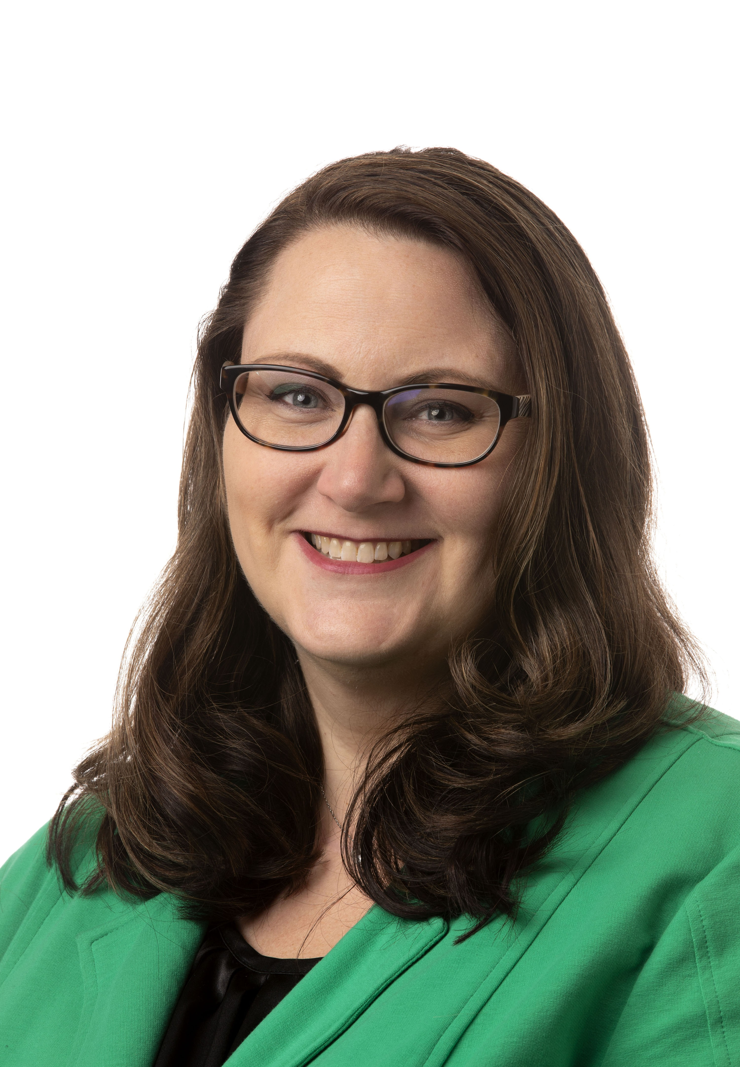
General Counsel Staff
Florida State University
Leslie Crosdale
Associate General Counsel
    H-1B, TN: Advising by appointment only
      travel, changes, dependents
    PR: FSU sponsors permanent positions

Slide 4
ADVISING
Florida State University
    J-1: Advising by appointment, email, or walk-in
    Virtual or in-person
    Travel, extensions, etc.
    J-1 immigration orientation every two weeks
    CGE Workshops Spring 2026:
    Employment (H-1B)
    Tax workshop with Certified Public Accountant
    Events calendar at https://cge.fsu.edu

Slide 5
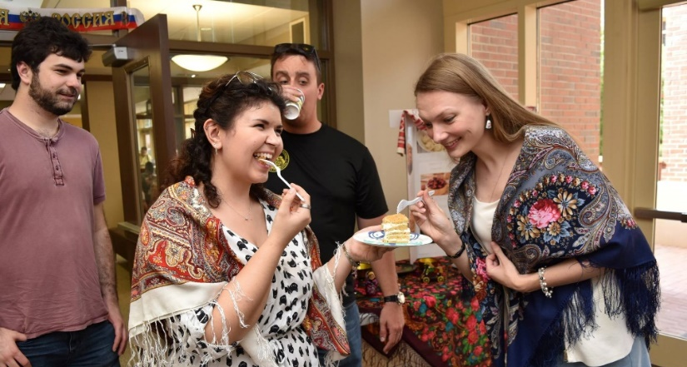
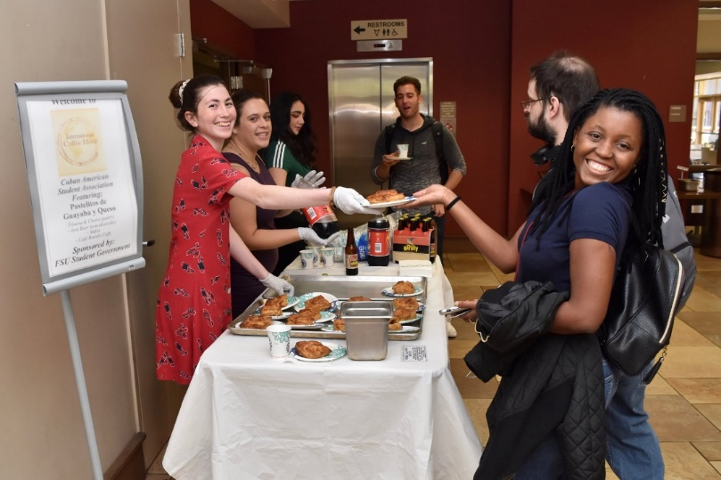
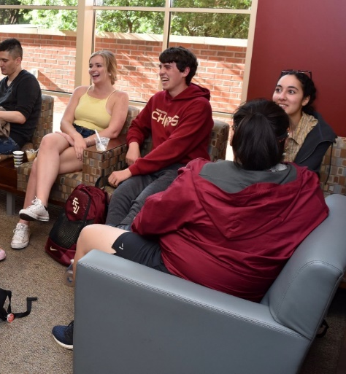
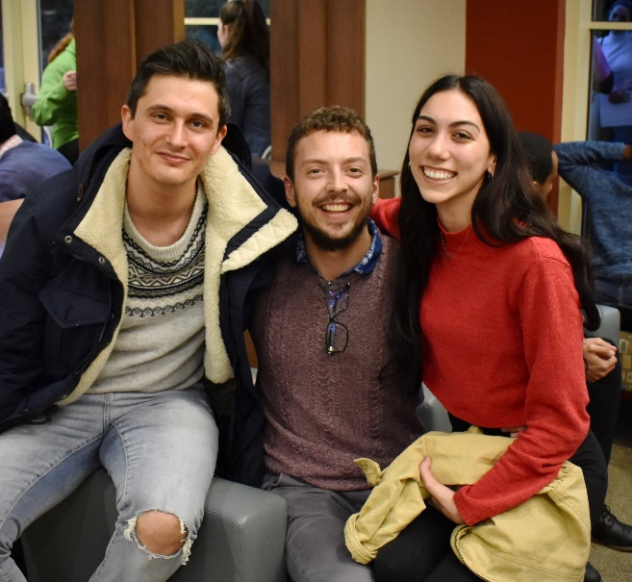
GET INVOLVED!
International Coffee Hour
Every Friday, 5 - 6:30 pm
Globe Dining Room

Slide 6
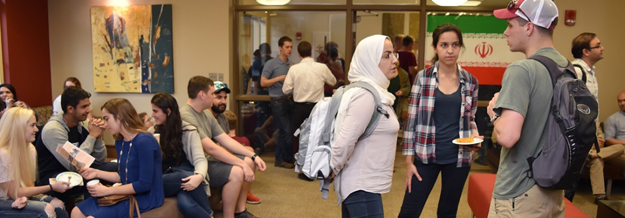
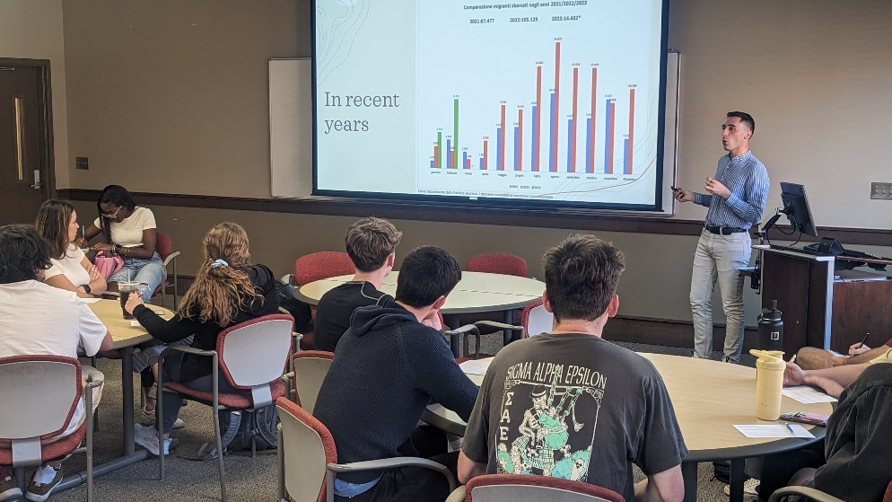
Engage Your World
Speaker Series
Twice a semester in the
Globe Auditorium
Global Ambassadors Program
Flexible schedule
Presentations by request
FSU and Tallahassee Community

Slide 7
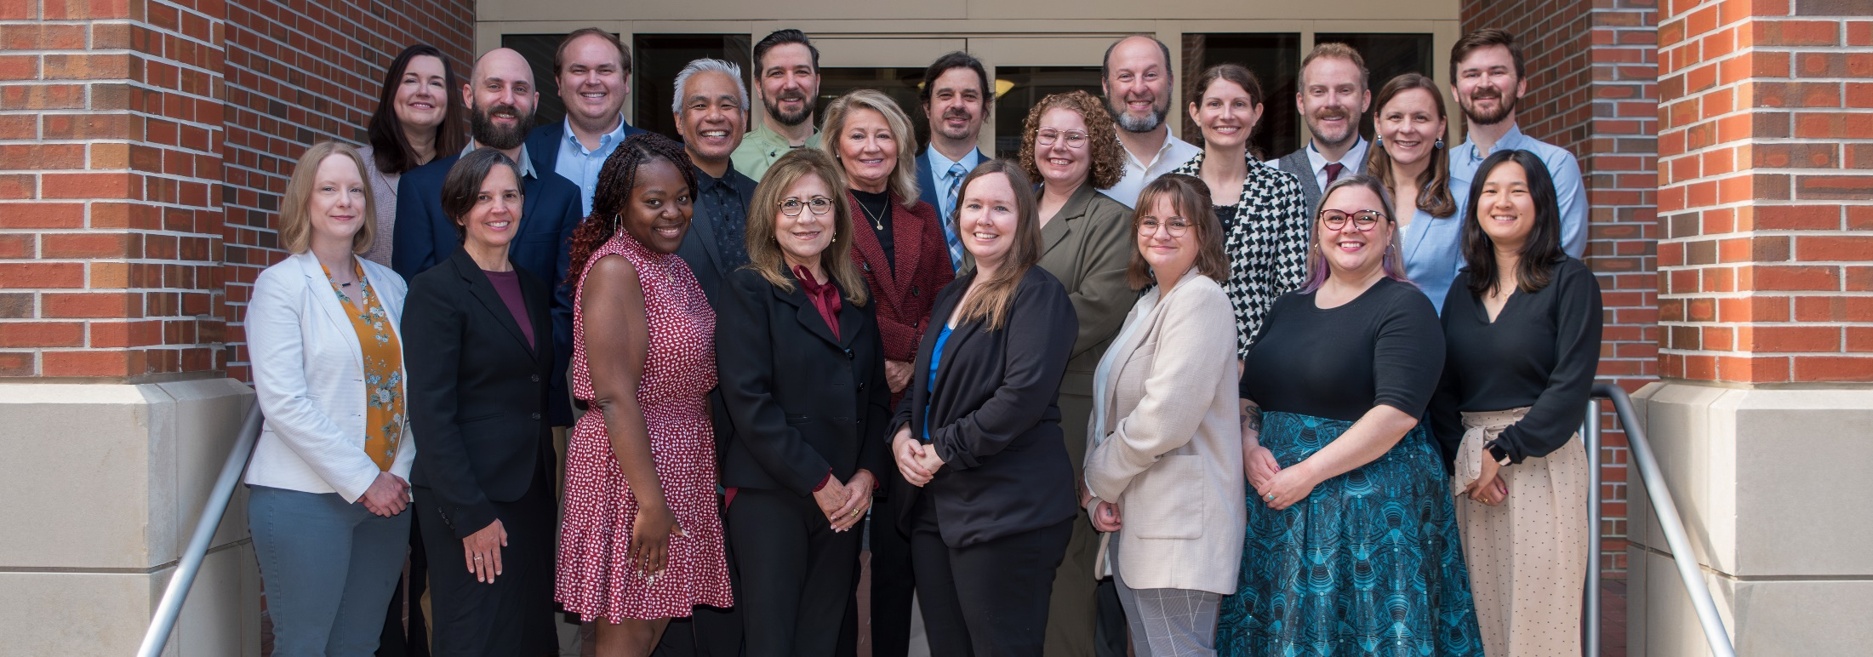



Our Weekly Newsletter
cge.fsu.edu/signup
Stay Connected with the CGE!
@FSUCGE
CGE website:
cge.fsu.edu

