Slide 1
Insurance, Retirement & Benefits
For Florida State University OPS Employees

Slide 2
Insurance
For Florida State University OPS Employees

Slide 3
Eligibility
All employment with state agencies or universities are considered collectively when determining eligibility​
Initial Eligibility: ​
  Newly hired at 0.75 FTE in original appointment (30 hours per week) or greater​
  Employees who increase to 0.75 FTE (30 hours per week)​
  OPS employees transferring from a benefits eligible position​

Slide 4

People First
Administers all State of Florida insurance benefits and:​
  Processes enrollment​
  Processes Qualifying Status Changes (QSC)​
  Verifies dependent eligibility​
  Administers COBRA benefits​
  Annual Open Enrollment​
FSU employees use the People First system to enroll, manage, and make changes to their State of Florida insurance benefits​

Slide 5
Coverage Begin Dates
When Coverage Begins:​
Health insurance: 1st day of the month following enrollment​
  If enrolling in the month of employment, 1st day of the month after hire date​
Supplemental plans: ​
  Dental, vision, accident, cancer, hospitalization, etc.​
  1st day of the month following 2 paychecks in the same month​
    Can be the 1st of the month after enrollment if you contact People First and request the early start date
Premiums are paid the month before coverage is effective
If you elect an "early" effective date, we will deduct extra premiums from your first paycheck to "catch up"

Slide 6

Enrollment
Enroll:​
Online through the People First website or,​
Over the phone by calling the People First Service Center​
People First will send log-in information to you:​
  Within 30 days by People First​
  Please see the MyFSU Benefits tab or HR Benefits section for your People First ID​
Deadline: 60 days from your hire date to enroll​

Slide 7
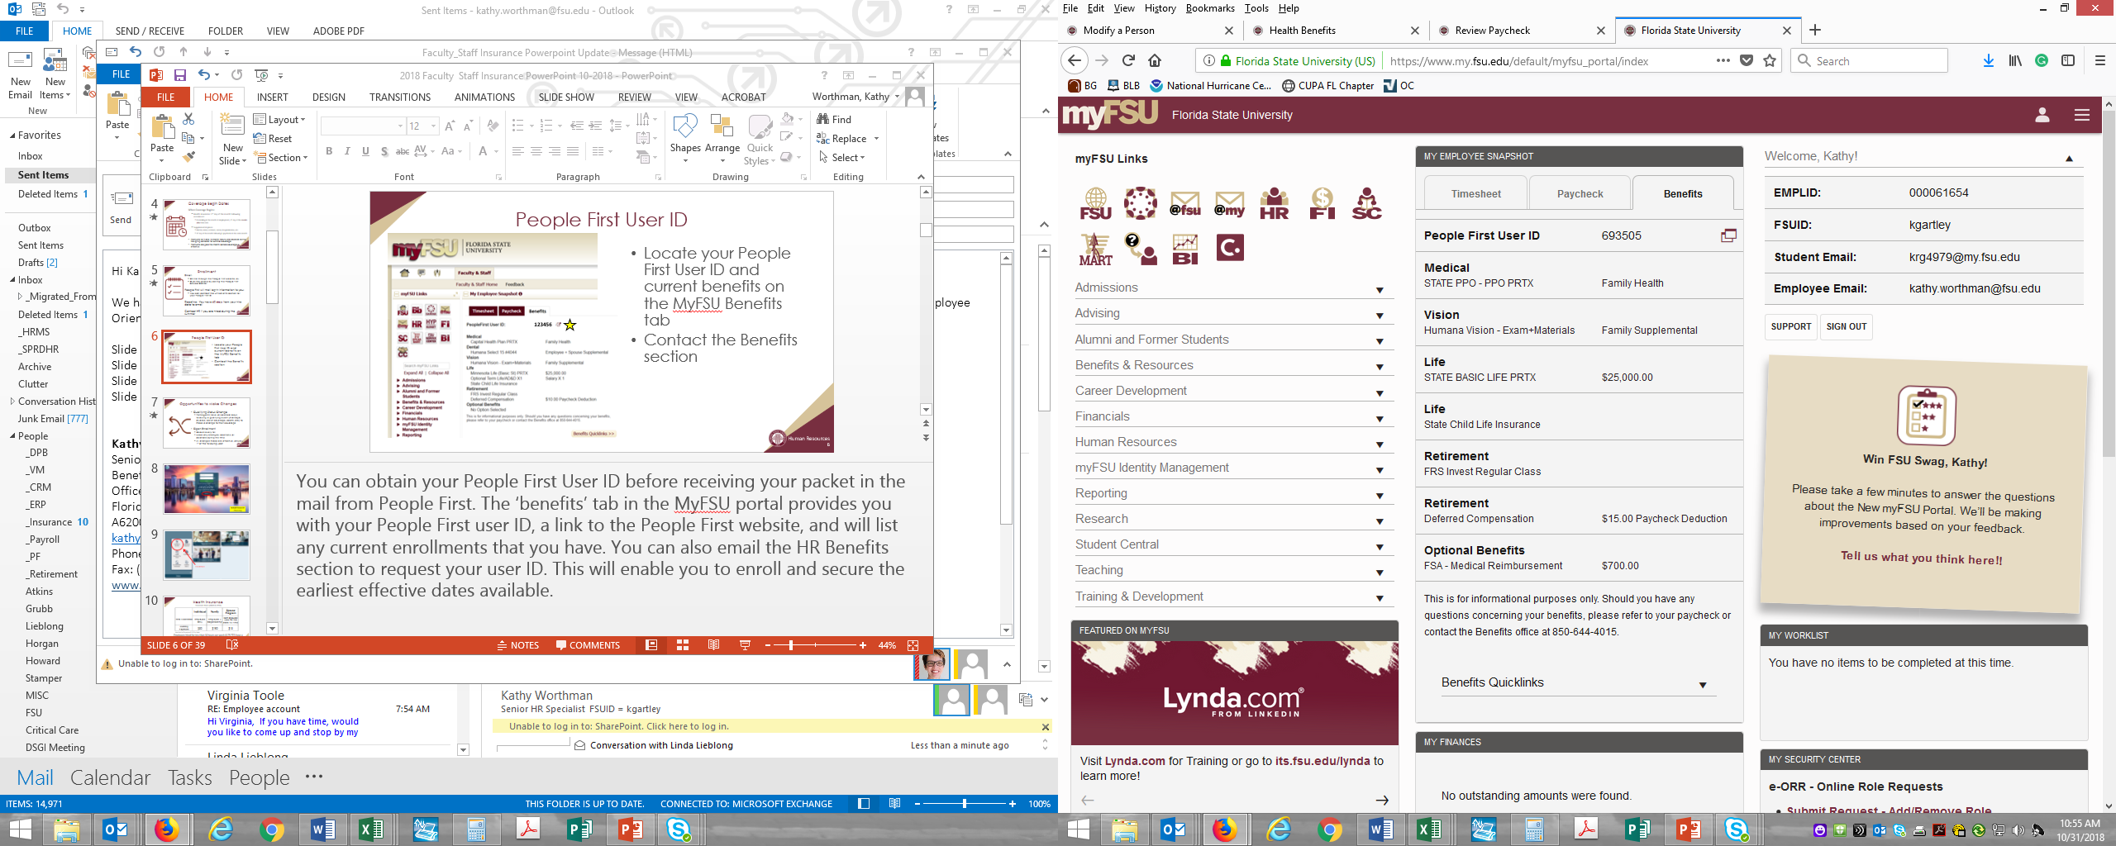
People First User ID
Locate your People First User ID and current benefits on the MyFSU Benefits tab​
  Special Note: User ID may be different if you had prior employment with the State of Florida​
Contact the Benefits section with any questions​

Slide 8

People First Landing Page
Default Password:
Pfmmddyy
*if the default password does not work, please use the "Forgot Password" link

Slide 9
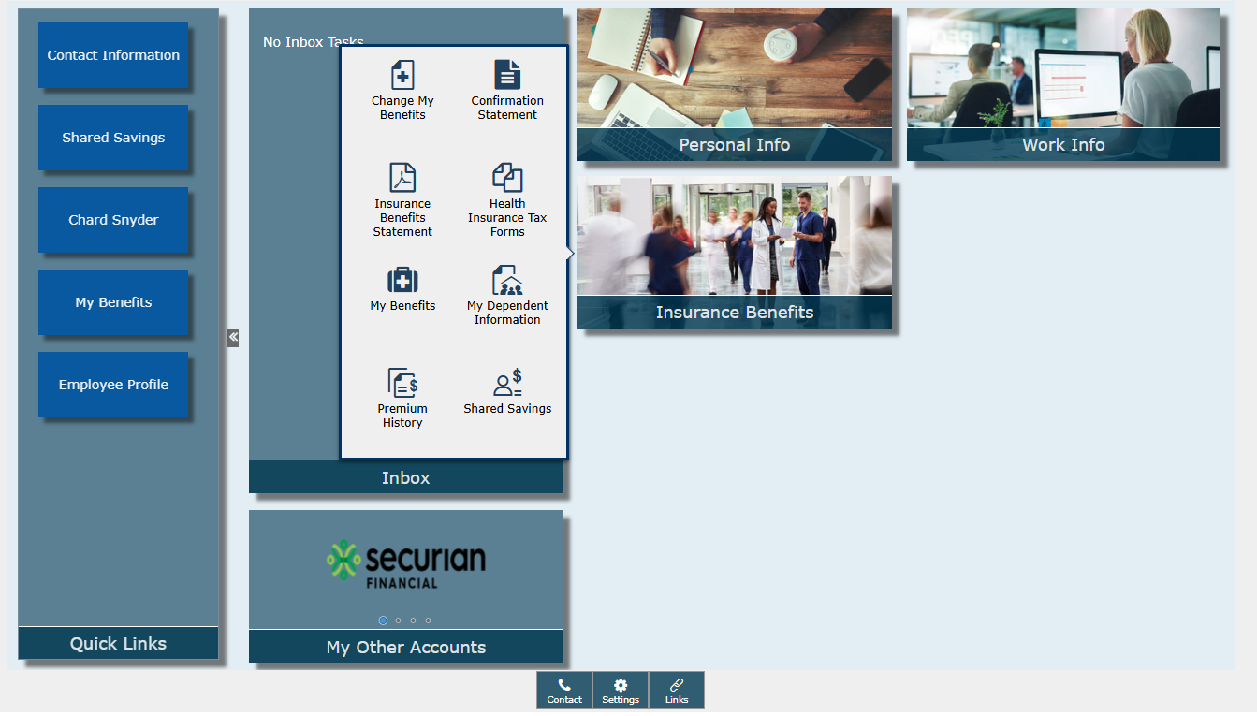
People First Insurance Benefits Tile

Slide 10
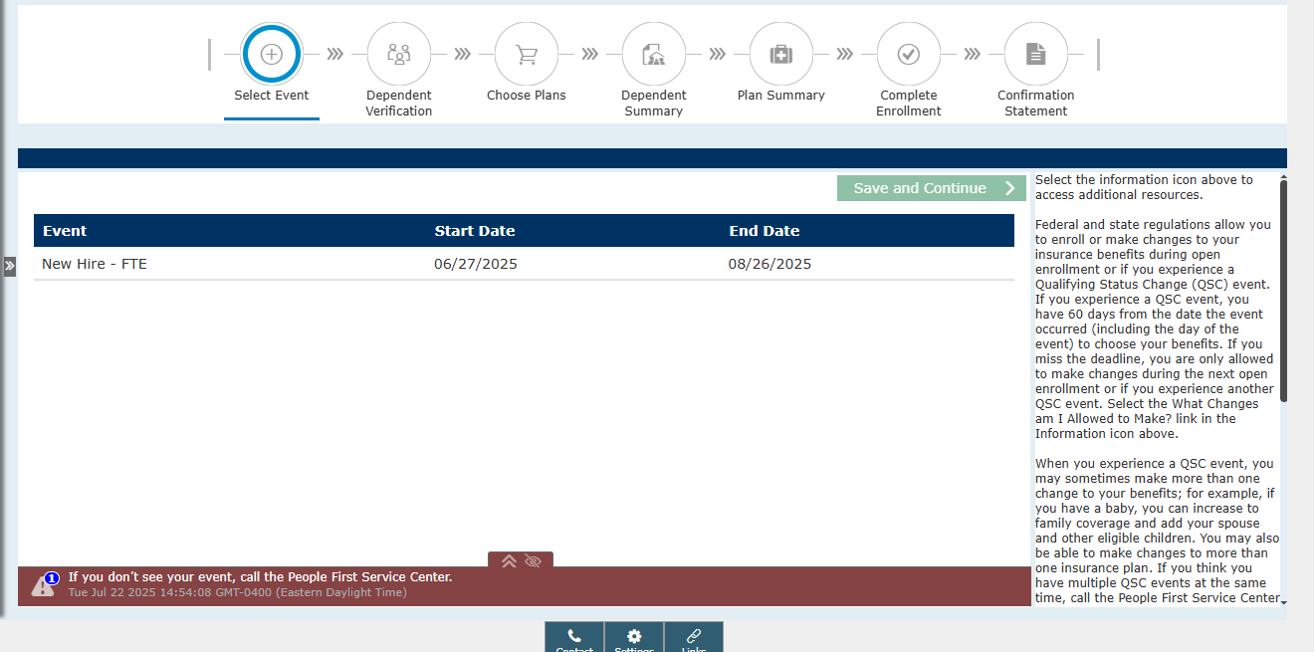
Electing Benefits

Slide 11
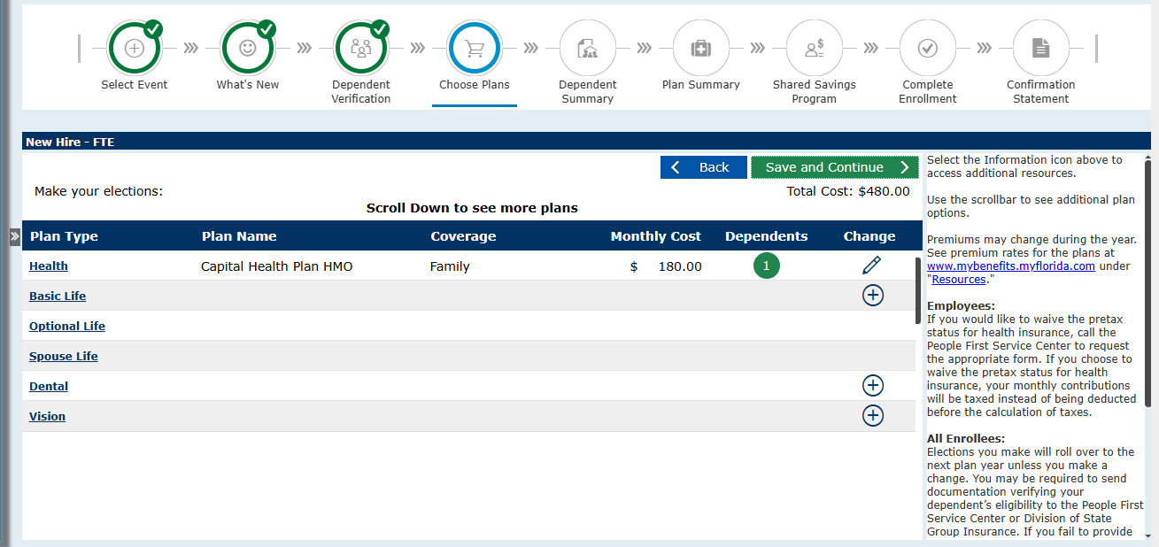
Special Reminder

Slide 12
Health Insurance
Standard Plans (HMO & PPO)
​ ​ Who is covered​ | Individual​ | Family​ | Spouse Program​
 | Employee Only​ | Employee + Dependent(s)​ | Both Employees & any other eligible dependents
Monthly Payment​ | $50​ | $180​ | $15​ (per spouse)
Rates listed are for positions 0.75 FTE or higher
Spouse Program requires that both spouses work for a State of Florida employer
Salaried employees hired for less than 30 hours per week (.75 FTE) may have a higher, pro-rated monthly premium

Slide 13


Standard Plans (HMO & PPO)
HMO (CHP - Tallahassee Area)
PPO (Florida Blue/BCBS)
Services limited to network
Requires primary care provider
Referrals needed for certain specialists
No deductibles
Only emergency services are paid outside the service area
HMO must be notified within 48 hours of an emergency
No restrictions on providers
Co-payments
Annual deductibles before provider pays
Co-Insurance
Specialist self-referrals
Costs vary based on network and non-network providers
No pre-existing condition exclusions

Slide 14
Health Insurance
High-Deductible Health Plans (HMO & PPO)
​ ​ Who is covered​ | Individual​ | Family​ | Spouse Program​
 | Employee Only​ | Employee + Dependent(s)​ | Both Employees & any other eligible dependents
Monthly Payment​ | $15 | $64.30 | $15​ (per spouse)
Rates listed are for positions 0.75 FTE or higher
Spouse Program requires that both spouses work for a State of Florida employer
Salaried employees hired for less than 30 hours per week (.75 FTE) may have a higher, pro-rated monthly premium

Slide 15
Health Savings Account (HSA)
Pre-tax funds for medical purposes​
Accumulates interest on roll over balances​
Participants 55 and older can contribute an extra $1,000/year​
Employees 65 and older are ineligible for an HSA ​
      * Only for employees enrolled in a HDHP
Yearly Contribution​ | Individual​ | Family​
Employee​ | $4,300 | $8,550
Employer​ | $500​ | $1,000​

Slide 16
Prescription Drugs
OptumRx: 800-547-9767/Optum's State of Florida Website
​ | Standard Plans​ |  | HDHP​
Prescription drug class​ | 30-day supply​ | 90-day supply​ | Retail (30-day);Mail Order (90-day) and Retail (90-day)​
Generic​ | $7​ | $14​ | 30%*​
Preferred Drugs ​ (contact provider for a list)​ | $30​ | $60​ | 30%*​
Non-preferred​ | $50​ | $100​ | 50%*​
*The cost for prescriptions applies after meeting the applicable individual or family annual deductible.

Slide 17
Flexible Spending Account (FSA)
Pre-tax dollars to cover expenses
Renews Automatically
FSA Account | Minimum Election ​ | Maximum ​ Election ​ | Expenses​ | Other​
Health Care​ | $60​ | $3,300​ | For tax deductible medical expenses​ | $660 roll over to next calendar year​
Limited Purpose​ | $60​ | $3,300​ | Available if enrolled in an HDHP plan with an HSA​ | $660 roll over to next calendar year​
Dependent Care​ | $60​ | $5,000 per household​ | For expenses incurred for care of dependents​ | Grace period. Funds are use-it-or-lose-it​

Slide 18

Shared Savings Program
Healthcare Bluebook- online transparency portal. Allows members to shop for health services based on cost and quality, and earn financial rewards.​
Lantern - Receive a "bundled" medical service that covers the most expensive costs associated with surgery, so you will pay less for your procedure and earn rewards.
Chard Snyder - Oversees reimbursement accounts opened to receive earned rewards from this program.

Slide 19
Life Insurance
Basic Life Insurance
  $25,000 policy​
  Automatic enrollment for ​salaried employees​
  Part-time employees must enroll into coverage through People First​
  Term Life insurance​
  Employee paid benefit for OPS employees​

Slide 20
Life Insurance
Spouse Life
  $15,000 or $20,000 coverage levels
  Term Life insurance​
  Employee pays premium​
  After-tax benefit​
  Not available if your spouse works at another state agency or university​
Child Life
  $10,000 coverage​
  Term Life insurance​
  Employee pays premium​
  After-tax benefit

Slide 21
Dental & Vision Insurance
Dental Insurance
Vision Insurance
Plans offered through multiple companies
Four plan types offered:
  Prepaid
  PPO
  Indemnity w/ PPO
  Indemnity
Talking to your current or perspective dentist office is a great way to help decide which plan will work for you
Only one plan through Humana
Talking to your current or perspective optometrist office is a great way to see if this will work for you
  Can include discounts on LASIK services

Slide 22
Additional Insurance Options
Gabor Financial Solutions (850-894-9611)
  Life Insurance
  Long Term Disability
  Long Term Care
  Accidental Death & Dismemberment (AD&D) Insurance
U.S. Legal (800-356-5297)
  Family Defender
  Identity Defender
Colonial Life (888-756-6701)
  Critical Care
*Must enroll through the provider directly

Slide 23
Reminders
Enrollment Deadline for Benefits: 60 days from date of hire to enroll through People First​
Changes can be made during Open Enrollment or with a Qualifying Status Change (QSC) event​
Contact the Benefits office with any questions on eligibility at insurance@fsu.edu ​

Slide 24
Retirement
For Florida State University OPS Employees

Slide 25
401(a) FICA Alternative Plan - Bencor
Eligible OPS employees are mandatory participants in the Bencor 401(a) FICA Alternative Retirement Plan.​
7.5% contribution to Bencor instead of paying FICA (Social Security) tax. ​
  No Social Security credits are earned while in Bencor.​
Participants can invest contributions within the plan.​
Account withdrawals/transfers are permitted only if terminated from OPS employment or upon transferring to a salaried position at FSU. ​

Slide 26
401(a) FICA Alternative Plan - Bencor
Bencor online account access (view current account balance, history, maintain investments, etc.)
  http://www.bencorplans.com ​
Choose “Participant Login”​
Bencor Administrative Services: 866-296-9712
Bencor Plan Information and Account Access Instructions​
Questions? ​
  Benefits Office – (850) 645-4015 or retirement@fsu.edu

Slide 27
Voluntary Retirement Plans
Voluntary 403(b) Plan
Florida Deferred Compensation Plan
Administered by FSU exclusively for FSU employees.
Lower Fees & Administrative Costs
Changes can be made online via the Retirement@Work portal
Administered by the State of Florida
Portable to other State of Florida employers
No early withdrawal penalty after separation from a State of Florida employer after 30 days
Changes must be made through the Bureau of Deferred Compensation

Slide 28



Voluntary 403(b) Provider Companies

Slide 29

Deferred Compensation Provider Companies

Slide 30

Savi
Partnership between TIAA, Savi & FSU
  Designed and implemented to help FSU employees:
    Navigate the Public Service Loan Forgiveness (PSLF) process
    Reduce their monthly payment by an average of $120
  Due to FSU’s relationship with TIAA, the cost to FSU employees is only $74 a year
    Participation or program use is voluntary
    Additional information can be found on our Seminole Savings Employee Discount Page

Slide 31

Thank You
Human Resources – Benefits​
  University Center A, Suite 6200​
  (850) 644-4015​
  Retirement: retirement@fsu.edu
  Insurance: insurance@fsu.edu
  www.hr.fsu.edu

