Slide 1
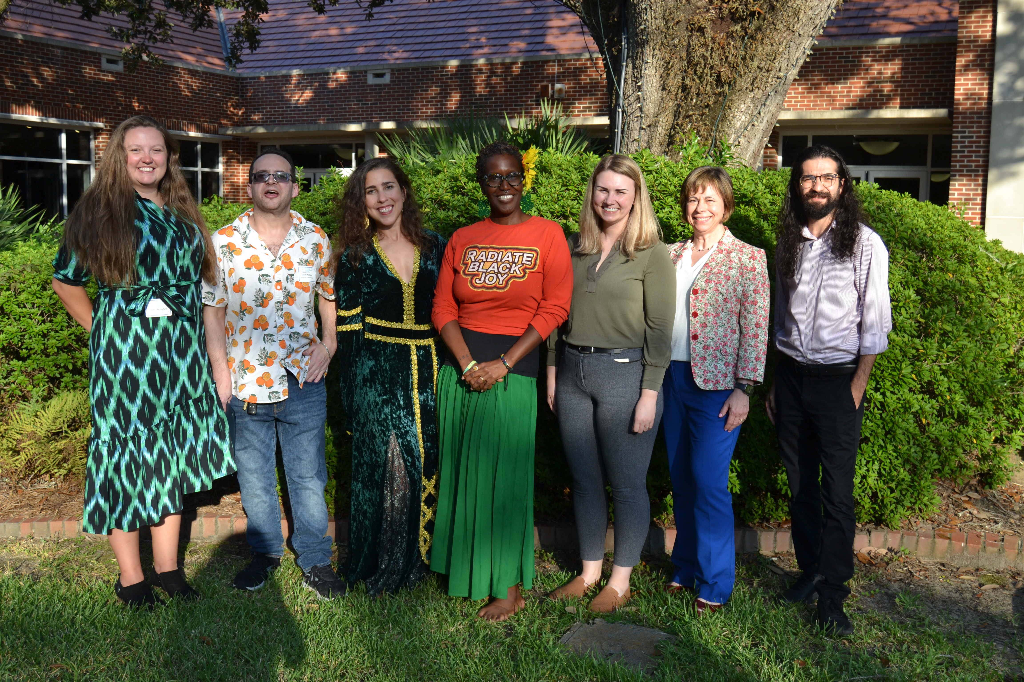
The Postdoctoral Association (PDA)

Slide 2
What does the PDA do?
Our mission:
Represent postdocs across all units (colleges/departments)
Advocate for policies to improve postdoctoral experience (training, orientation, PI engagement...)
Advocate for policies that improve postdoc conditions (benefits, minimum salary, parental leave…)
Facilitate community building and networking by organizing postdoc events (training, socials, networking...)
Notes:
So what does the PDA do?
Our main aim is to improve the postdoc training experience at FSU.
We do that by advocating for policies that directly impact postdocs, to improve the postdoctoral experience and to improve working conditions. We have successfully completed many projects and we have on going projects …
We also offer social opportunities to give the postdocs the chance to meet new people and network with their peers, and also engage with more social activities…
We want to be the voice of all postdocs across the FSU, so we try to have postdocs from different departments and colleges to be a part of pda…

Slide 3
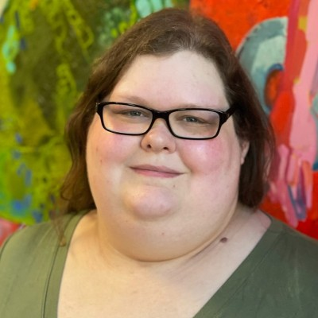
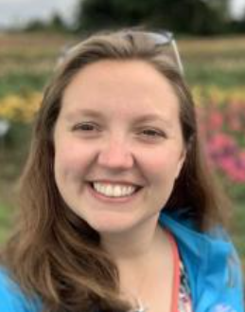
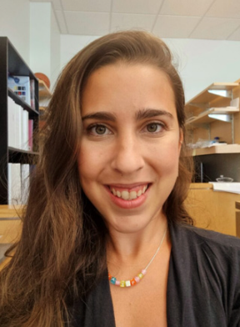
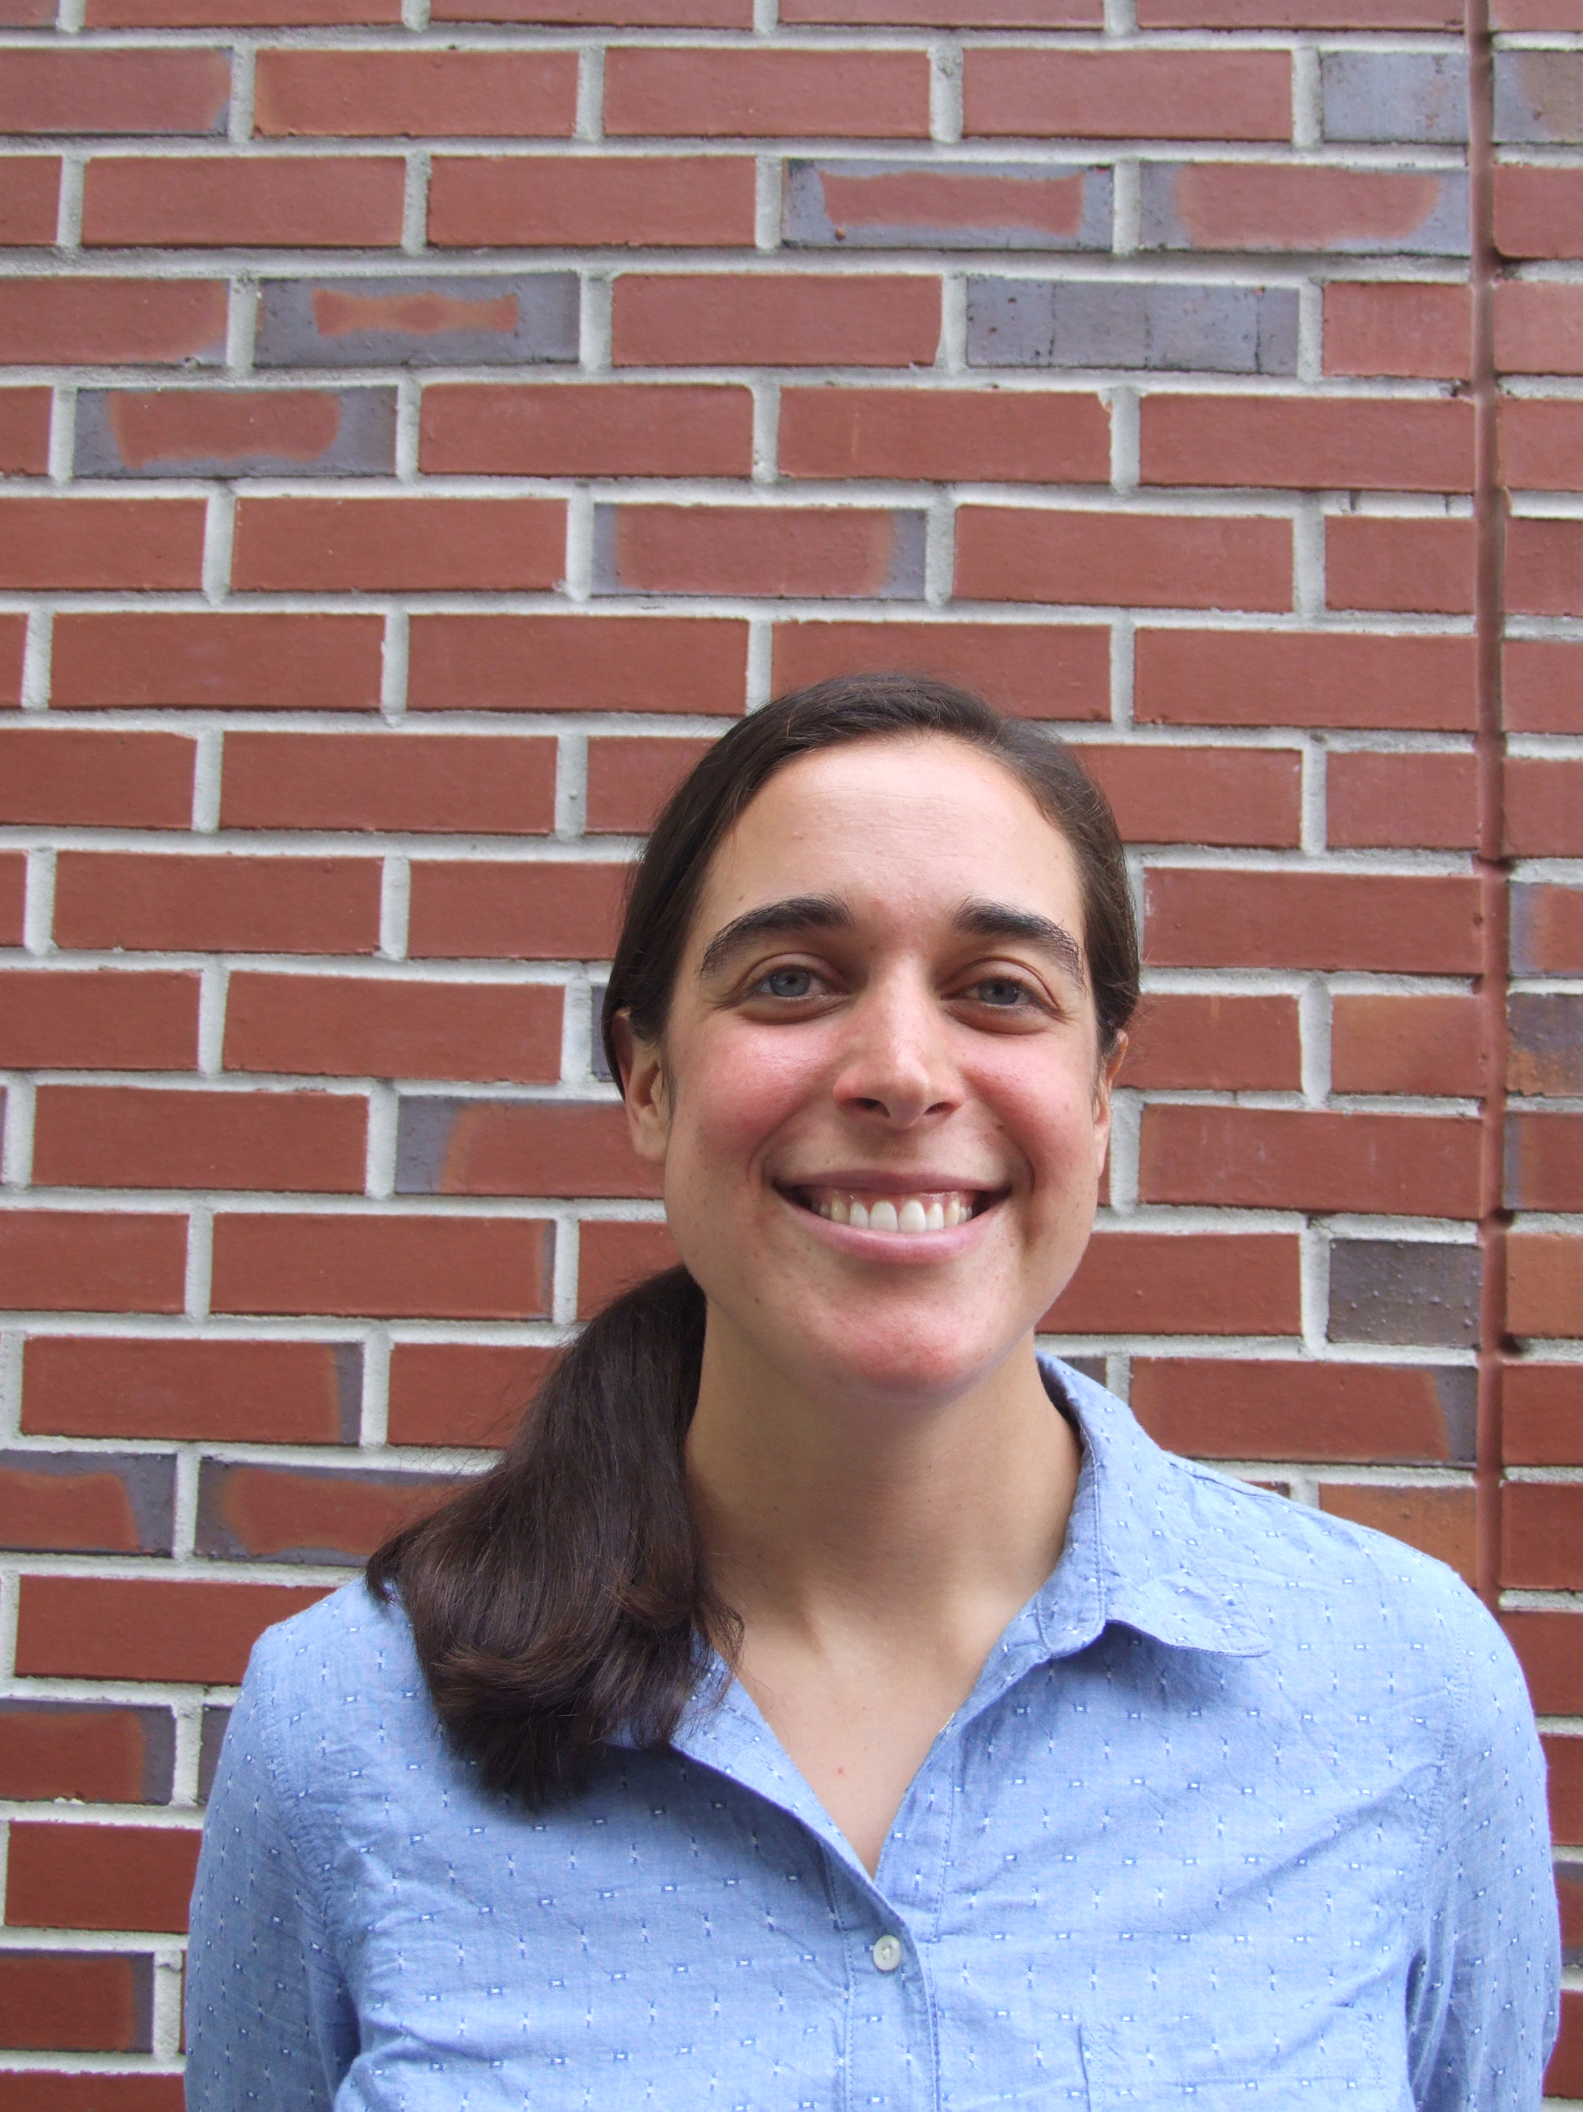
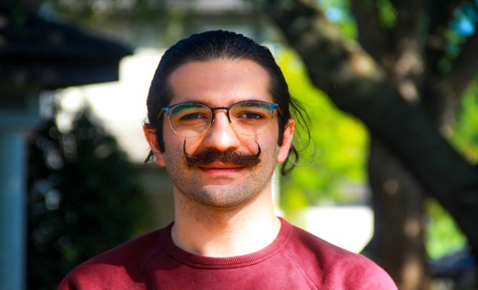
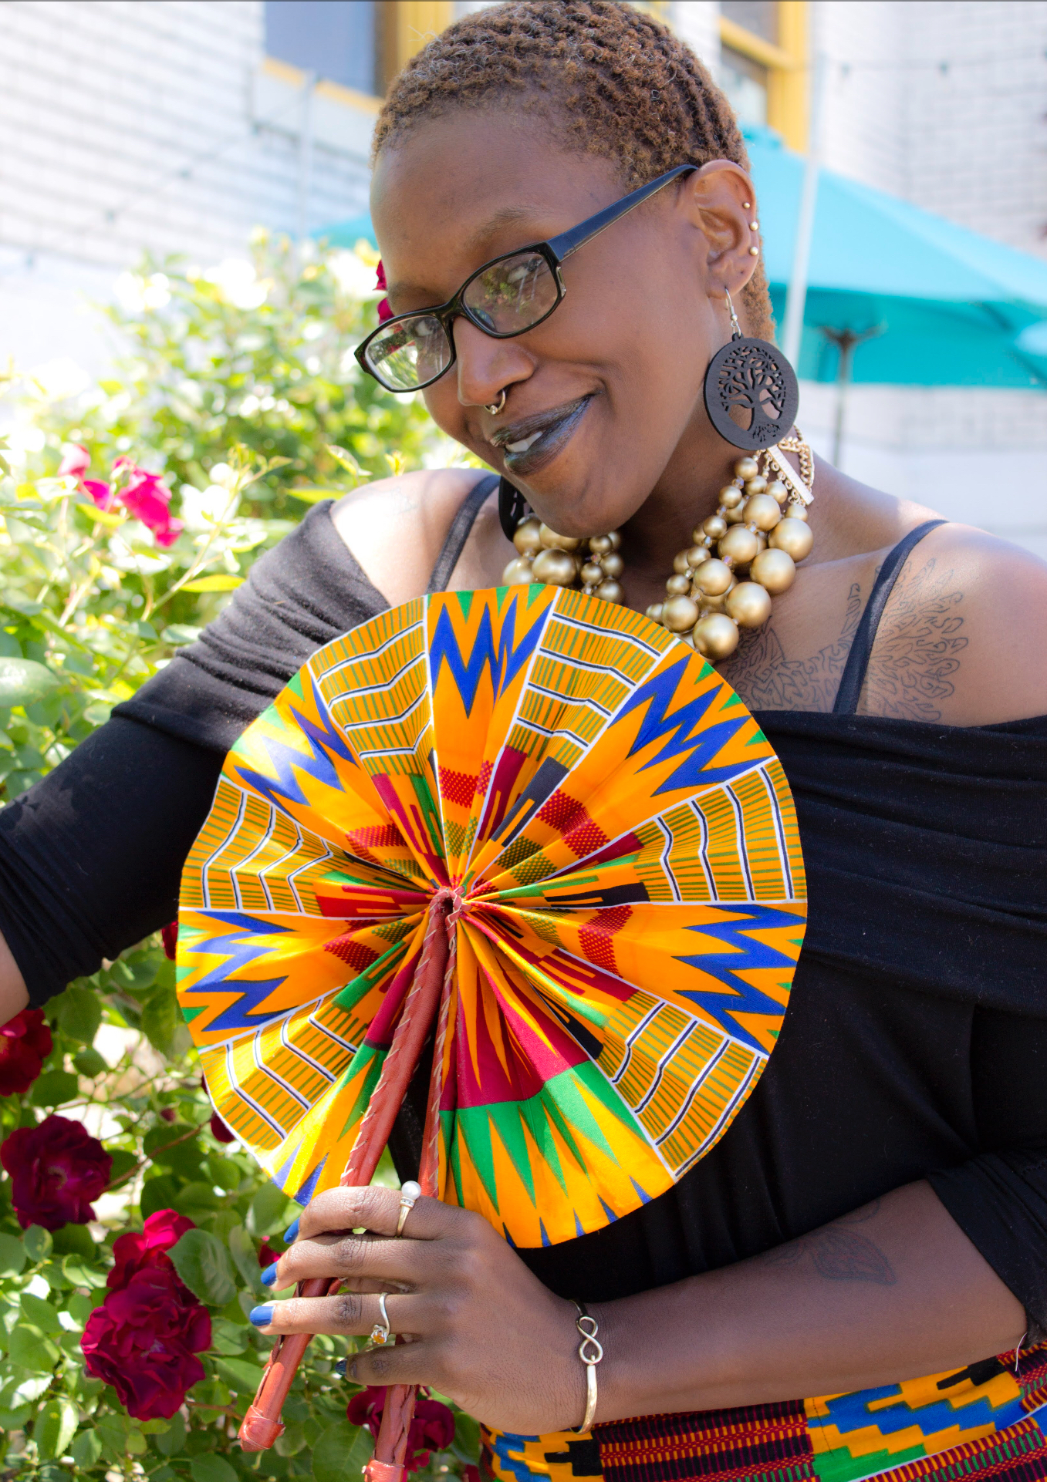
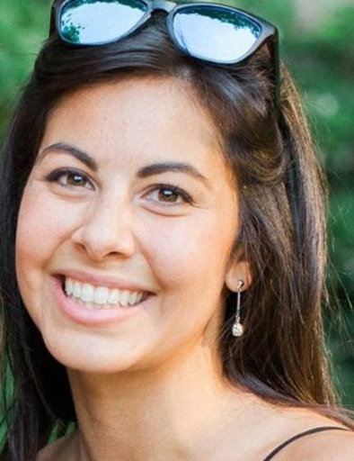
Meet your PDA representatives!
We are here to help you and make FSU Postdoctoral training better
Kasey
Pearl
Olivia
Betsy
Jayasankar
Luna
Thais
President
FICW
Vice-President
Biological Science
Senior Advisor
Psychology
Senior Advisor
Coastal and
Marine Laboratory
Social Media
COAPS
Senior advisor
COAPS
Senior Advisor
Chemistry
Mohammad
Chris
Member
Geography
Alyssa
Emily
Mario
Jiwon
Josephine
Tsegai
Senior Advisor
Mathematics
Social Chair
Coastal and Marine Laboratory
Buddy Program
FICW
Member
Mathematics
Member
FICW
Member
Retail Management
Member
Civil and Environmental Engineering
Email: opda-info@fsu.edu
Notes:
These are the current members of the PDA. You can see we have postdocs from many different colleges and departments here at FSU
If you would like to get in contact, you can contact us by email – see below - opda-info@fsu.edu

Slide 4
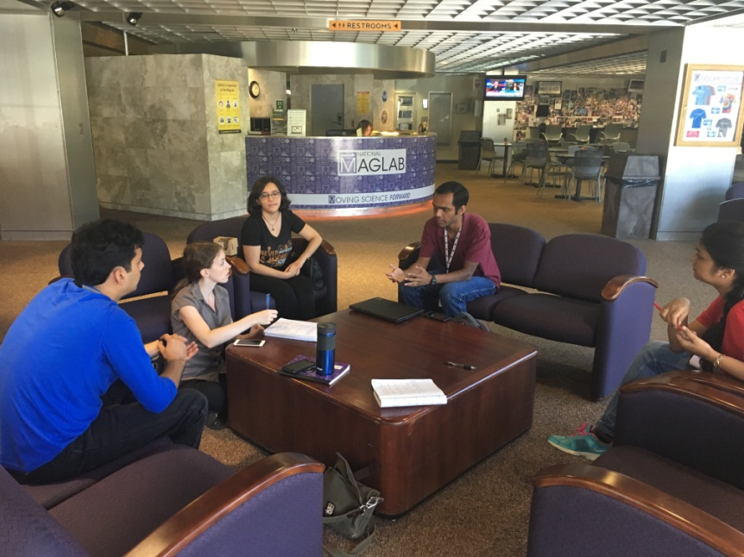
What has PDA done for you so far?
Definition of a postdoctoral scholar (defines the
length, 4-5 years, and the mentored training)
Teaching postdoctoral scholars (~15-25 postdocs)
Preparing future faculty certificate
Minimum salary ($47,658) and retirement and benefits
Termination policy
Travel awards
Attend National Postdoctoral Association events
Postdoc meal plan ($120 for 20 meals)
Recently accepted: Paid time off policy
Working projects: Paid parental leave Minimum salary increase
Working project: Mental health for postdocs
Notes:
In terms of policies the PDA has made happen over the years, here are a list of a few. One major policy the PDA worked on recently, which will impact every postdoc at FSU is the paid time off policy. Postdocs are now eligible for 2 weeks of paid time off, which came in to effect at the beginning of last year. Prior to this policy coming into effect, postdocs were not eligible for PTO
We are now working on expanding that policy by incorporating paid Parental Leave.

Slide 5
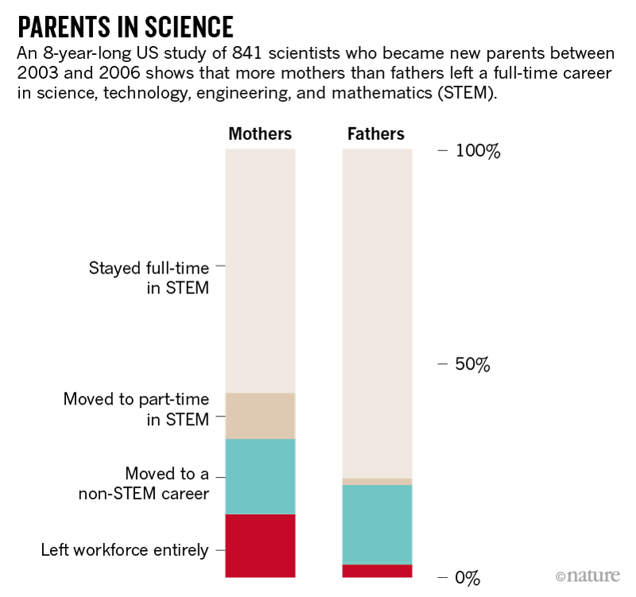
Fighting for Paid Parental Leave
At the moment, postdocs at FSU can take 12 weeks unpaid leave when they give birth.
We want to change that!
72% of Top 25 Public schools have some paid parental leave.
Median paid leave (for mothers and fathers) is 4 weeks.
OUR GOAL: 8 weeks of paid parental leave
Estimated costs ~ $7000 per postdoc, with a projection of 4-5 postdocs (2%) requesting leave/year
Notes:
paid parental leave has been associated with improved infant and maternal health outcomes (Heymann et al., 2017). Under federal law, postdoc fathers and mothers who have worked at FSU for at least 12 months have the right to 12 weeks unpaid leave in accordance with the Family Medical Leave Act (FMLA). Currently, tenure-track faculty at FSU have access to 16 weeks paid parental leave. However, there is currently no paid parental leave policy in place for FSU postdocs.
We are advocating for 8 weeks of paid parental leave for postdocs. That means we raise this at Postdoc Advisory board meetings & we hold discussions on how we can make this happen. At present, We are creating surveys for the Faculty and Postdocs to assess their thoughts and opinions on a paid parental leave policy for postdocs.
Kasey and Olivia will be presenting results from the survey at the national postdoctoral association NPA conference this year

Slide 6
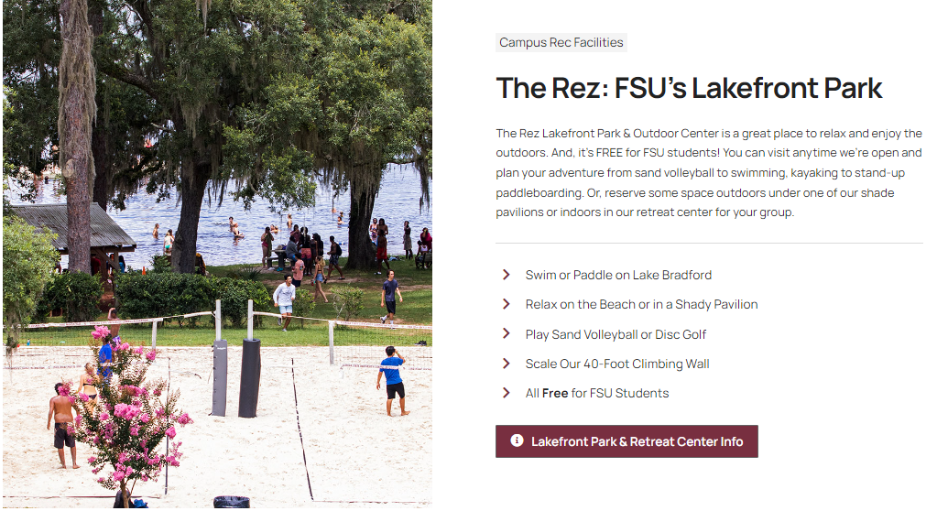
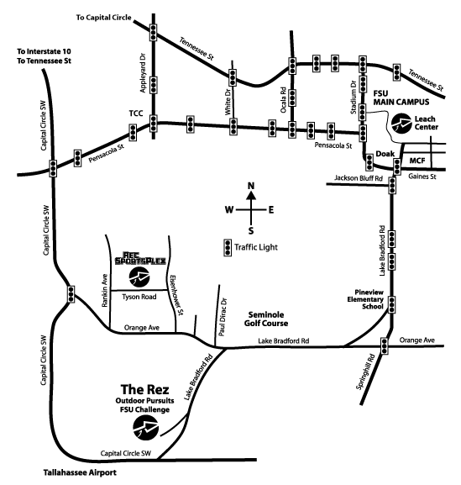
FSU REZ
Take Care of Your Mental & Physical Health
Leisure activities (trails, parks, day beach, canoeing, paddling, outdoor climbing, yoga, meditation,..)
FREE with FSU ID!!
https://campusrec.fsu.edu/outdoors/

Slide 7
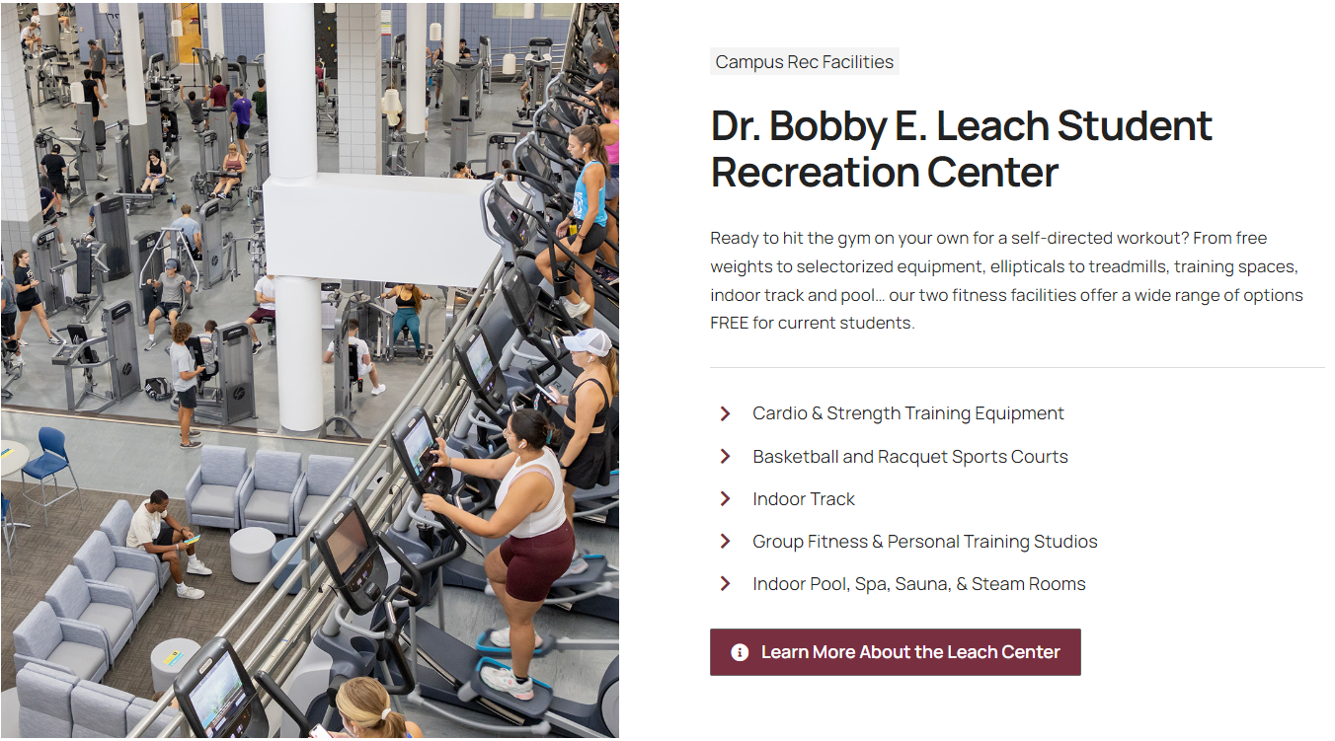
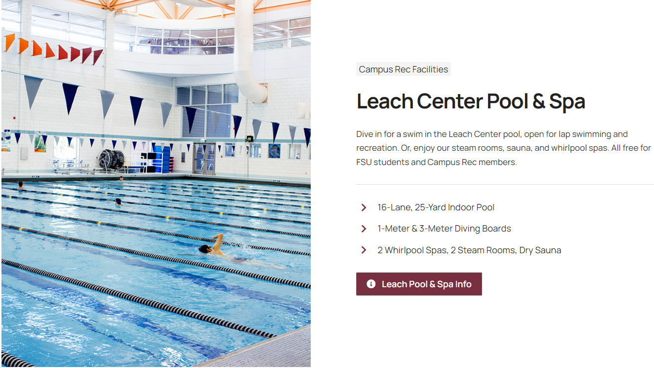
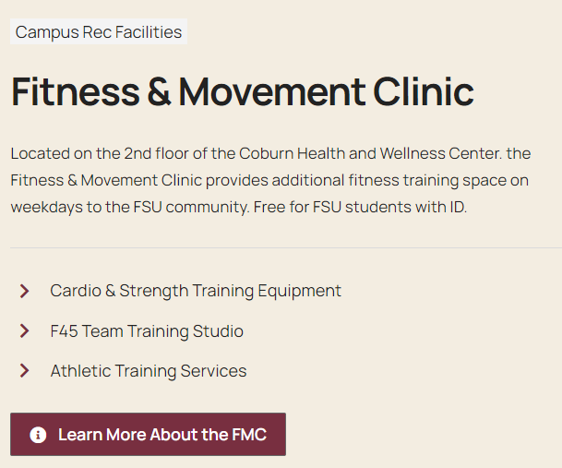
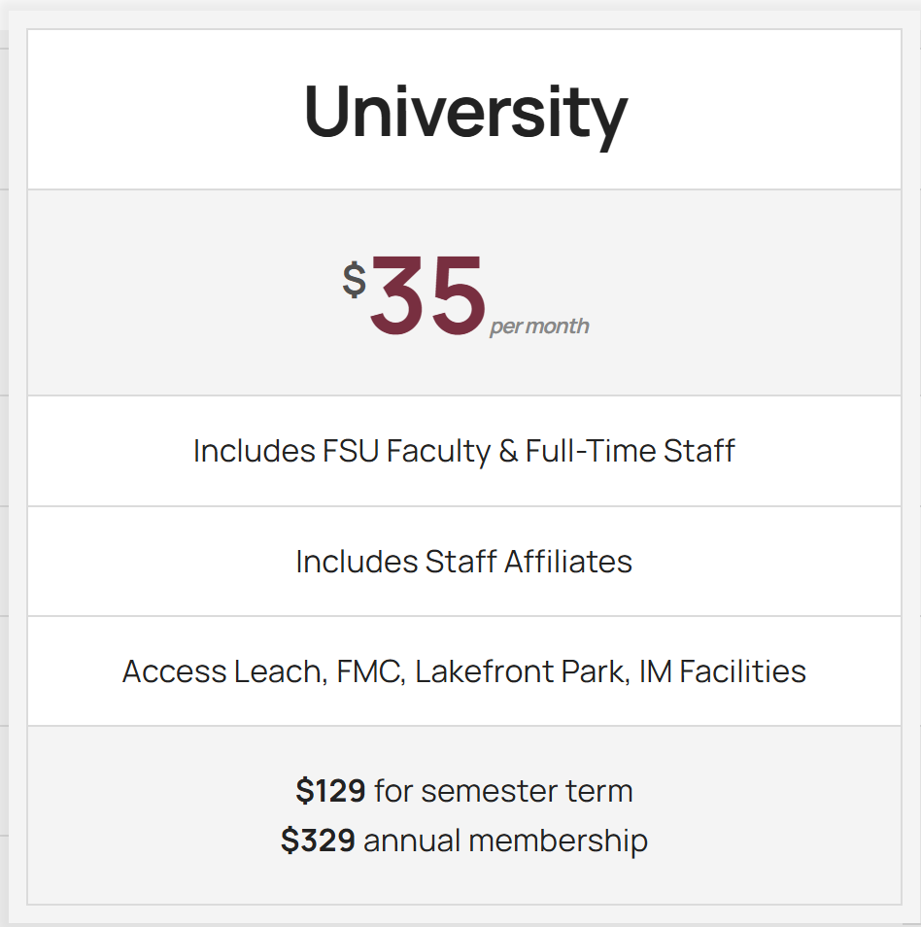
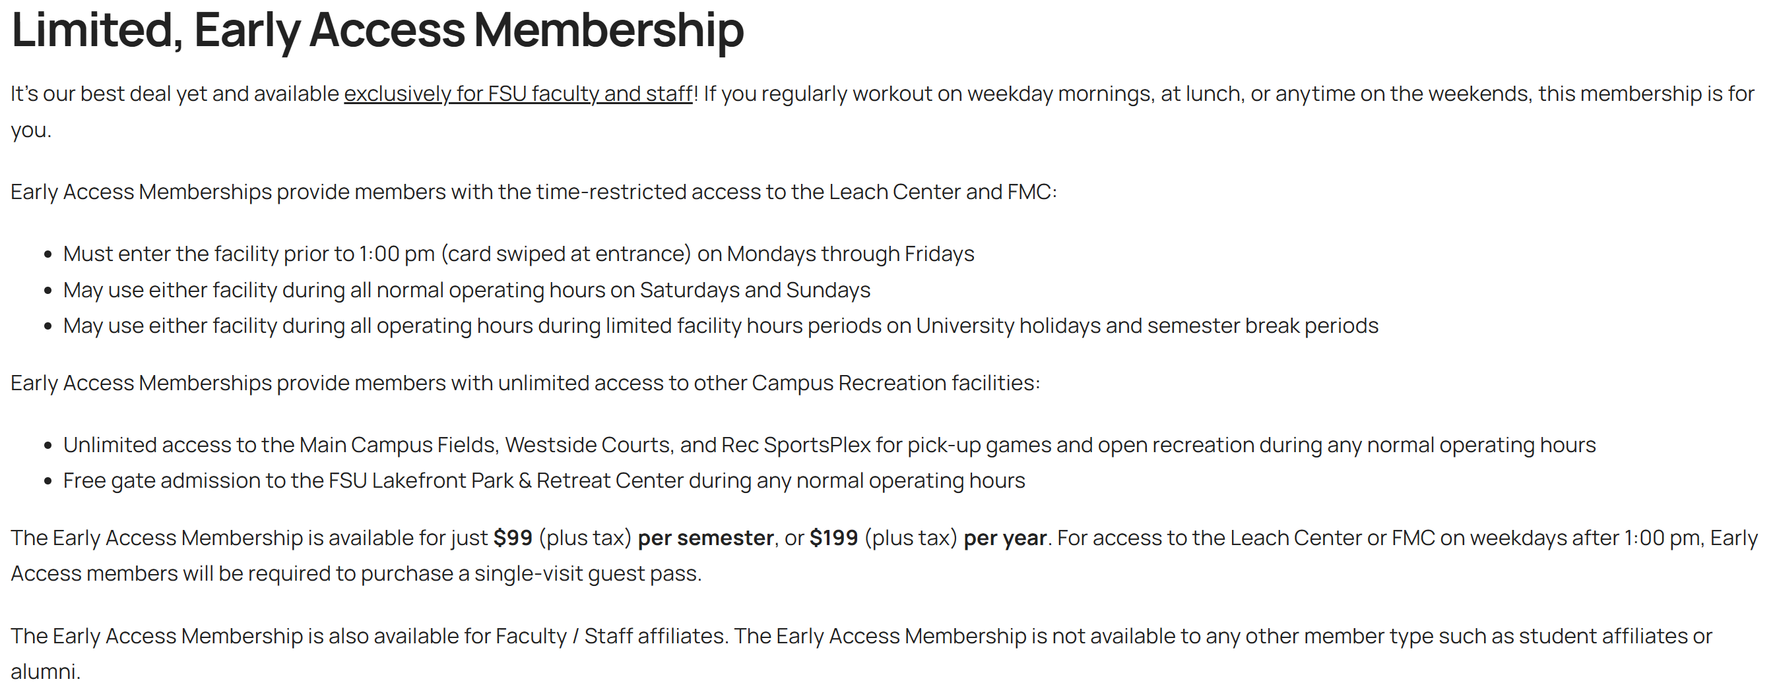
Take Care of Your Mental & Physical Health
https://campusrec.fsu.edu/fitness/
Notes:
Some insurance plans have a fitness reimbursement program that will reimburse you for membership fees.

Slide 8
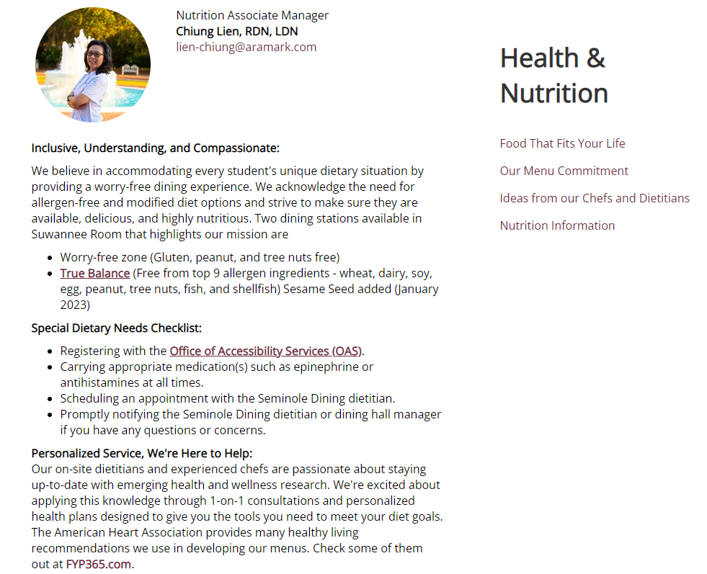
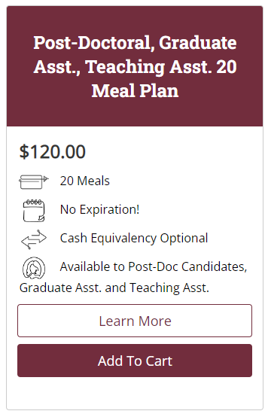
SEMINOLE DINING
Take Care of Your Mental & Physical Health
https://seminoledining.campusdish.com/HealthAndWellness

Slide 9
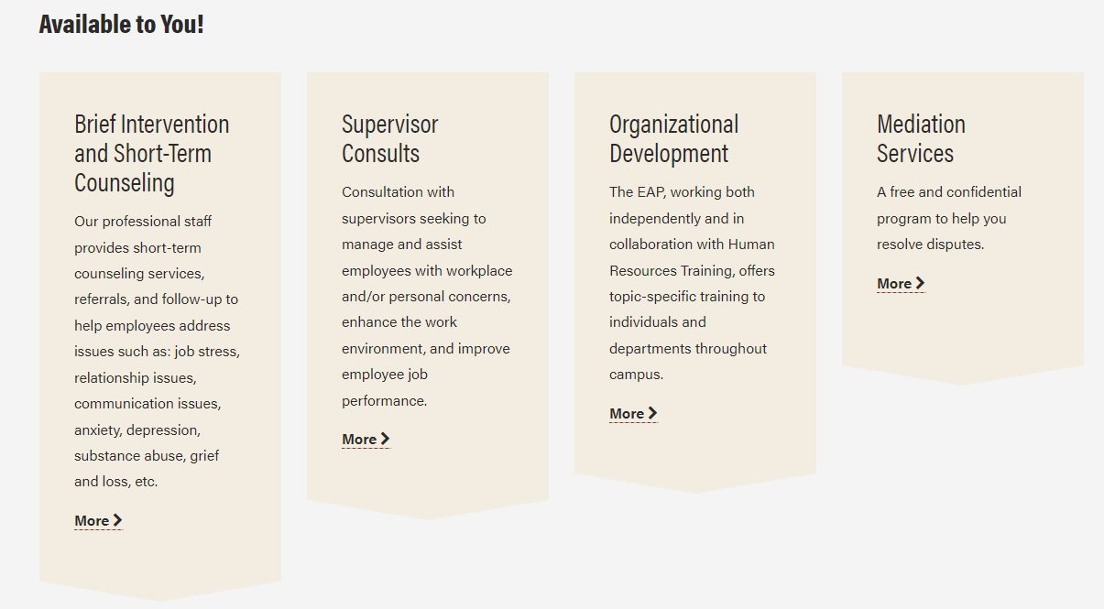
EMPLOYEE ASSISTANCE PROGRAM
Take Care of Your Mental & Physical Health
5x 1-hour free therapy sessions
https://eap.fsu.edu/

Slide 10
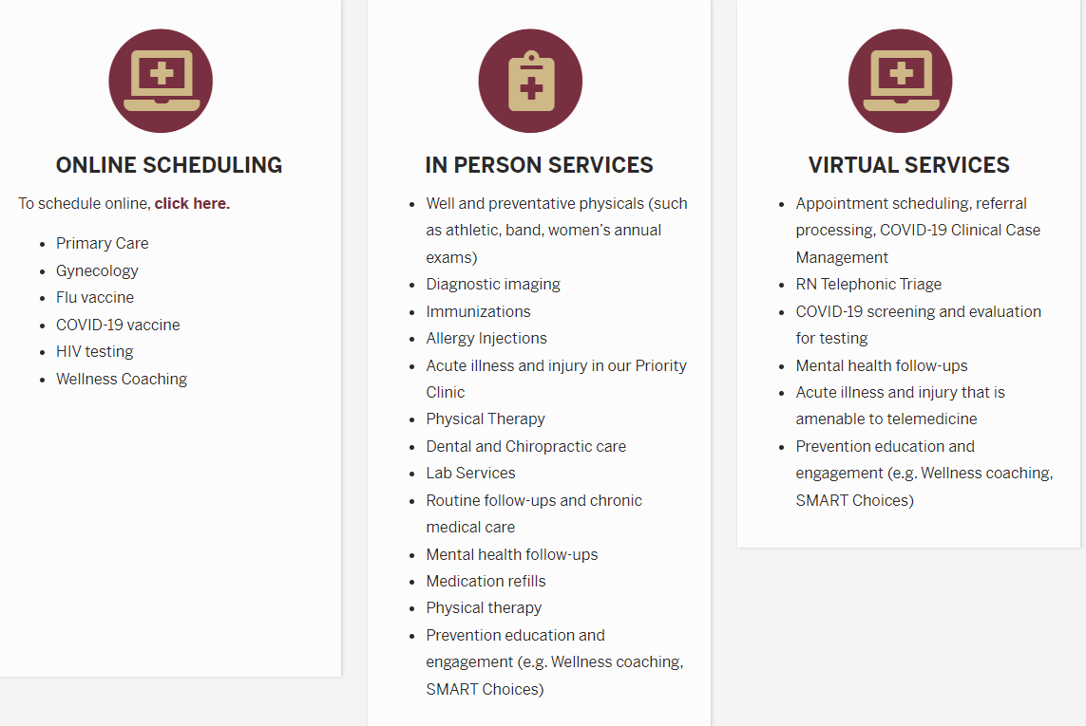
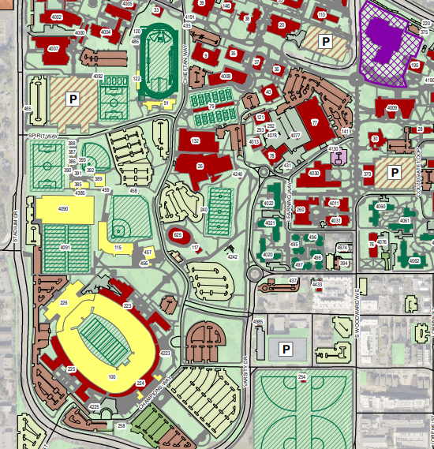
UNIVERSITY HEALTH SERVICES
Take Care of Your Mental & Physical Health
Accepts Florida Blue health insurance
https://uhs.fsu.edu/

Slide 11
Postdoc Office Hours
The FSU Postdoctoral Association is excited to announce a new program: Postdoc Office Hours! Come chat with seasoned postdocs on zoom to ask questions about life as a postdoc at FSU, have conversations just for fun, and connect with peers.
Office hours are held monthly on the first Friday of the month, from 11am-12noon
The next office hours held Friday, May 2nd and will be hosted this month by PDA President, Kasey Longley
Zoom link: https://fsu.zoom.us/j/94768662495

Slide 12
5MR Competition
Explain the impact of postdoc research in five minutes
Do so alone (no teams).
Look for this event in Fall 2025
Notes:
The Five Minute Research Competition for Postdocs (5MRP) is a research communication competition developed by The Graduate School and hosted by the Office of Postdoctoral Affairs at Florida State University in which postdoctoral presenters are asked to:
Explain the impact of their research in five minutes and;
Do so alone (no teams).
Participants are also competing for the chance to win up to $1000, with a monetary prize for the top 3 placing postdocs.

Slide 13
5MR Competition
May use ANY medium to present research
appeal to a non-specialist audience
reach across their discipline
challenge the audience to want to know more!
Notes:
In this competition Trainees may use ANY medium they want to present their research (i.e., slides, video, sing, dance, recite literature, props-anything!). However, the information must appeal to a non-specialist audience, reach across their discipline, and challenge the audience to want to know more!

Slide 14
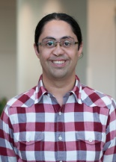
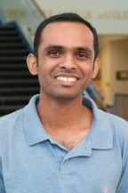
PDA Networking & Social Opportunities
Sumudu and Tiglet met at the Spring Event 2017, it turned into a collaboration and a paper!

Slide 15
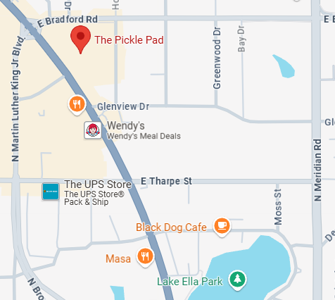
PDA Monthly Social – Pickle Pad Social Happy hour
Thursday, May 29th, 6:00 pm
Happy hour at The Pickle Pad
Partners and Families Welcome
1925 N Monroe St Suite 109, Tallahassee, FL 32303
Events will happen monthly, look out for emails or Tweets about them! Partners & families always welcome.

Slide 16
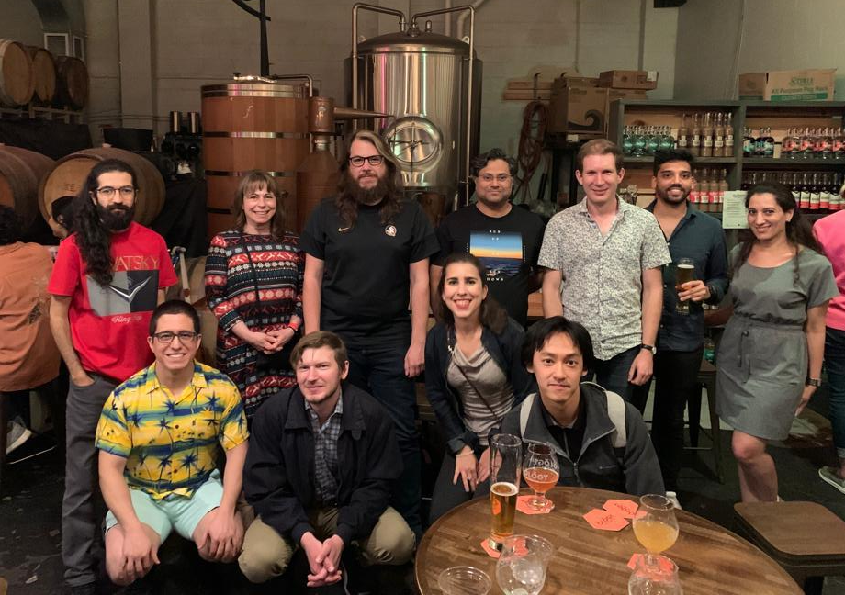
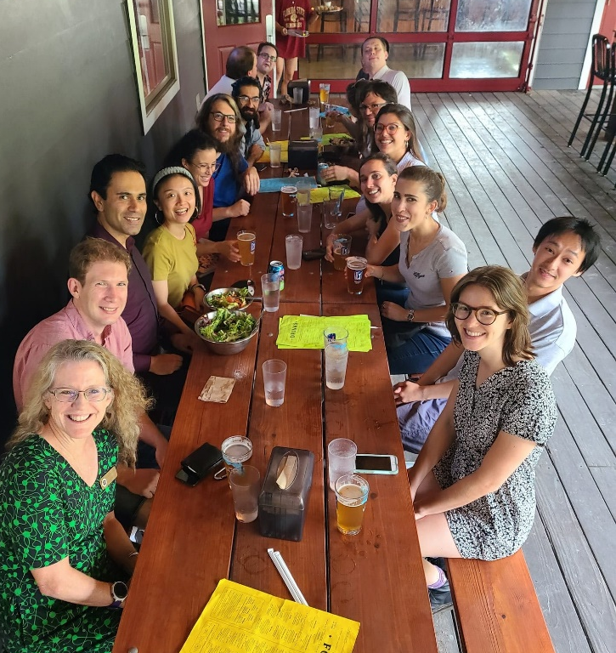
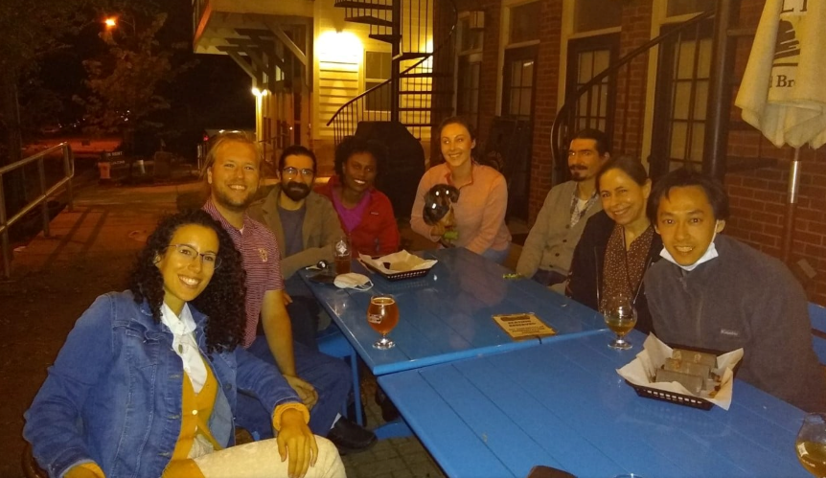
PDA Happy Hour
Location /date changes each month, look out for an email and/or tweet!
Notes:
Recently went to pickleball bar, breweries, lots of different cool hangs across Tallahassee area and a great way to meet fellow postdocs in a relaxed and fun setting.

Slide 17
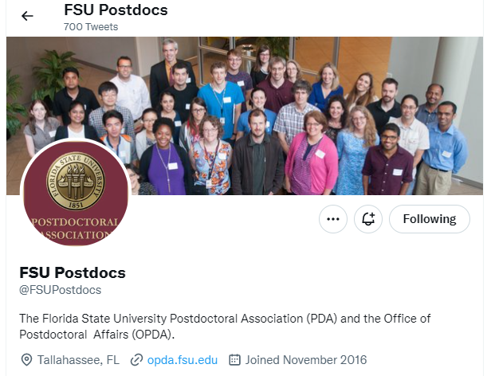
FOLLOW US ON TWITTER!!
@FSUPostdocs
Notes:
We have a Facebook and a Twitter account where we post the different events we organize

Slide 18
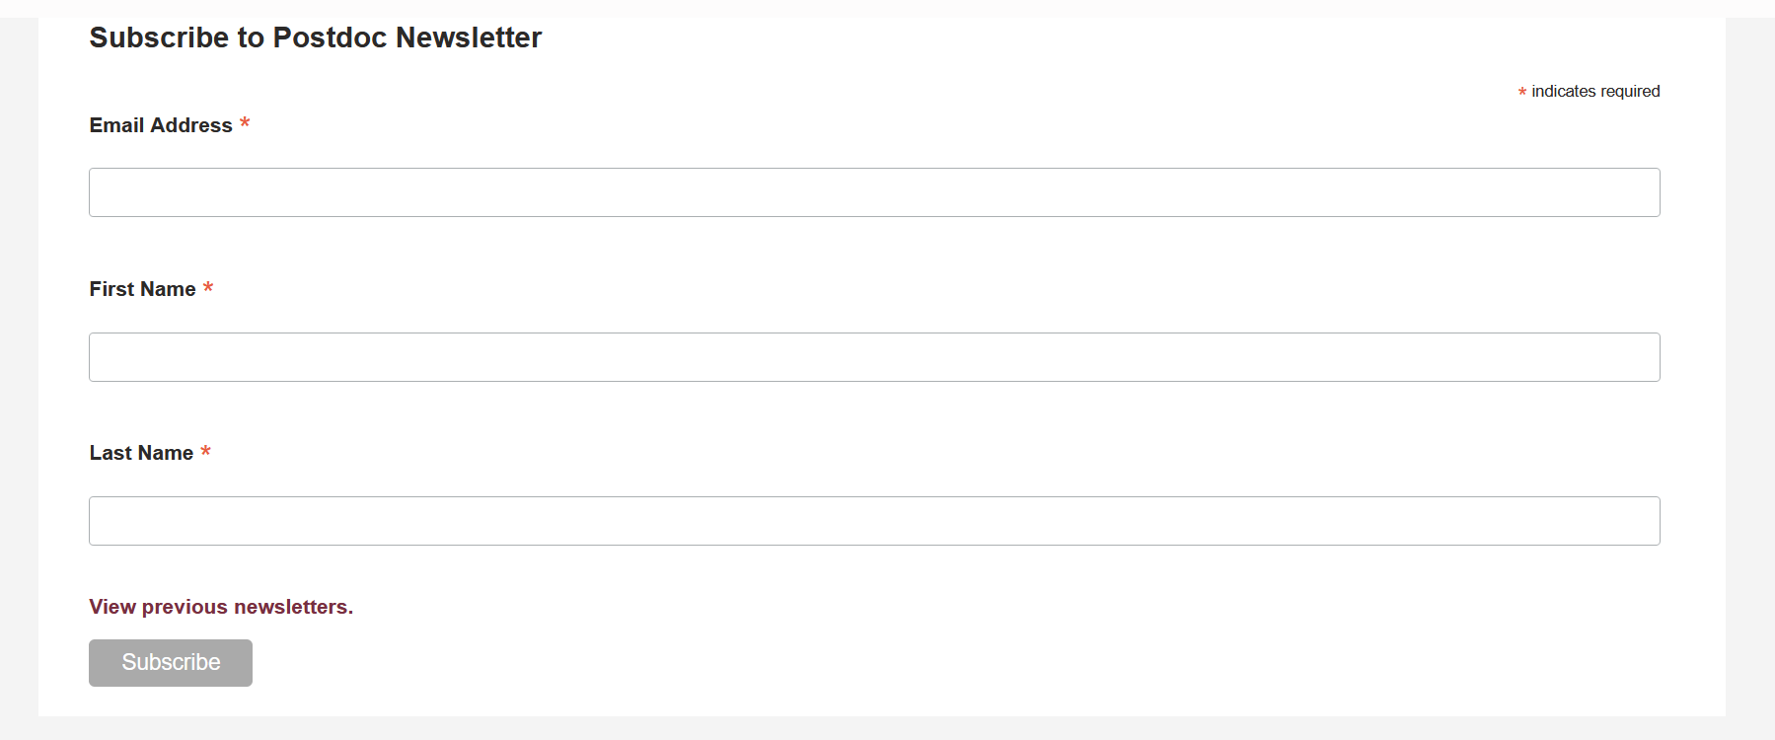
SIGN UP TO GET THE UPCOMING
FSU POSTDOC NEWSLETTERS
Go to: https://opda.fsu.edu/
Scroll to the bottom of the page and subscribe!

Slide 19
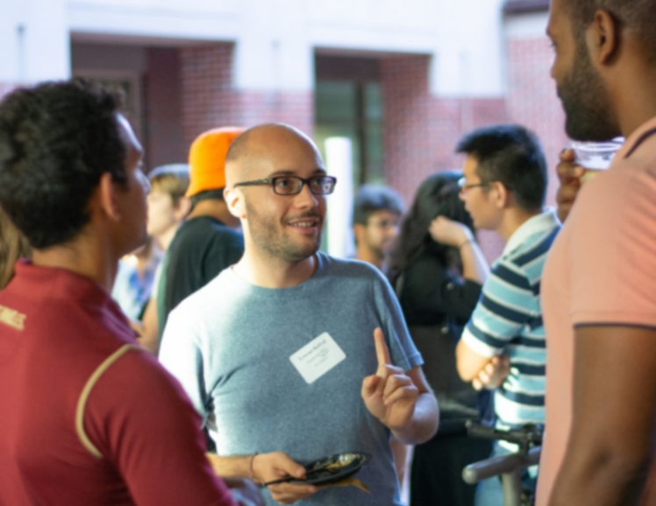
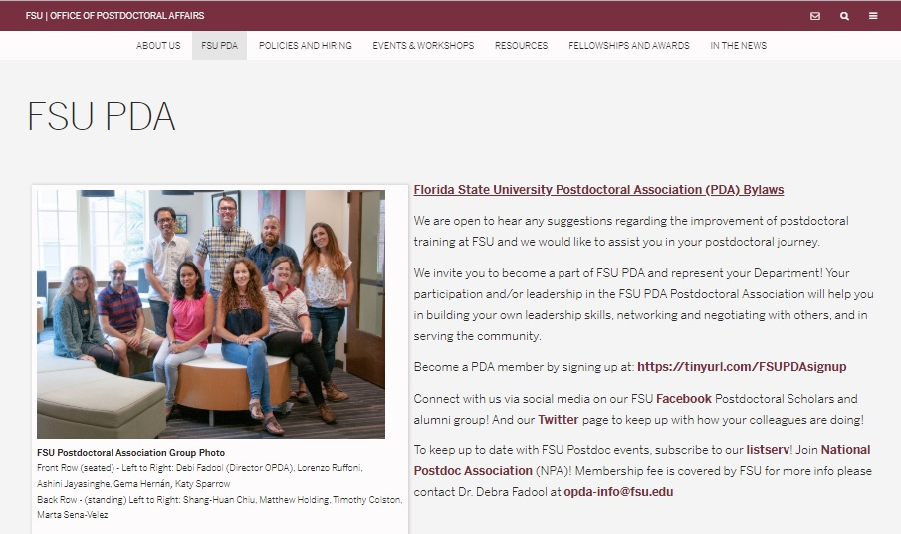
JOIN the Association!
https://opda.fsu.edu/fsu-pda
Do you have ideas for activities, recruitment, career development, initiatives or just want to help us in our initiatives?
Join us, together we can make it happen!
Notes:
https://opda.fsu.edu/fsu-pda
So
so if you’re interested in joining us an awesome time while boosting your CV and learning new skills, and helping the rest of the postdoc community – join us!

Slide 20
What does it mean to be a PDA member…
Propose initiatives or changes in postdoctoral policies.
Give your opinion and ideas on the topics discussed
Help organizing events:
e.g., Spring and fall events, happy hours, picnics, workshops, etc.
Duty: Attend the monthly meeting (usually 1h) currently by zoom
https://opda.fsu.edu/fsu-pda
Notes:
I believe it is really important to highlight that the time commitment for a regular member is really small, you just need to attend the monthly meetings through Zoom that usually last about 1 hour. This attendance although it is highly encouraged, it is also very flexible.

Slide 21
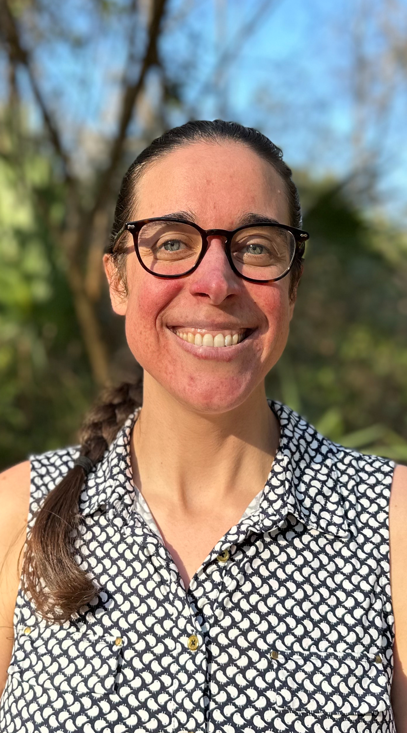
Congrats, Welcome, and Join Us!
Monthly Happy Hour
Outdoor Socials
Tri-Monthly Speed Networking
Monthly PDA Meetings
Postdoc WhatsApp Group
Kasey
President
FICW
Pearl
Vice-President
Biological Science
prr17@fsu.edu
klongley@fsu.edu

